Slide 1
Internet of Things: Electronics
John L. Manferdelli
johnmanferdelli@hotmail.com
Nov 16, 2020, 18:00

Slide 2
Guide
This is a rather condensed introduction to electronics mainly to give a sense of scope and establish terminology.
A full treatment of this material could be a full time and rewarding hobby; in fact, many people have this hobby, see, for example, http://www.arrl.org.
You should consult some standard works like the Radio Amateurs Handbook and Make Electronics by Charles Platt as well as the SparkFun Tutorials which are online.
A basic background in physics would help a lot. See, for example:
Feynman’s Lectures on physics.
Berkeley physics course volumes 1, 2, 3.
Any standard two year physics course textbook (e.g.- Sears, Zemansky and Young).
Schaum’s outline in Physics for Engineering and Science.
Griffiths, Introduction to Electrodynamics.
Scherz, Practical Electronics for Inventors. This book bridges theory and practice and is a bargain.

Slide 3
Electronics part 1, charge, current potential and circuits
Charge and forces on charged particles are the basis for electronics. There are four things we can measure related to this. You should be able to define them and say how to measure them.
Electric field (E)
Magnetic field (B)
Current (I)
Voltage (V)
How do you process electrical signals to produce useful output?
Currents and potentials are affected by “lumped components” like resistors, capacitors and transistors. You should know what they are and model their effect.
Circuits: Lumped components can be connected to implement complex relationships between input currents and potentials and output currents and potentials. You should be able to draw circuit diagrams (showing how the components are connected) and analyze the circuit.
Analyzing circuits: You should know what phasors are and model complex circuits using Thevenin and Norton equivalent circuits.
Power
You should be able to define and calculate electrical power in a circuit.

Slide 4
Current and potential
A principled understanding of electronics requires an understanding of Maxwell’s equations but that is not easy. We’ll get into Maxwell’s equations later, but it will likely not mean anything unless you have the right background. I’ll start out here in the middle of the story with an “artzy-craftzy” description of charge and potential but let me say, if you’re willing to start in the middle, you’re a better person than I am.
First, you need to accept the concept of an electric field, E(r,t). Bold means a vector in three space. Electric fields are created by charged particles. Charged particles come in two flavors, -, like an electron and +, like a proton. Charged particles experience a force when placed in an electric field. This force is proportional to their charge, namely F(r,t) = q E(r,t), where q is the charge. Accelerating charges, produce special electric fields that radiate. Electric fields have companion fields called magnetic fields. Magnetic fields are produced by moving charges. Moving charged particles also experience a force when placed in a magnetic field. In fact, the full force law is
F(r,t) = q (E(r,t) + v × B(r,t)), where × is the vector cross product.
Charge is measured in Coulombs (C). One coulomb has the same (negative) charge as 6.24 × 10¹⁸ electrons.

Slide 5
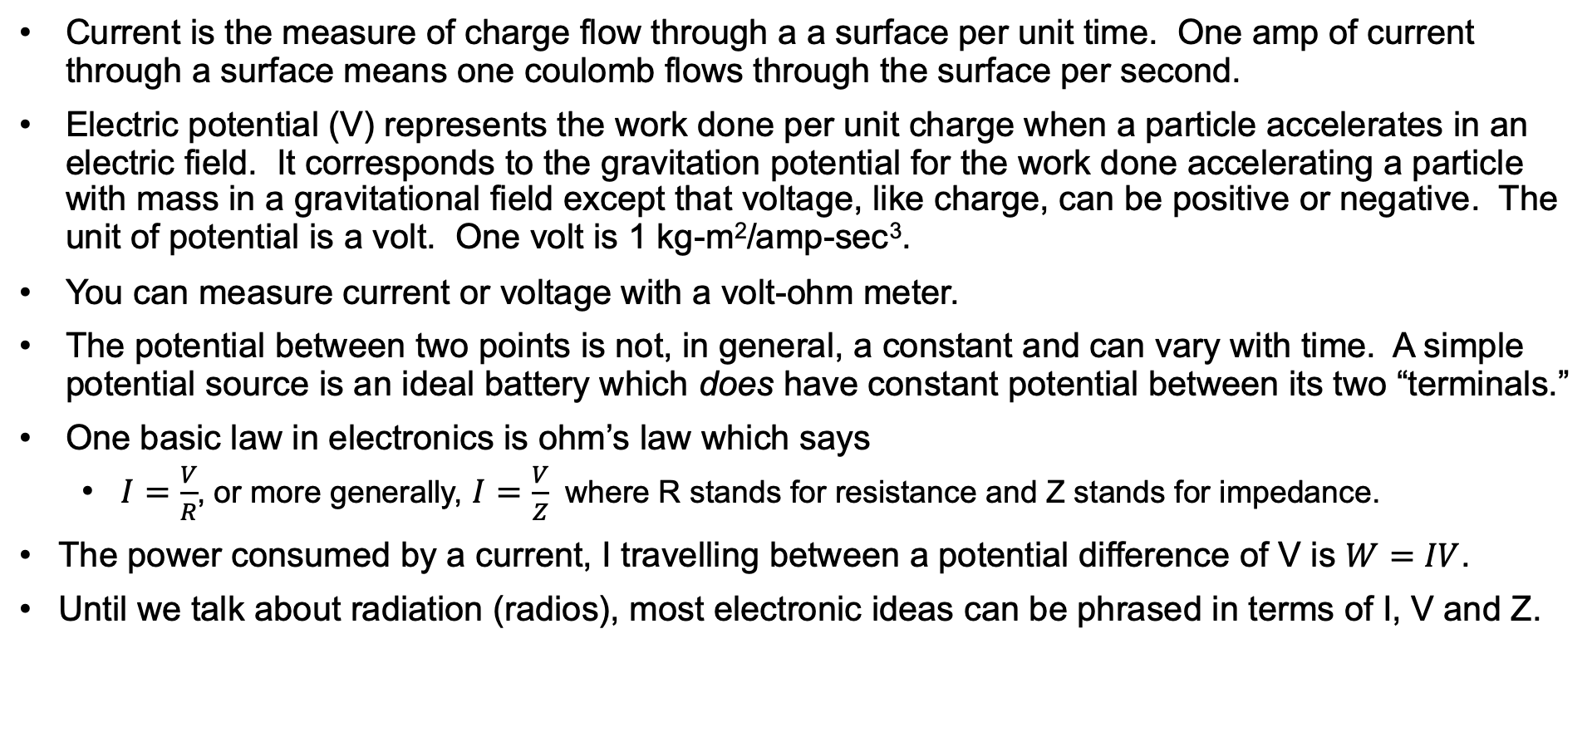
Current and potential (continued)
Current is the measure of charge flow through a a surface per unit time. One amp of current through a surface means one coulomb flows through the surface per second.
Electric potential (V) represents the work done per unit charge when a particle accelerates in an electric field. It corresponds to the gravitation potential for the work done accelerating a particle with mass in a gravitational field except that voltage, like charge, can be positive or negative. The unit of potential is a volt. One volt is 1 kg-m²/amp-sec³.
You can measure current or voltage with a volt-ohm meter.
The potential between two points is not, in general, a constant and can vary with time. A simple potential source is an ideal battery which does have constant potential between its two “terminals.”
One basic law in electronics is ohm’s law which says
$I=\frac{V}{R}$, or more generally, $I=\frac{V}{Z}$ where R stands for resistance and Z stands for impedance.
The power consumed by a current, I travelling between a potential difference of V is $W=IV$.
Until we talk about radiation (radios), most electronic ideas can be phrased in terms of I, V and Z.

Slide 6
Circuit diagrams and lumped circuits
At low frequencies, circuits can be analyzed as “lumped devices” with terminals wired together.
The components (resistors, transistors, … ) correspond to the nodes of a graph and the wires correspond to edges.
There are potential differences between any two points and current flowing through edges. Each component has a recognizable symbol (see later) ; when drawn this way, we call the graph-like representation a circuit diagram.
Here is an example:
V_{CC}
R_{C}
C_{out}
R₁
C_{i}
v_{s}
R₂
v_{s}
C_{E}
R_{E}
Common emitter amp

Slide 7
Circuit symbols
Resistor
Inductor
Capacitor
Transformer
Diode
PNP BJT
NPN BJT
Photo transistor
PNP
NPN
Battery
Voltage source
Ground symbols
Switches
Microphone
Speaker
Op amp
SPST
SPDT
DPST
Symbols from http://www.eehomepage.com/symbols.ppt. Copyright 2008 by EE HomePage.com. These symbols may be freely reused.

Slide 8

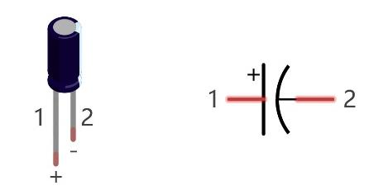
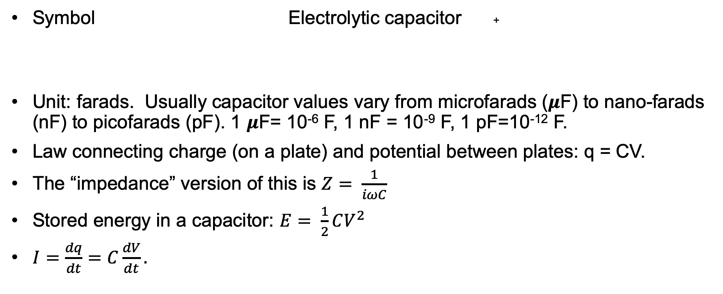
Capacitors
Symbol Electrolytic capacitor +
Unit: farads. Usually capacitor values vary from microfarads (𝝁F) to nano-farads (nF) to picofarads (pF). 1 𝝁F= 10⁻⁶ F, 1 nF = 10⁻⁹ F, 1 pF=10⁻¹² F.
Law connecting charge (on a plate) and potential between plates: q = CV.
The “impedance” version of this is $Z= \frac{1}{iωC}$
Stored energy in a capacitor: $E= \frac{1}{2}CV^{2}$
$I=\frac{dq}{dt}=C\frac{dV}{dt}.$

Slide 9


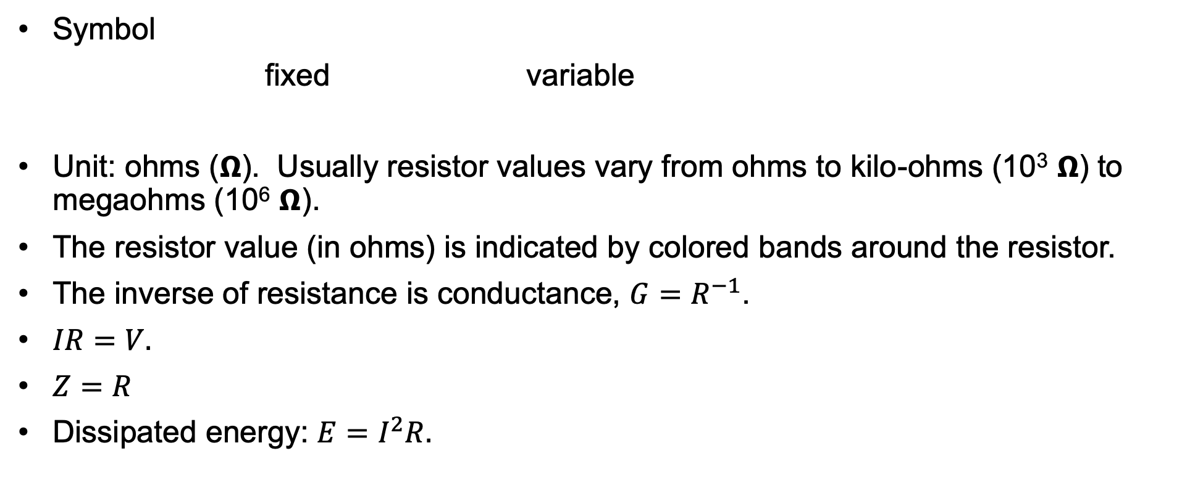
Resistors
Credit: Make Electronics
Symbol
fixed variable
Unit: ohms (𝝮). Usually resistor values vary from ohms to kilo-ohms (10³ 𝝮) to megaohms (10⁶ 𝝮).
The resistor value (in ohms) is indicated by colored bands around the resistor.
The inverse of resistance is conductance, $G=R^{−1}$.
$IR=V.$
$Z=R$
Dissipated energy: $E=I^{2}R.$
R

Slide 10
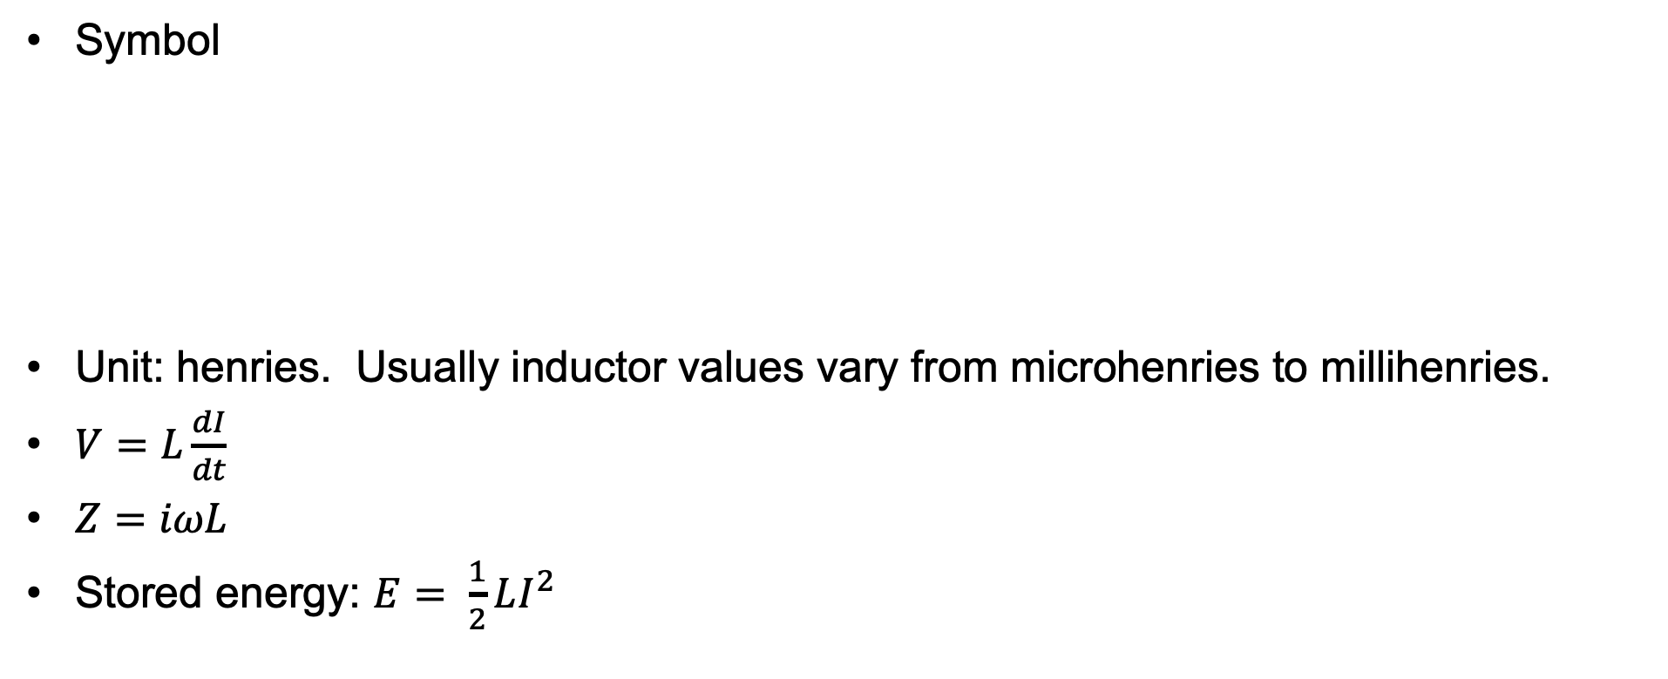
Inductors
Wikipedia
Symbol
Unit: henries. Usually inductor values vary from microhenries to millihenries.
$V=L\frac{dI}{dt}$
$Z=iωL$
Stored energy: $E= \frac{1}{2}LI^{2}$

Slide 11
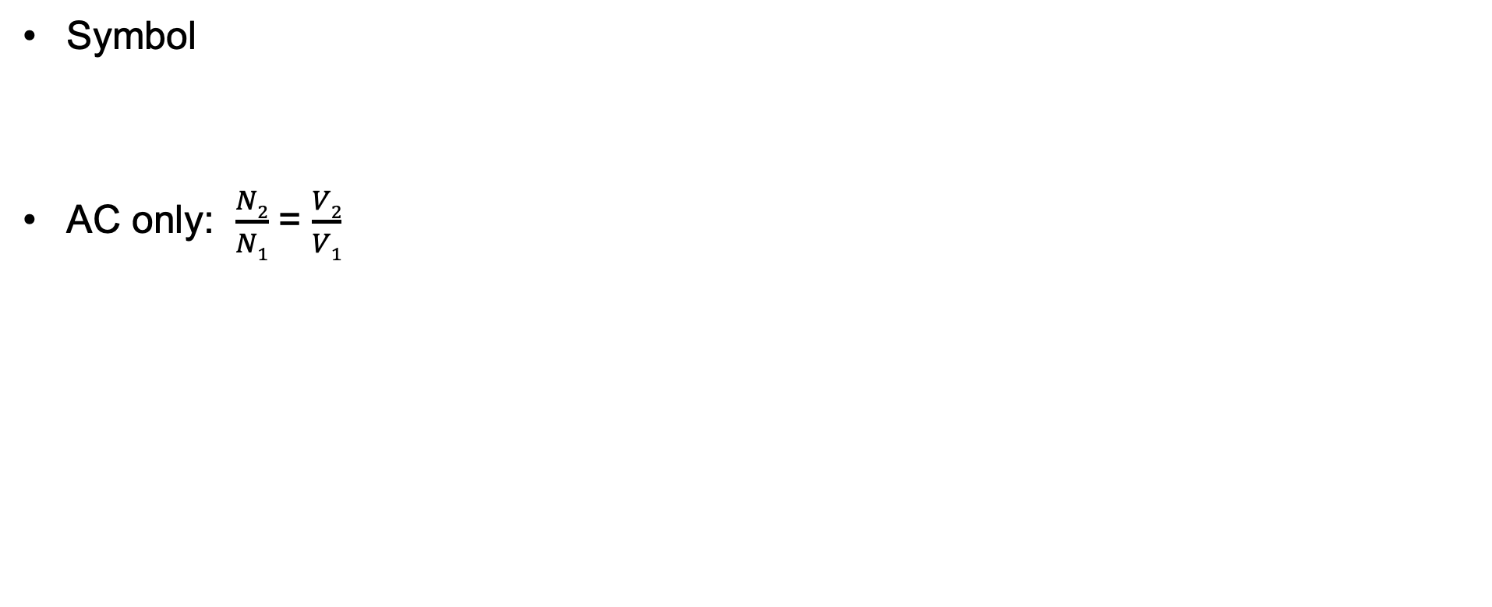
Transformers
Symbol
AC only: $\frac{N2}{N1}$ = $\frac{V2}{V1}$
Electronics hub

Slide 12
Impedance
Impedance captures both pure resistance and complex “reactance” effects like capacitance and inductance.
Z_{R} = R. Z_{C} = -i/(𝜔C), Z_{L} = -i𝜔L
Here, 𝜔, is the angular frequency of the signal and 𝜔 = 2𝜋f
The inverse of impedance is admittance, Y = Z⁻¹.
Z₁
Z₂
Z_{eq} = Z₁ + Z₂
1/Z_{eq} = 1/Z₁ + 1/Z₂
Z₁
Z₂

Slide 13
Kirchhoff
There are two Kirkoff’s laws, one describes voltages the other describes currents.
i₁
i₄
V₁
V₂
V₃
V₄
i₂
i₅
i₃
i₆
V₅
V₆
i₁ + i₂ + i₃ + i₄ + i₅ + i₆ = 0
(V₂ - V₁) + (V₃ – V₂) + (V₄ - V₃) + (V₅ – V₄) + (V₆ - V₁) + (V₁ – V₆ )= 0

Slide 14
Thevenin and Norton
Thevenin: Any combination of linear sources and passive elements terminating in two terminals is equivalent to a pure voltage source in series with an impedance
Norton: Any combination of linear sources and passive elements terminating in two terminals is equivalent to a pure current source in parallel with an conductance
Similar theorems for two terminal input and output devices (with transfer function)
Z_{Th}
V_{Th}
I_{N}
G_{Th}

Slide 15
Thevenin example: a real battery
Real batteries have a Thevenin equivalent of an ideal battery in series with a pure resistance, R_{i}, called the internal resistance.
The equivalent resistance is sometimes called the “lookback” resistance.
R_{i}

Slide 16
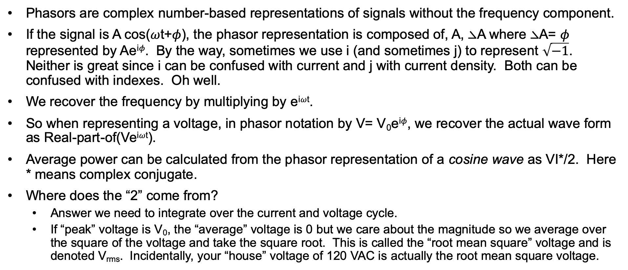
Phasors
Phasors are complex number-based representations of signals without the frequency component.
If the signal is A cos(𝜔t+𝜙), the phasor representation is composed of, A, ⦣A where ⦣A= 𝜙 represented by Ae^{i𝜙}. By the way, sometimes we use i (and sometimes j) to represent $\sqrt{−1}$. Neither is great since i can be confused with current and j with current density. Both can be confused with indexes. Oh well.
We recover the frequency by multiplying by e^{i𝜔t}.
So when representing a voltage, in phasor notation by V= V₀e^{i𝜙}, we recover the actual wave form as Real-part-of(Ve^{i𝜔t}).
Average power can be calculated from the phasor representation of a cosine wave as VI*/2. Here * means complex conjugate.
Where does the “2” come from?
Answer we need to integrate over the current and voltage cycle.
If “peak” voltage is V₀, the “average” voltage is 0 but we care about the magnitude so we average over the square of the voltage and take the square root. This is called the “root mean square” voltage and is denoted V_{rms}. Incidentally, your “house” voltage of 120 VAC is actually the root mean square voltage.

Slide 17
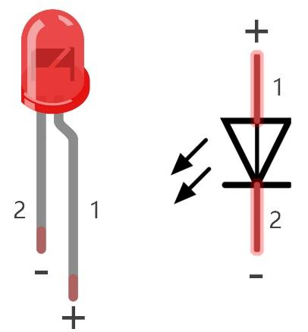

Diodes
Credit: Make Electronics
Cathode
Symbol
Diodes are devices that allow current to flow only in one direction. Silicon diodes, for example have, essentially infinite resistance if V_{ac}<0, that is if the cathode is at a higher potential than the anode and very low resistance if V_{ac}> .7V.
The cathode is usually labelled with a band.
There are several types of diodes (e.g.-Zener) with slightly different characteristics.
One recently popular diode (the last symbol above) is the light emitting diode which is a very efficient light source.
v_{ac}
Anode
Sparkfun

Slide 18
Bipolar Junction Transistors (BJT)
Emitter (e)
Collector (c)
i_{c}
i_{b}
Symbol PNP NPN
Transistors are 3 terminal non-linear devices. They are constructed of one thin layer of semiconductor (Si) sandwiched by two thicker layers. In the case of an NPN transistor the middle layer is “doped” to have a slight excess of hole (positive charge carriers) and the outer layers are doped to have an excess of electrons (negative charge carriers).
BJT’s have three operating regions that depend on the potential differences between the terminals.
Base (b)
Collector (c)
Base (b)
Emitter (e)
v_{be}
Region | V_{be} | V_{bc} | V_{ce} | i_{c}
Active | ≧V_{f} | <V_{f} | >V_{s} | 𝛽i_{b}
Reverse active | <V_{f} | ≧V_{f} | <-V_{s} | -(𝛽_{r}+1)i_{b}
Saturated | ≧V_{f} | ≧V_{f} | >-V_{s} <V_{s} | >-(𝛽_{r}+1)i_{b} <𝛽i_{b}
Off | <V_{f} | <V_{f} | * | 0
For silicon resistors (e.g.-2N3904): V_{f} ∼ .7v, V_{s} ∼ .2v, 𝛽 ∼ 100, 𝛽_{r} ∼ 10

Slide 19

BJTs - continues
We really care about two regions: the active region where the collector current is proportional to the base current (when V_{be} > V_{f}) and the cutoff region where there is no current flow.
The transistor acts as a switch and is the basis of digital electronics where we care if it’s “off” or “on” but don’t care how on it is.
Transistors can also be used as linear amplifiers when biased (when V_{be}>V_{f}) so that they are always in the active region.
Transistors can be modeled at low frequencies by the following parameters you will find in their specs,
i_{C} = 𝛼i_{E}
i_{C}= 𝛽i_{B}
𝛽 = 𝛼/(1- 𝛼)
𝛽 ∼ 100
Many transistors have a rounded back and a flat front. Looking from the front the terminals are, in order, emitter, base, collector.
There are other types of transistors with slightly different symbols: FET’s, MOSFETS, …
b
c
r_{p}
𝛽i_{b}
v_{s}
R_{S}
e
Bipolar terminal model
Credit: Make Electronics
Bipolar source model

Slide 20
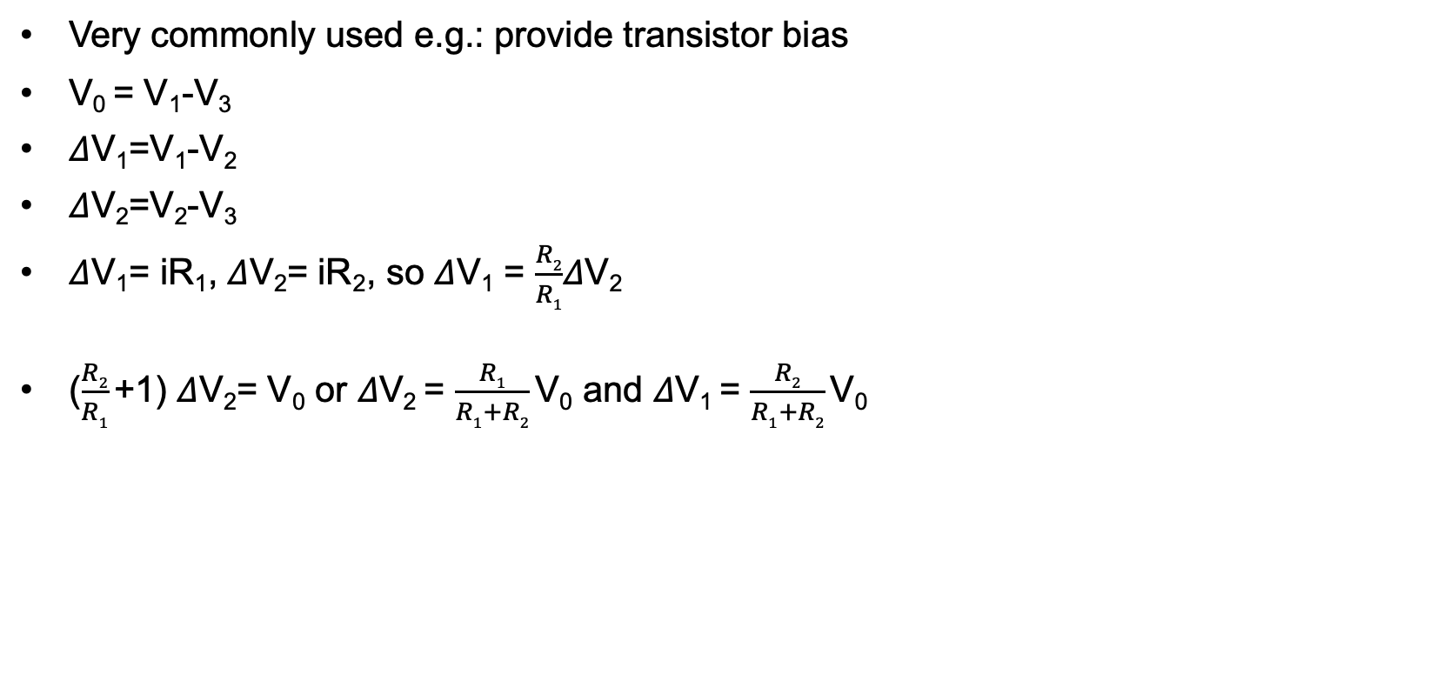
Analysis: Voltage divider
Very commonly used e.g.: provide transistor bias
V₀ = V₁-V₃
𝛥V₁=V₁-V₂
𝛥V₂=V₂-V₃
𝛥V₁= iR₁, 𝛥V₂= iR₂, so 𝛥V₁ = $\frac{R2}{R1}$𝛥V₂
($\frac{R2}{R1}$+1) 𝛥V₂= V₀ or 𝛥V₂ = $\frac{R1}{R1+R2}$V₀ and 𝛥V₁ = $\frac{R2}{R1+R2}$V₀
V₁
V₀
V₂
V₃

Slide 21
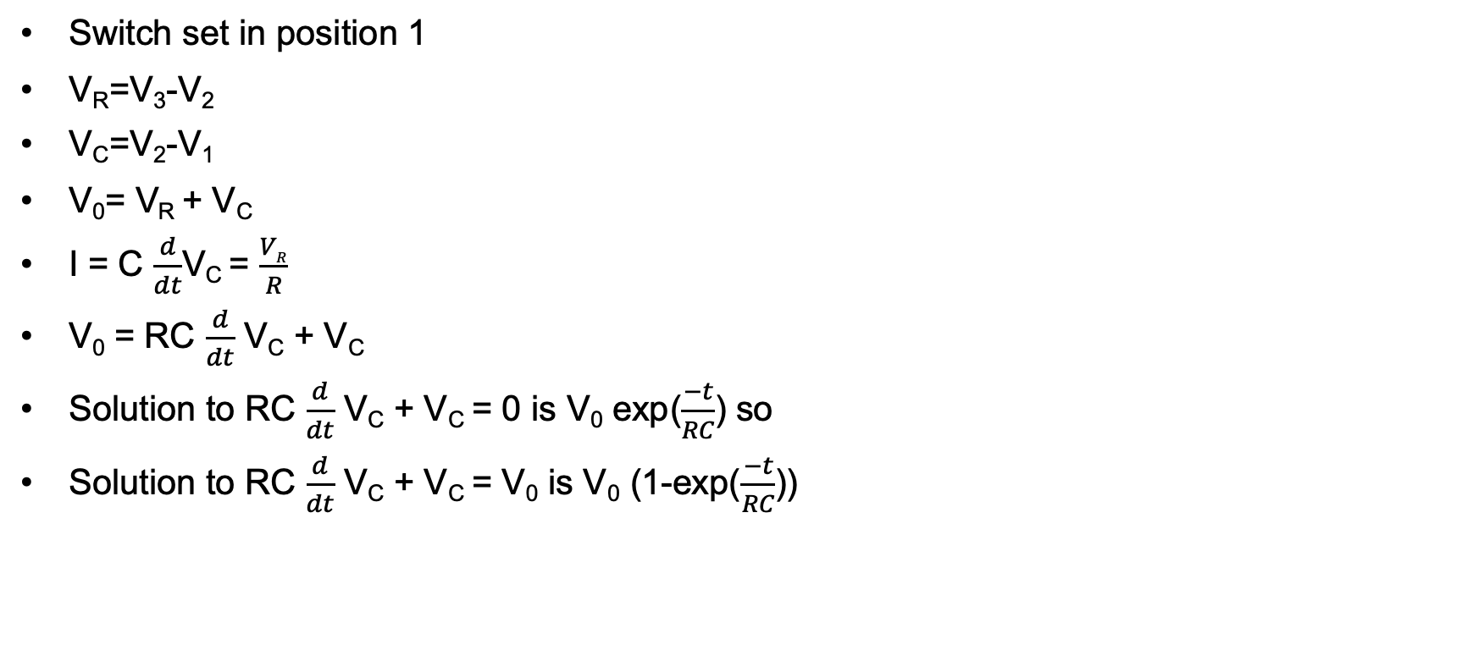
Analysis: RC circuit
Switch set in position 1
V_{R}=V₃-V₂
V_{C}=V₂-V₁
V₀= V_{R} + V_{C}
I = C $\frac{d}{dt}$V_{C} = $\frac{VR}{R}$
V₀ = RC $\frac{d}{dt}$ V_{C} + V_{C}
Solution to RC $\frac{d}{dt}$ V_{C} + V_{C} = 0 is V₀ exp($\frac{−t}{RC}$) so
Solution to RC $\frac{d}{dt}$ V_{C} + V_{C} = V₀ is V₀ (1-exp($\frac{−t}{RC}$))
Position 1
SPDT
V₁
Position 2
C
V₀
V₂
R
V₃

Slide 22
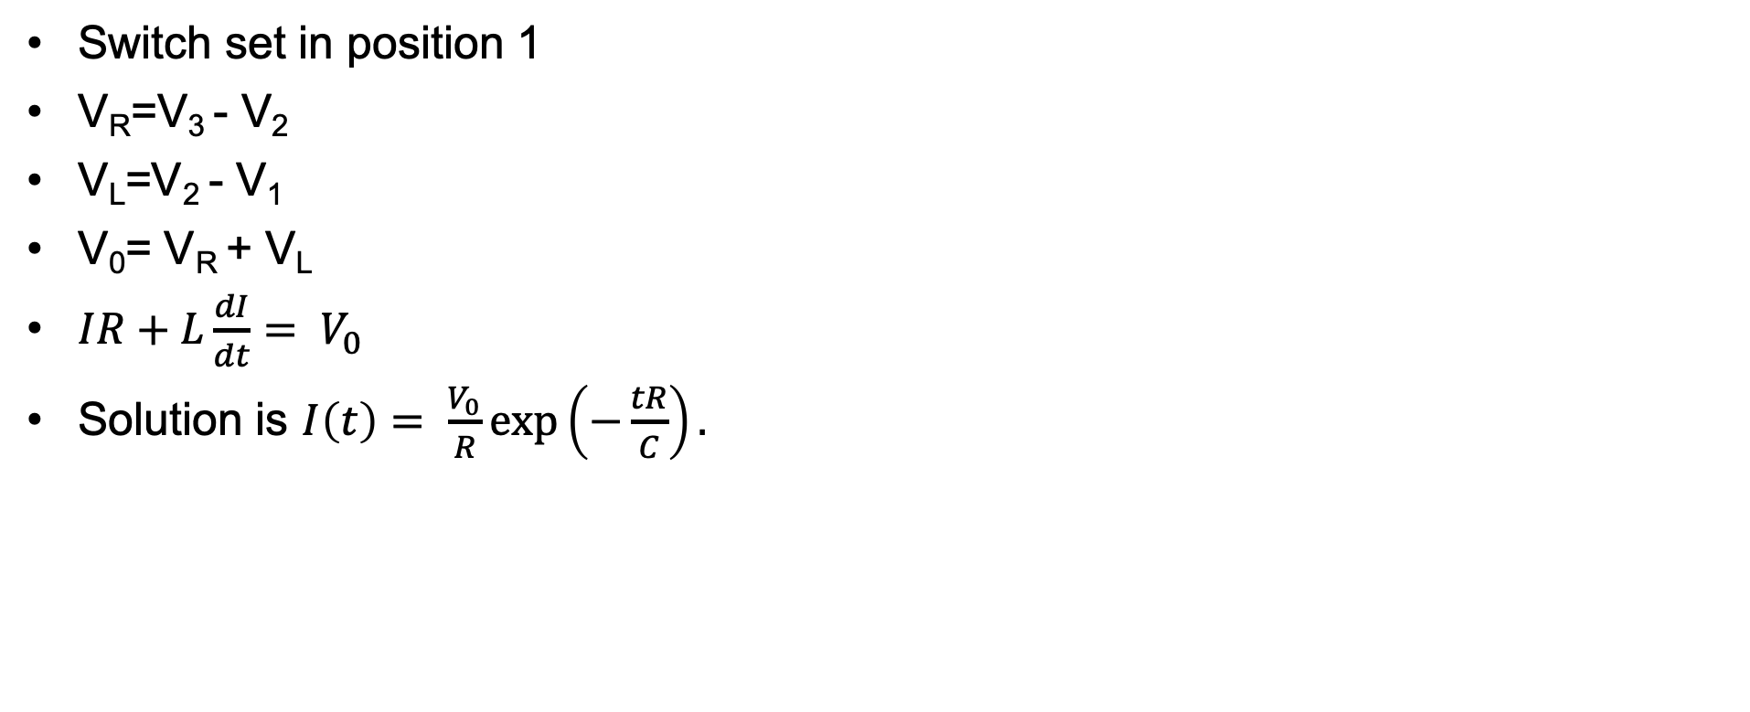
Analysis: RL circuit
Switch set in position 1
V_{R}=V₃ - V₂
V_{L}=V₂ - V₁
V₀= V_{R} + V_{L}
$IR+L\frac{dI}{dt}= V_{0}$
Solution is $I\left(t\right)= \frac{V_{0}}{R}\exp\left(−\frac{tR}{C}\right).$
V₁
L
V₀
V₂
R
V₃

Slide 23
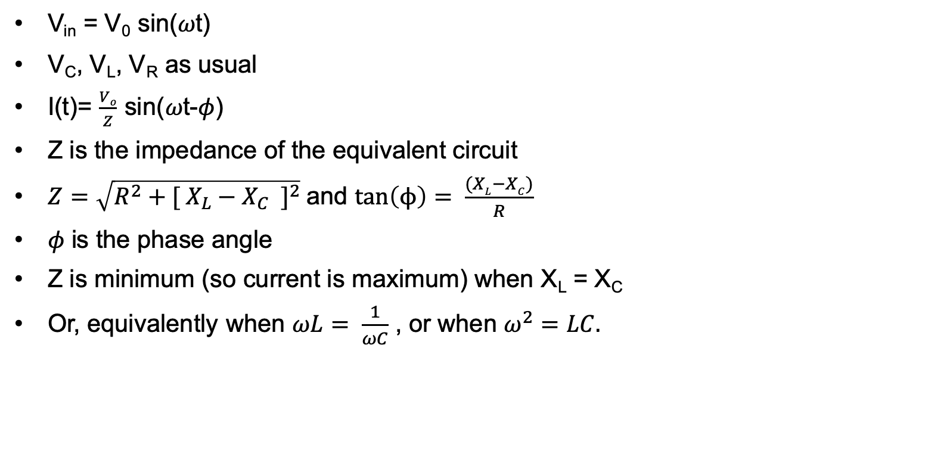
Analysis: Resonance
V_{in} = V₀ sin(𝜔t)
V_{C}, V_{L}, V_{R} as usual
I(t)= $\frac{Vo}{Z}$ sin(𝜔t-𝜙)
Z is the impedance of the equivalent circuit
$Z=\sqrt{R^{2}+{[ X_{L}−X_{C} ]}^{2}}$and $tan\left(ϕ\right)= \frac{(XL−XC)}{R}$
𝜙 is the phase angle
Z is minimum (so current is maximum) when X_{L} = X_{C}
Or, equivalently when $ωL= \frac{1}{ωC}$ , or when $ω^{2}=LC.$

Slide 24
Subsystem components and integrated circuits
Miniaturization has allowed us to cram a lot of components into a small package called an integrated circuit or IC.
We’ll use the NEC 555 timer later, this is an analog IC with a small number of integrated devices (transistors, resistors, capacitors). Small scale integration components include operational amplifiers (e.g.-741, 358), audio amps (386), mixers (NEC-602), phase lock loops, and many others.
An Intel processor has billions of transistors crammed onto a single die with feature sizes around 14 nm (1 nm = 10⁻⁹ meters).
We’ll be using ICs extensively, especially in digital electronics. The Arduinos and Raspberry Pi processors have millions of transistors on a tiny die and cost peanuts.

Slide 25
BJT amplifiers
Here’s how to design a common emitter amplifier. We use a 2n3904 transistor with 𝛽=150. This circuit will work! Build it.
Pick the supply voltage V_{cc}=12V.
Choose a gain (amplification factor), A = 5.
Choose the “Q point” of the conducting transistor (4mA).
V_{cc} = (i_{c}∙R_{C}) + V_{ce} + i_{e} R_{E} ∼ i_{e}∙ (R_{C}+R_{E}) +V_{ce} with i_{c}=4mA. We get (R_{C}+R_{E}) = (V_{cc} - V_{ce})/(4mA) =1.75 k𝝮.
Since A = 5 and A=R_{C}/R_{E}, R_{C}= 5 R_{E} so R_{E} ∼ 270 𝝮 (this is a standard resistor value) and R_{C}= 1.5k𝝮.
i_{b} = 4mA/𝛽 = 27 𝝁A.
Since V_{be} must be greater than .7V throughout the input signal range, we want the voltage across R₂ to satisfy V_{be} + i_{c}R_{E} = 1.8V.
We insert a voltage divider consisting of R₁ and R_{2,} so that R₁= (12-1.8)/270 𝝁A ∼ 39 k𝝮.
C_{o} and C_{i} are picked to offer small resistance to the frequency range we’re interested in and C_{o} = C_{i} = 5 𝝁F.
I haven’t explained why we want R_{E} but it provides thermal stability for the transistor over the range we care about. The fact that A=R_{C}/R_{E} can be calculated using Kirchhoff’s laws.
V_{CC}
R_{C}
R₁
C_{o}
C_{i}
v_{s}
R₂
v_{s}
R_{E}
Common emitter amp
Credit: Ward, Hands on Radio.

Slide 26
Filters
Filters attenuate signals over unwanted frequency ranges and preferentially pass signals in wanted frequency ranges.
High pass filters pass frequencies over some threshold.
Low pass filters pass frequencies under some threshold.
Band pass filters pass frequencies within a lower and higher frequency range.
Here are some sample filters. You can calculate, H, the transfer function using Kirchhoff’s laws.
L=500mH
C
R
R
C
R= 60W
C=120mF
RC-high pass filter
RC low pass filter
H= (1-j/(𝜔RC))⁻¹ = (j𝜔t)/(1+j𝜔t), t= RC
H= R(1+j/(𝜔RC))⁻¹
RC Band-pass filter
H= R(R+j(𝜔L-1/(𝜔C)))⁻¹

Slide 27
Oscillators
Oscillators are a combination of amplifiers and filters.
The output of an amplifier is fed back to the input through a filter or resonance circuit so that the desired frequency output is favored.
The output rapidly settles on a clean signal with the right frequency
The Clapp Oscillator on the right uses a balanced resonant circuit to pick the desired frequency.
Crystals can also be used to obtain very precise frequency selection that does not change as circuit elements heat up.
+12V
68K
RFC
.1 𝜇F
.01 𝜇F
5000 pF
20 𝜇H
8.2K
100 nF
820
5000 pF
.01 𝜇F

Slide 28
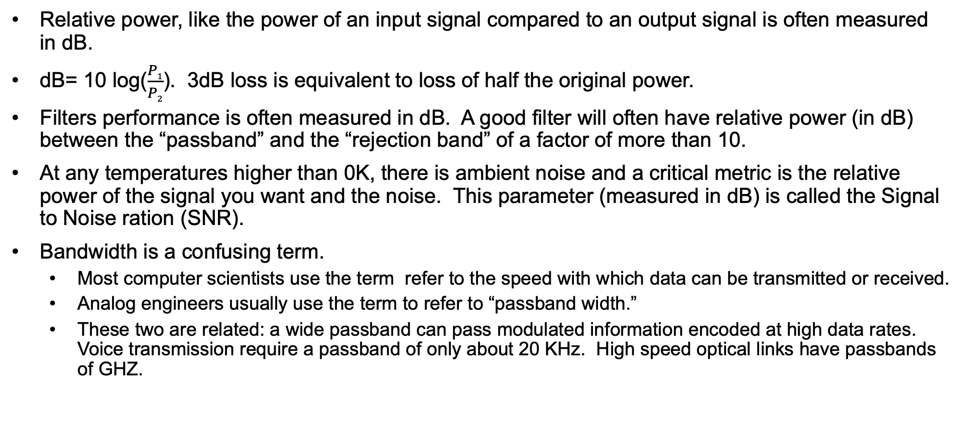
Power, SNR and bandwidth
Relative power, like the power of an input signal compared to an output signal is often measured in dB.
dB= 10 log($\frac{P1}{P2}$). 3dB loss is equivalent to loss of half the original power.
Filters performance is often measured in dB. A good filter will often have relative power (in dB) between the “passband” and the “rejection band” of a factor of more than 10.
At any temperatures higher than 0K, there is ambient noise and a critical metric is the relative power of the signal you want and the noise. This parameter (measured in dB) is called the Signal to Noise ration (SNR).
Bandwidth is a confusing term.
Most computer scientists use the term refer to the speed with which data can be transmitted or received.
Analog engineers usually use the term to refer to “passband width.”
These two are related: a wide passband can pass modulated information encoded at high data rates. Voice transmission require a passband of only about 20 KHz. High speed optical links have passbands of GHZ.

Slide 29
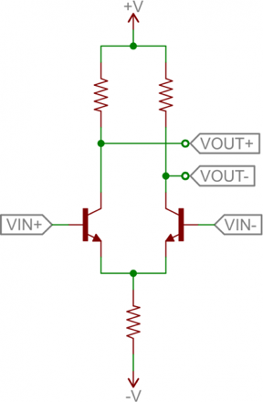
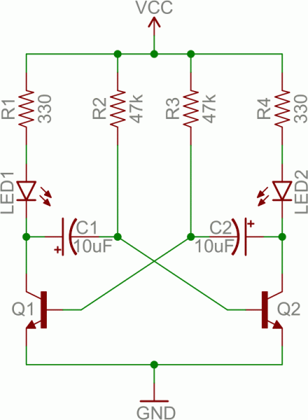
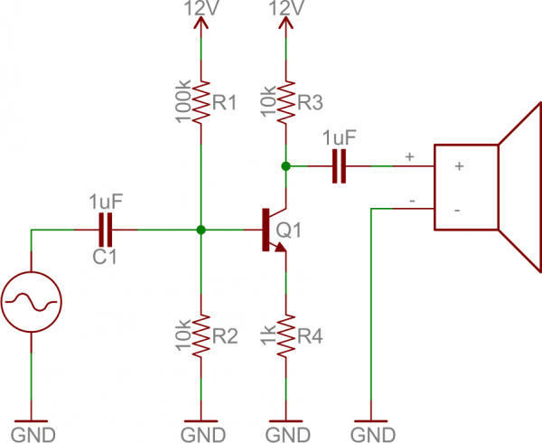
More circuits
Differential amp
Multi-vibrator
Common emitter as audio amp
Diagram credit: Sparkfun
Build this and try 100 𝝁F capacitors.
How often do the LED’s blink?

Slide 30
More Circuits
Debounce
Power supply
Voltage regulator
+
10K
10K
.33 +
SB
Q
R_{L}
1
C= 1000 pf
LM7805
QB
RB
.1

Slide 31
Electronics part 2, digital circuits
You should understand what integrated circuits (IC’s) are and be able to describe, model and use:
Timers (like the 555 timer)
Op Amps (like the 741)
Digital circuits are clocked circuits that implement operation on binary values in clock cycles.
You should understand how digital memories are implemented and be able to describe two: SRAM and DRAM as well as their characteristics.

Slide 32
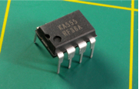
IC’s: 555 Timer
Package: 8 pin dual inline package (“DIP”)
Pin 1: -Vs
Pin 8: +Vs
Pin 2 (Trigger): Out HIGH if V < V_{CC}/3. Pin 2 has control over pin 6. If pin 2 is LOW, and pin 6 LOW, output goes and stays HIGH. If pin 6 HIGH, and pin 2 goes LOW, output goes LOW while pin 2 LOW. This pin has a very high impedance (about 10M) and will trigger with about 1uA.
Pin 3 (Output): (Pins 3 and 7 are "in phase.") Goes HIGH (about 2v less than rail) and LOW (about 0.5v less than 0v) and will deliver up to 200mA.
Pin 4 (Reset): Internally connected HIGH via 100k. Must be taken below 0.8v to reset the chip.
Pin 5 (Control): A voltage applied to this pin will vary the timing of the RC network (quite considerably).
Pin 6 (Threshold): HIGH if > 2 V_{CC} /3, make output LOW only if pin 2 is HIGH. Pin 6 has very high impedance (~10M) and will trigger with about 0.2uA.
Pin 7 (Discharge): Pin 7 is equal to pin 3 but pin 7 does not go high - it goes OPEN. When LOW it sinks about 200mA.
Credit: Make Electronics

Slide 33
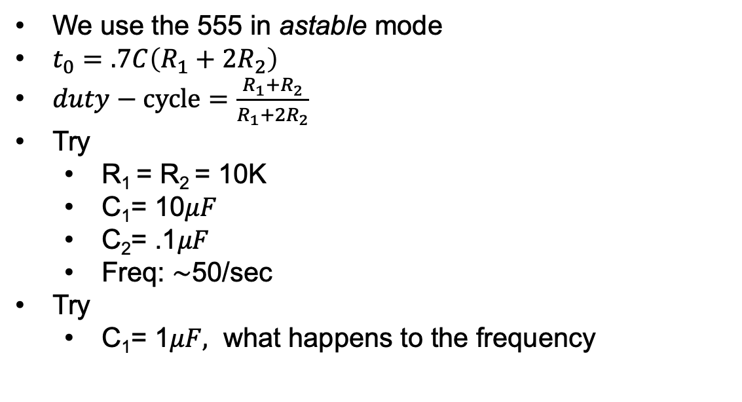
Lab: Using the 555 to generate a clock
We use the 555 in astable mode
$t_{0}=.7C\left(R_{1}+2R_{2}\right)$
$duty−cycle=\frac{{R_{1}+R}_{2}}{R_{1}+{2R}_{2}}$
Try
R₁ = R₂ = 10K
C₁= 10$μF$
C₂= .1$μF$
Freq: ∼50/sec
Try
C₁= 1$μF,$ what happens to the frequency
C₂
5
4
out
C₁
6
3
R₂
555
7
1
R₁
2
8
1
SPST
+
9V

Slide 34
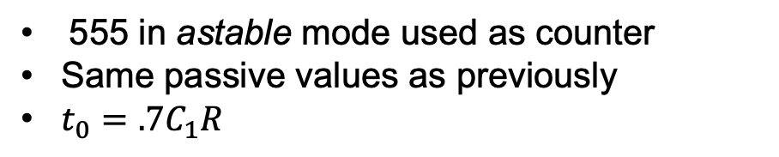
Lab: Using the 555 to clock a counter
555 in astable mode used as counter
Same passive values as previously
$t_{0}=.7C_{1}R$
5V
9 EN
8
C₂
5V
10 UP
CO 7
NC
1K
1K
5
4
11 Q2
Q1 6
C₁
6
NC
12 J2
CI 5
NC
3
555
CD4029
R₂
13 J3
J2 4
NC
7
1
1K
NC
R₁
2
14 Q3
J3 3
NC
1K
8
1
15 CNT
Q4 2
SPST
5V
16 Vcc
1
+
5V

Slide 35
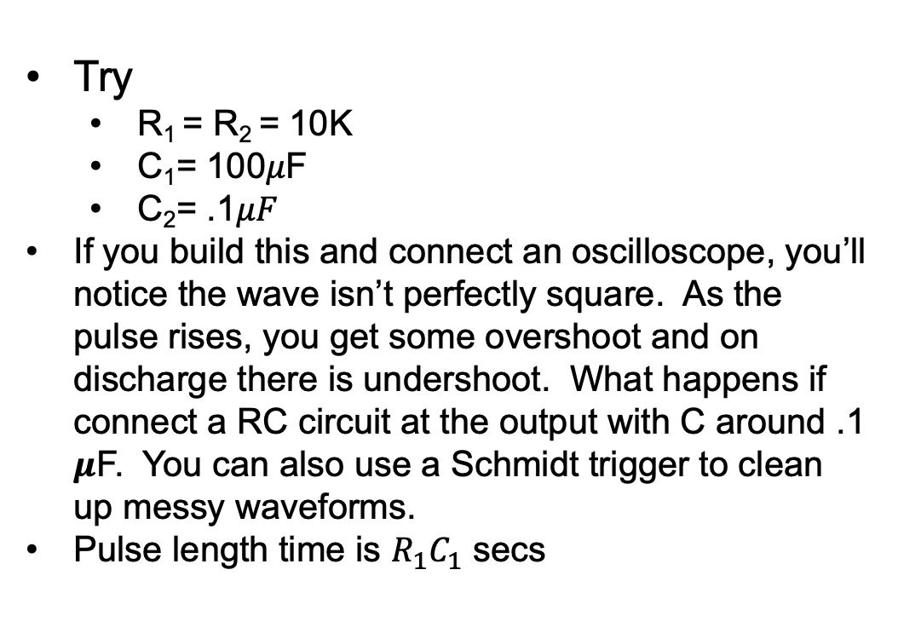
Lab: Using the 555 to generate a pulse
Try
R₁ = R₂ = 10K
C₁= 100𝜇F
C₂= .1$μF$
If you build this and connect an oscilloscope, you’ll notice the wave isn’t perfectly square. As the pulse rises, you get some overshoot and on discharge there is undershoot. What happens if connect a RC circuit at the output with C around .1 𝝁F. You can also use a Schmidt trigger to clean up messy waveforms.
Pulse length time is $R_{1}C_{1}$ secs
C₂
_{10K}
5
4
reset
C₁
6
555
3
out
7
1
R₁
2
set
8
1
SPST
+
5V

Slide 36
Logic symbols, flip flops, latches and shift registers
We can build circuits that implement logic operations. For example, the and below will output a 1 (5V) only if both inputs are 1.
We can combine these elements together with a clock to build important digital building blocks.
The circuit on the right is an S-R flip flop. QB = ¬Q, always. If EN=0, i₁=i₂=1 and the other NAND input will be Q will get ¬Q and Q will keep whatever value it had. If EN=1, S=1 and R=0, Q=1 and QB=0. If EN=1, S=0 and R=1, Q=0 and QB=1. The output is undefined if EN=1, and S and R have the same value.
We can also build memory elements, arithmetic elements, and comparators from these elements.
and
or
not and
not or
i₁
S
Q
EN
i₂
QB
R

Slide 37
Digital signals and synchronous circuits
Digital signals have two level, on (say 5V) and off (say 0V).
Digital circuits are clocked meaning there is a clock signal pictured below.
A value is calculated by combinatorial logic (and’s or’s,…) with and memory elements and moved into storage elements (registers) on each clock cycle.
In a microcontroller or computer, a program which consists of binary instructions and on each cycle, the instruction selects the logic connecting input registers, the particular logic required by an instruction and an output register.
A program moves from one instruction to the next each clock cycle although some instructions may cause a change in program flow by “jumping” to an earlier or later instruction based, say on some test condition (e.g. jump if the value of register 1 > the value of register 2).
Digital circuits are pretty simple but when so many of them are composed, the processing power is formidable; it has changed our lives.

Slide 38
SRAM and DRAM
Binary values can be stored in and retrieved from computer memory.
Computer memory comes in two types: Static random-access memories (SRAM) retain the storage value with no intervention and have very fast access times. The registers and caches in your computer are based on SRAM.
Dynamic random-access elements retain values for fairly brief periods and must be “refreshed” regularly. The main memory in your PC is built on DRAM.
You can see how DRAM and SRAM are built below.
Vcc
Data in/out
¬Data-in
Data-in
SRAM
Bit select
DRAM
Select

Slide 39
Circuit tools
In addition to the sort of analysis we’ve done, there are many computer aided design tools. Here are two:
SPICE: This is a famous device/ circuit analysis tools.
EagleCAD PCB files on GitHub: This is a cad system to lay out printed circuit boards.

Slide 40
Electronics part 3: Maxwell and Electromagnetic radiation
We cover:
The laws of physics including electricity and magnetism
Maxwell’s four field equations describe all electricity and magnetism.
Electromagnetic radiation in space
Maxwell’s equations, in addition to describing “lumped circuits,” also predicts a new phenomenon called electromagnetic radiation. You should have an intuitive understanding of how this happens by the time we’re done.
Electromagnetic waves in a conductor
Electromagnetic waves travel in free space or through materials like a conductor or wave guide.
Antennas
Antenna’s convert (or “couple”) time varying voltages and currents in a wire into travelling E/B waves in space.
Different antenna’s have different directionality and efficiency characteristics.

Slide 41
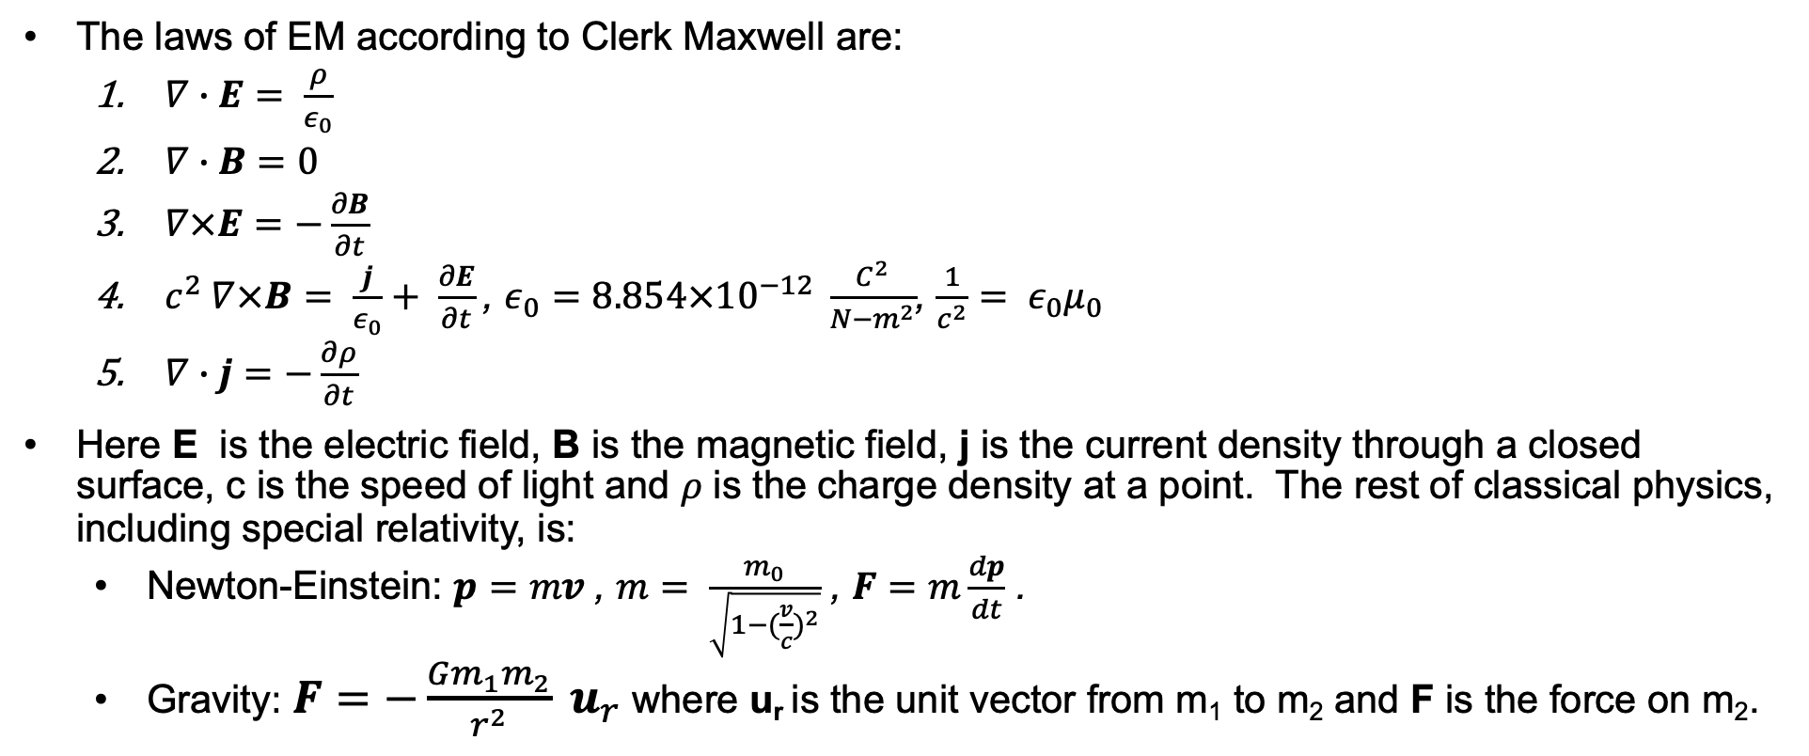
In the beginning God created Maxwell (just after Newton)
The laws of EM according to Clerk Maxwell are:
$∇∙E= \frac{ρ}{ε_{0}}$
$∇∙B=0$
$∇×E=−\frac{∂B}{∂t}$
$c^{2} ∇×B= \frac{j}{ε_{0}}+ \frac{∂E}{∂t}$, $ε_{0}=8.854×{10}^{−12} \frac{C^{2}}{N−m^{2}}$, $\frac{1}{c^{2}}= ε_{0}μ_{0}$
$∇∙j=−\frac{∂ρ}{∂t}$
Here E is the electric field, B is the magnetic field, j is the current density through a closed surface, c is the speed of light and 𝜌 is the charge density at a point. The rest of classical physics, including special relativity, is:
Newton-Einstein: $p=mv$, $m= \frac{m_{0}}{\sqrt{1−{(\frac{v}{c})}^{2}}}$ , $F=m\frac{dp}{dt}$ .
Gravity: $F=−\frac{Gm_{1}m_{2}}{r^{2}} u_{r}$ where u_{r} is the unit vector from m₁ to m₂ and F is the force on m₂.

Slide 42
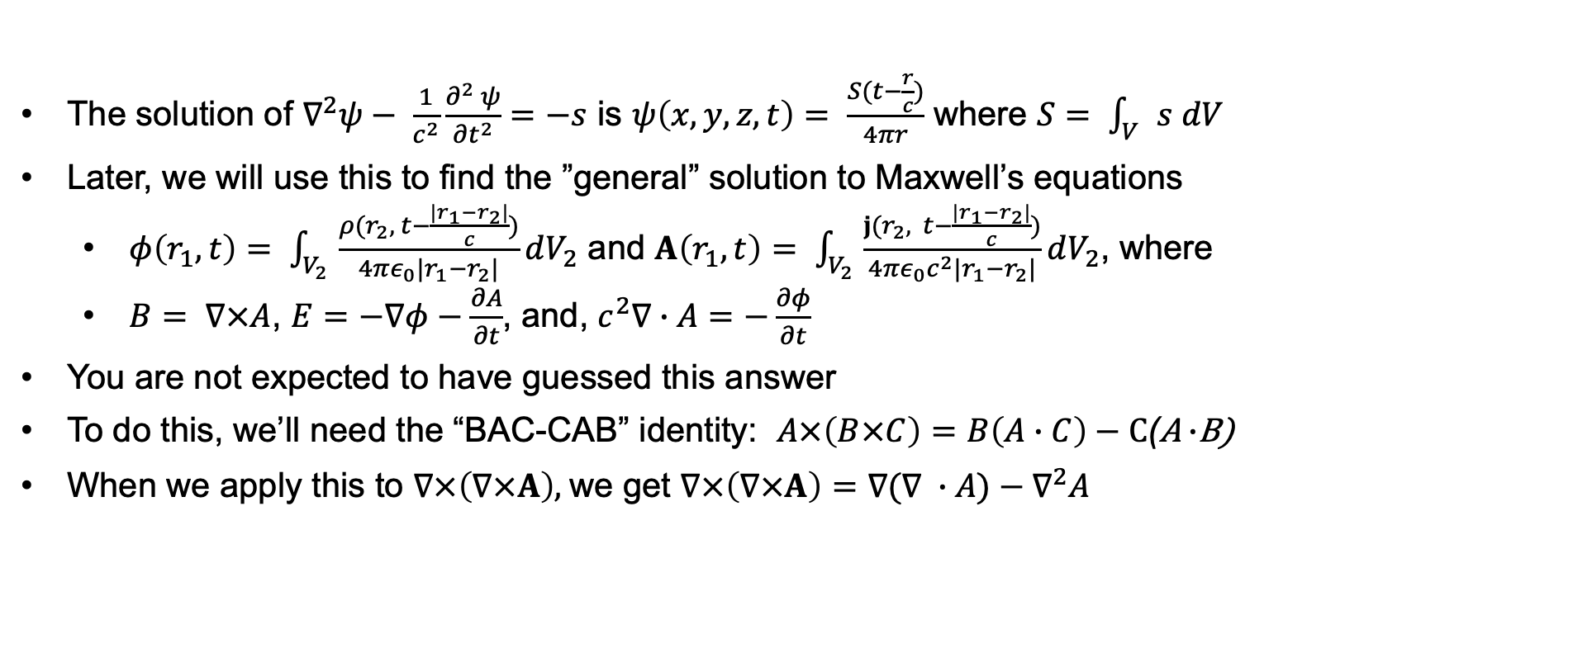
Solutions to the wave equation
The solution of $∇^{2}ψ− \frac{1}{c^{2}}\frac{∂^{2} ψ}{{∂t}^{2}}=−s$ is $ψ\left(x,y,z,t\right)= \frac{S(t−\frac{r}{c})}{4πr}$ where $S= \int_{V}{s dV}$
Later, we will use this to find the ”general” solution to Maxwell’s equations
$φ\left(r_{1}, t\right)= \int_{V_{2}}{\frac{ρ(r_{2}, t−\frac{|r_{1}−r_{2}|}{c})}{4πε_{0}|r_{1}−r_{2}|}dV_{2}}$ and $A\left(r_{1}, t\right)= \int_{V_{2}}{\frac{j(r_{2}, t−\frac{|r_{1}−r_{2}|}{c})}{4πε_{0}c^{2}|r_{1}−r_{2}|}dV_{2}}$, where
$B= ∇×A$, $E=−∇φ−\frac{∂A}{∂t}$, and, $c^{2}∇∙A=−\frac{∂φ}{∂t}$
You are not expected to have guessed this answer
To do this, we’ll need the “BAC-CAB” identity: $A×\left(B×C\right)=B\left(A∙C\right)−C$(A $∙$B)
When we apply this to $∇×\left(∇×A\right)$, we get $∇×\left(∇×A\right)=∇$($∇ ∙A)−∇^{2}A$

Slide 43
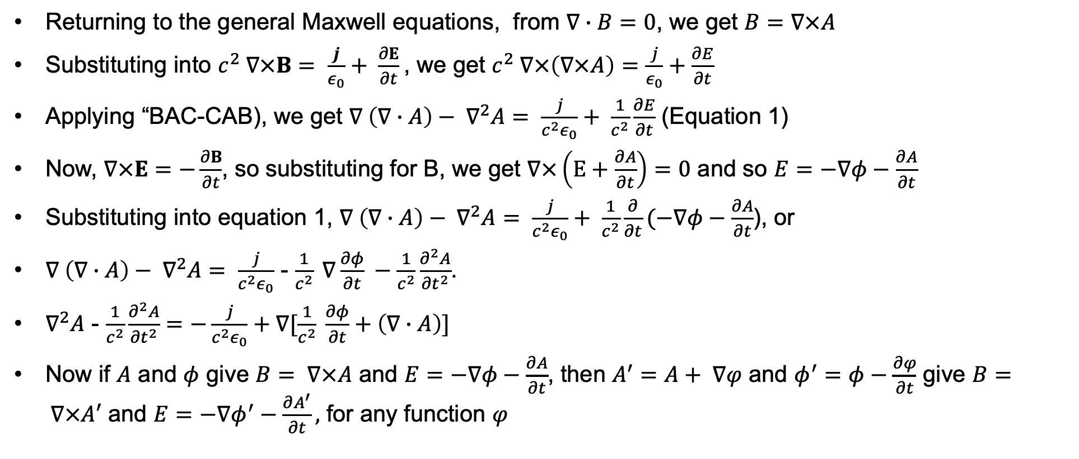
General solution to Maxwell’s equations
Returning to the general Maxwell equations, from $∇∙B=0$, we get $B=∇×A$
Substituting into $c^{2} ∇×B= \frac{j}{ε_{0}}+ \frac{∂E}{∂t}$, we get $c^{2} ∇×\left(∇×A\right)=\frac{j}{ε_{0}}+\frac{∂E}{∂t}$
Applying “BAC-CAB), we get $∇ \left(∇∙A\right)− ∇^{2}A= \frac{j}{c^{2}ε_{0}}+ \frac{1}{c^{2}}\frac{∂E}{∂t}$ (Equation 1)
Now, $∇×E=−\frac{∂B}{∂t}$, so substituting for B, we get $∇×\left(E+\frac{∂A}{∂t}\right)=0$ and so $E=−∇φ−\frac{∂A}{∂t}$
Substituting into equation 1, $∇ \left(∇∙A\right)− ∇^{2}A= \frac{j}{c^{2}ε_{0}}+ \frac{1}{c^{2}}\frac{∂}{∂t}(−∇φ−\frac{∂A}{∂t}$), or
$∇ \left(∇∙A\right)− ∇^{2}A= \frac{j}{c^{2}ε_{0}}$ - $\frac{1}{c^{2}} ∇\frac{∂φ}{∂t} −\frac{1}{c^{2}}\frac{∂^{2}A}{{∂t}^{2}}$.
$∇^{2}A$ - $\frac{1}{c^{2}}\frac{∂^{2}A}{{∂t}^{2}}=−\frac{j}{c^{2}ε_{0}}+∇[\frac{1}{c^{2}} \frac{∂φ}{∂t}+\left(∇∙A\right)]$
Now if $A$ and $φ$ give $B= ∇×A$ and $E=−∇φ−\frac{∂A}{∂t}$, then $A^{′}=A+ ∇φ$ and $φ^{′}=φ−\frac{∂φ}{∂t}$ give $B= ∇×A′$ and $E=−∇φ^{′}−\frac{∂A^{′}}{∂t},$ for any function $φ$

Slide 44
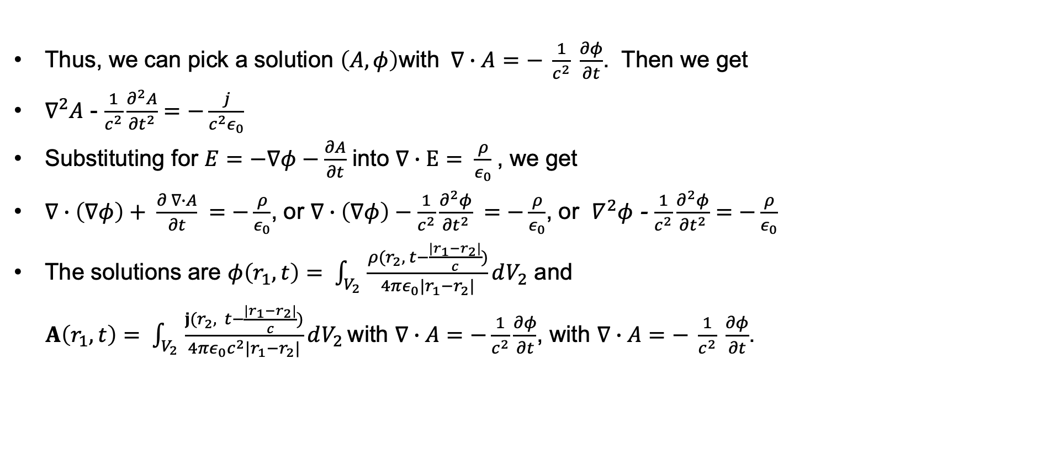
General solution to Maxwell’s equations
Thus, we can pick a solution $\left(A, φ\right)$with $∇∙A=− \frac{1}{c^{2}} \frac{∂φ}{∂t}$. Then we get
$∇^{2}A$ - $\frac{1}{c^{2}}\frac{∂^{2}A}{{∂t}^{2}}=−\frac{j}{c^{2}ε_{0}}$
Substituting for $E=−∇φ−\frac{∂A}{∂t}$ into $∇∙E= \frac{ρ}{ε_{0}}$, we get
$∇∙\left(∇φ\right)+ \frac{∂ ∇∙A}{∂t} =−\frac{ρ}{ε_{0}}$, or $∇∙\left(∇φ\right)−\frac{1}{c^{2}}\frac{∂^{2}φ}{{∂t}^{2}} =−\frac{ρ}{ε_{0}}$, or $∇^{2}φ$ - $\frac{1}{c^{2}}\frac{∂^{2}φ}{{∂t}^{2}}=−\frac{ρ}{ε_{0}}$
The solutions are $φ\left(r_{1}, t\right)= \int_{V_{2}}{\frac{ρ(r_{2}, t−\frac{|r_{1}−r_{2}|}{c})}{4πε_{0}|r_{1}−r_{2}|}dV_{2}}$ and
$A\left(r_{1}, t\right)= \int_{V_{2}}{\frac{j(r_{2}, t−\frac{|r_{1}−r_{2}|}{c})}{4πε_{0}c^{2}|r_{1}−r_{2}|}dV_{2}}$ with $∇∙A=−\frac{1}{c^{2}}\frac{∂φ}{∂t}$, with $∇∙A=− \frac{1}{c^{2}} \frac{∂φ}{∂t}$.

Slide 45
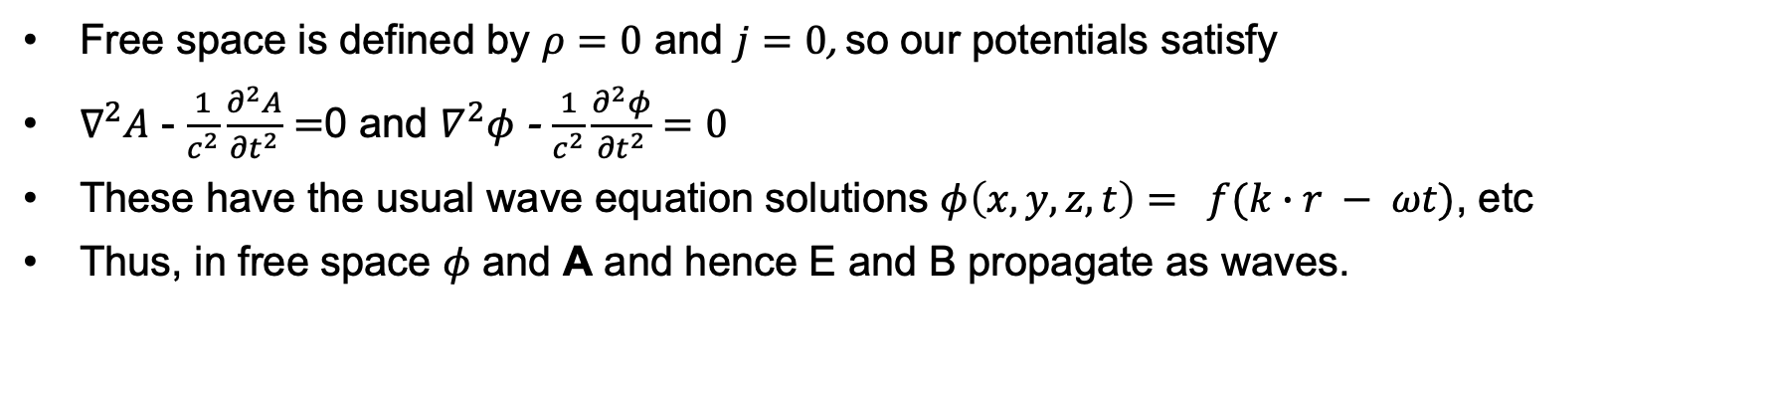
Solution to Maxwell’s equations in free space
Free space is defined by $ρ=0$ and $j=0$, so our potentials satisfy
$∇^{2}A$ - $\frac{1}{c^{2}}\frac{∂^{2}A}{{∂t}^{2}}=$0 and $∇^{2}φ$ - $\frac{1}{c^{2}}\frac{∂^{2}φ}{{∂t}^{2}}=0$
These have the usual wave equation solutions $φ\left(x,y,z,t\right)= f(k∙r − ωt)$, etc
Thus, in free space 𝜙 and A and hence E and B propagate as waves.

Slide 46
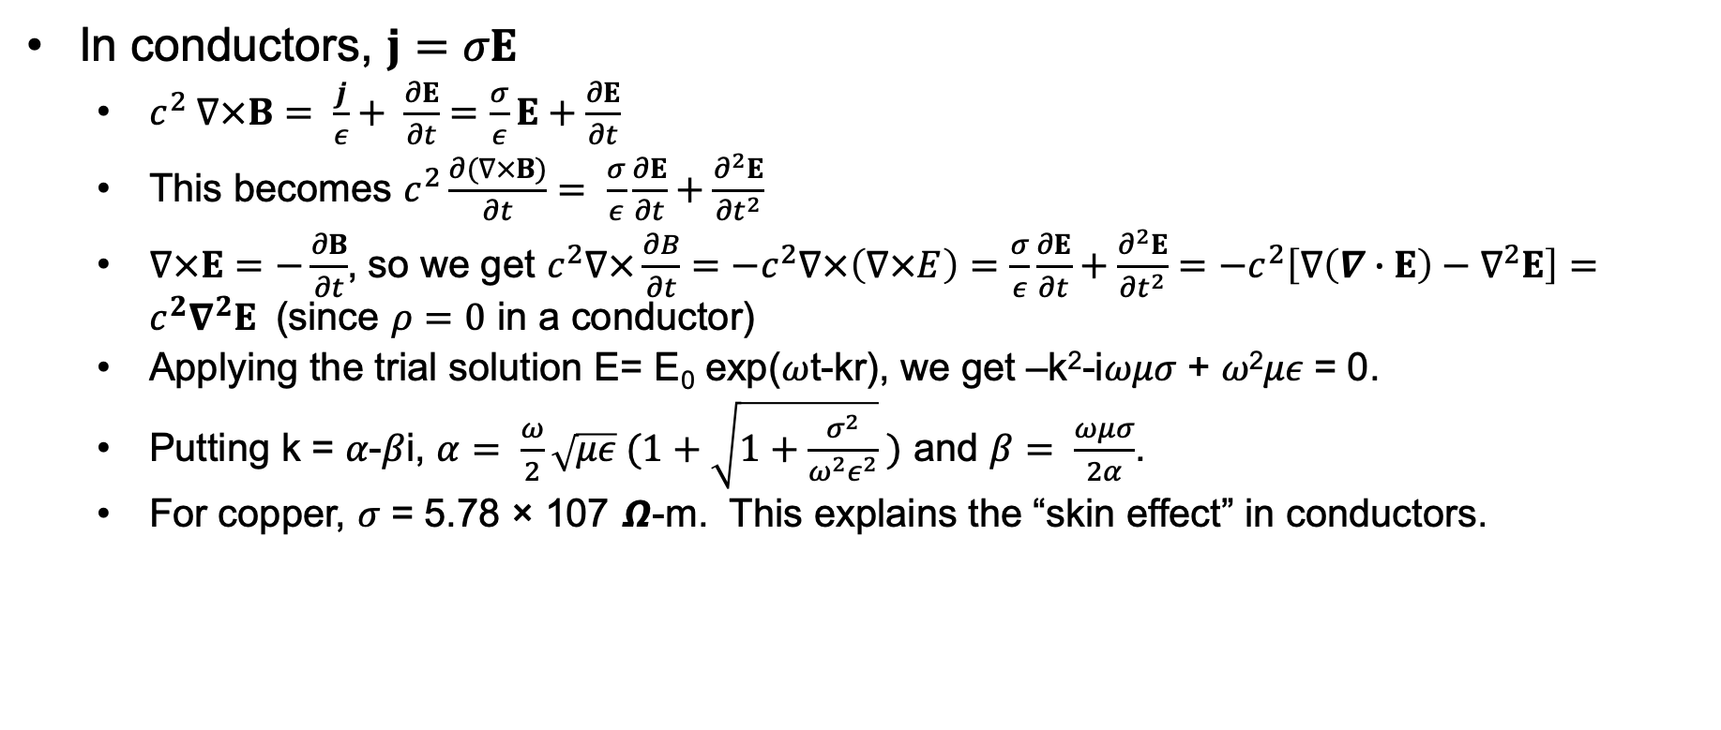
Solution to Maxwell’s equations in conductors
In conductors, $j=σE$
$c^{2} ∇×B= \frac{j}{ε}+ \frac{∂E}{∂t}=\frac{σ}{ε}E+\frac{∂E}{∂t}$
This becomes $c^{2}\frac{∂(∇×B)}{∂t}= \frac{σ}{ε}\frac{∂E}{∂t}+\frac{∂^{2}E}{{∂t}^{2}}$
$∇×E=−\frac{∂B}{∂t}$, so we get $c^{2}∇×\frac{∂B}{∂t}=−c^{2}∇×\left(∇×E\right)=\frac{σ}{ε}\frac{∂E}{∂t}+\frac{∂^{2}E}{{∂t}^{2}}=−c^{2}\left[∇\left(∇∙E\right)−∇^{2}E\right]=c^{2}∇^{2}E$ (since $ρ=0$ in a conductor)
Applying the trial solution E= E₀ exp(𝜔t-kr), we get –k²-i𝜔𝜇𝜎 + 𝜔²𝜇𝜖 = 0.
Putting k = 𝛼-𝛽i, $α= \frac{ω}{2}\sqrt{με} (1+\sqrt{1+\frac{σ^{2}}{ω^{2}ε^{2}}} )$ and $β= \frac{ωμσ}{2α}$.
For copper, 𝜎 = 5.78 × 107 𝞨-m. This explains the “skin effect” in conductors.

Slide 47
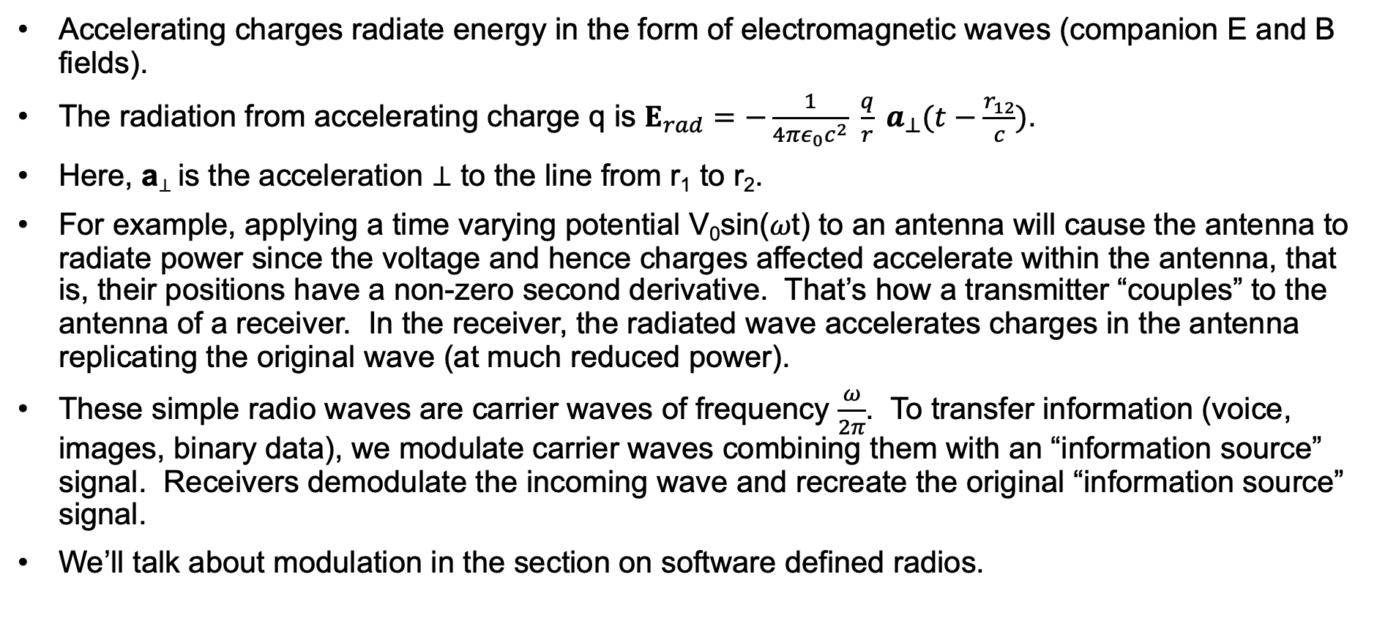
Radiation, antennas
Accelerating charges radiate energy in the form of electromagnetic waves (companion E and B fields).
The radiation from accelerating charge q is $E_{rad}=−\frac{1}{4πε_{0}c^{2}} \frac{q}{r} a_{⊥}(t−\frac{r_{12}}{c})$.
Here, a⊥ is the acceleration ⊥ to the line from r₁ to r₂.
For example, applying a time varying potential V₀sin(𝜔t) to an antenna will cause the antenna to radiate power since the voltage and hence charges affected accelerate within the antenna, that is, their positions have a non-zero second derivative. That’s how a transmitter “couples” to the antenna of a receiver. In the receiver, the radiated wave accelerates charges in the antenna replicating the original wave (at much reduced power).
These simple radio waves are carrier waves of frequency $\frac{ω}{2π}$. To transfer information (voice, images, binary data), we modulate carrier waves combining them with an “information source” signal. Receivers demodulate the incoming wave and recreate the original “information source” signal.
We’ll talk about modulation in the section on software defined radios.

Slide 48
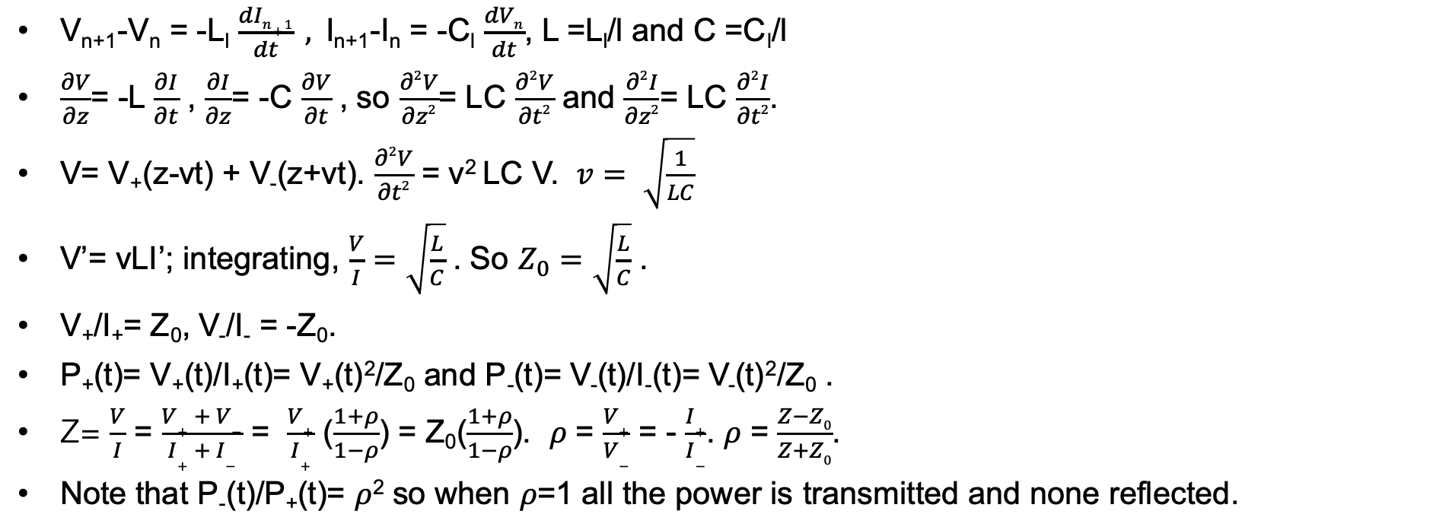
Travelling waves and reflections
input
output
Impedance of output device is Z
“Lookback” impedance is Z₀
V_{n+1}-V_{n} = -L_{l} $\frac{dIn+1}{dt} ,$I_{n+1}-I_{n} = -C_{l} $\frac{dVn}{dt}$, L =L_{l}/l and C =C_{l}/l
$\frac{∂V}{∂z}$= -L $\frac{∂I}{∂t}$ , $\frac{∂I}{∂z}$= -C $\frac{∂V}{∂t}$ , so $\frac{∂2V}{∂z2}$= LC $\frac{∂2V}{∂t2}$ and $\frac{∂2I}{∂z2}$= LC $\frac{∂2I}{∂t2}$.
V= V₊(z-vt) + V₋(z+vt). $\frac{∂2V}{∂t2}$ = v² LC V. $v= \sqrt{\frac{1}{LC}}$
V’= vLI’; integrating, $\frac{V}{I}=\sqrt{\frac{L}{C}}$ . So $Z_{0}=\sqrt{\frac{L}{C}}$ .
V₊/I₊= Z₀, V₋/I₋ = -Z₀.
P₊(t)= V₊(t)/I₊(t)= V₊(t)²/Z₀ and P₋(t)= V₋(t)/I₋(t)= V₋(t)²/Z₀ .
Z= $\frac{V}{I}$ = $\frac{V+ + V−}{I+ + I−}$ = $\frac{V+}{I+}$ ($\frac{1+ρ}{1−ρ}$) = Z₀($\frac{1+ρ}{1−ρ}$). 𝜌 = $\frac{V+}{V−}$ = - $\frac{I+}{I−}$. 𝜌 = $\frac{Z−Z0}{Z+Z0}$.
Note that P₋(t)/P₊(t)= 𝜌² so when 𝜌=1 all the power is transmitted and none reflected.

Slide 49
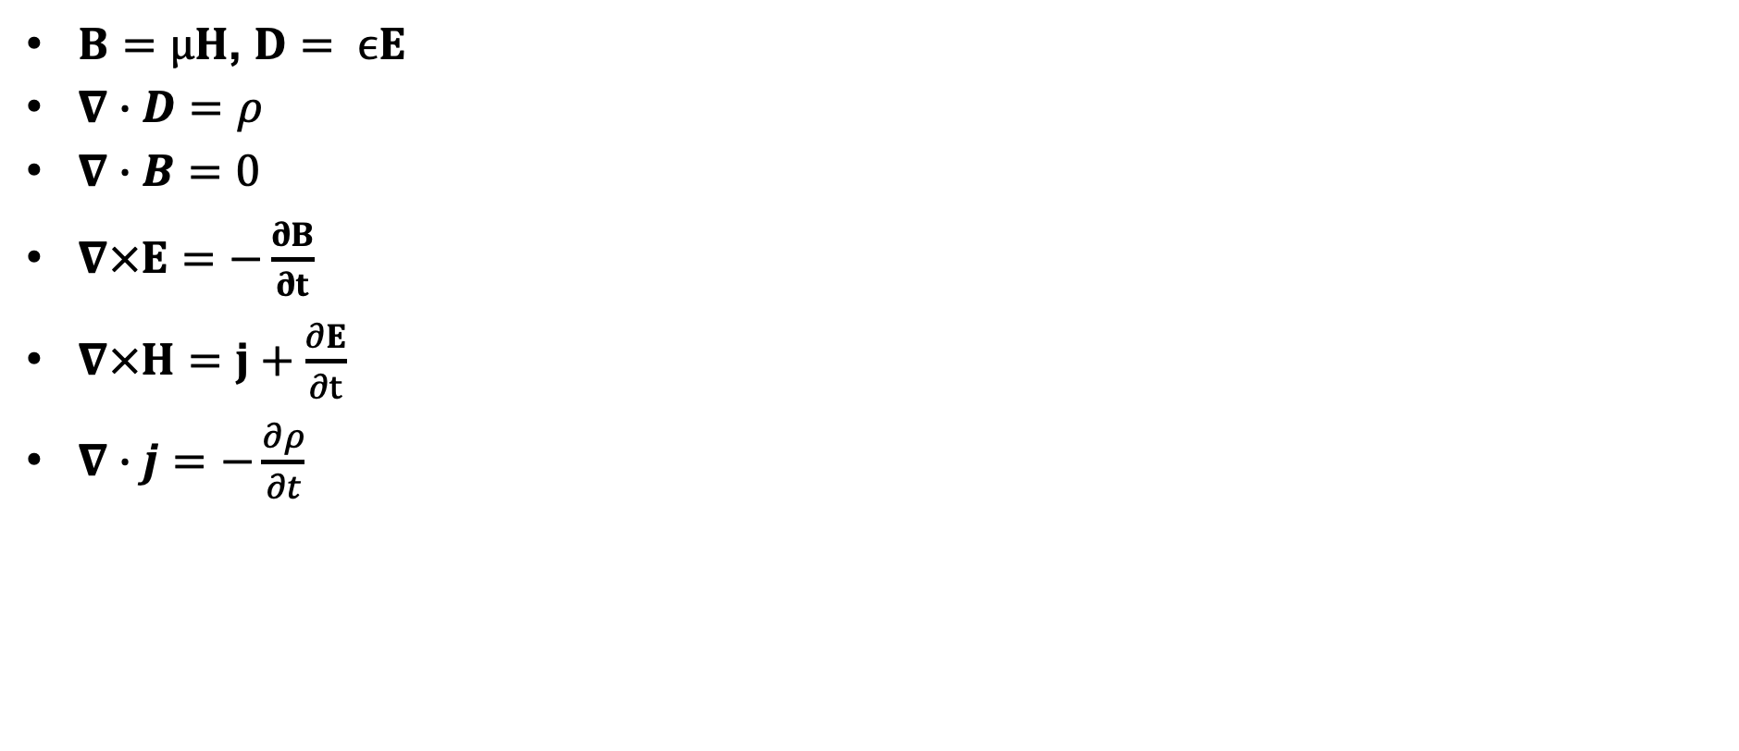
Maxwell’s equations in a non-dispersive media
$B=μH$, $D= ϵE$
$∇∙D=ρ$
$∇∙B=0$
$∇×E=−\frac{∂B}{∂t}$
$∇×H=j+\frac{∂E}{∂t}$
$∇∙j=−\frac{∂ρ}{∂t}$

Slide 50
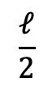
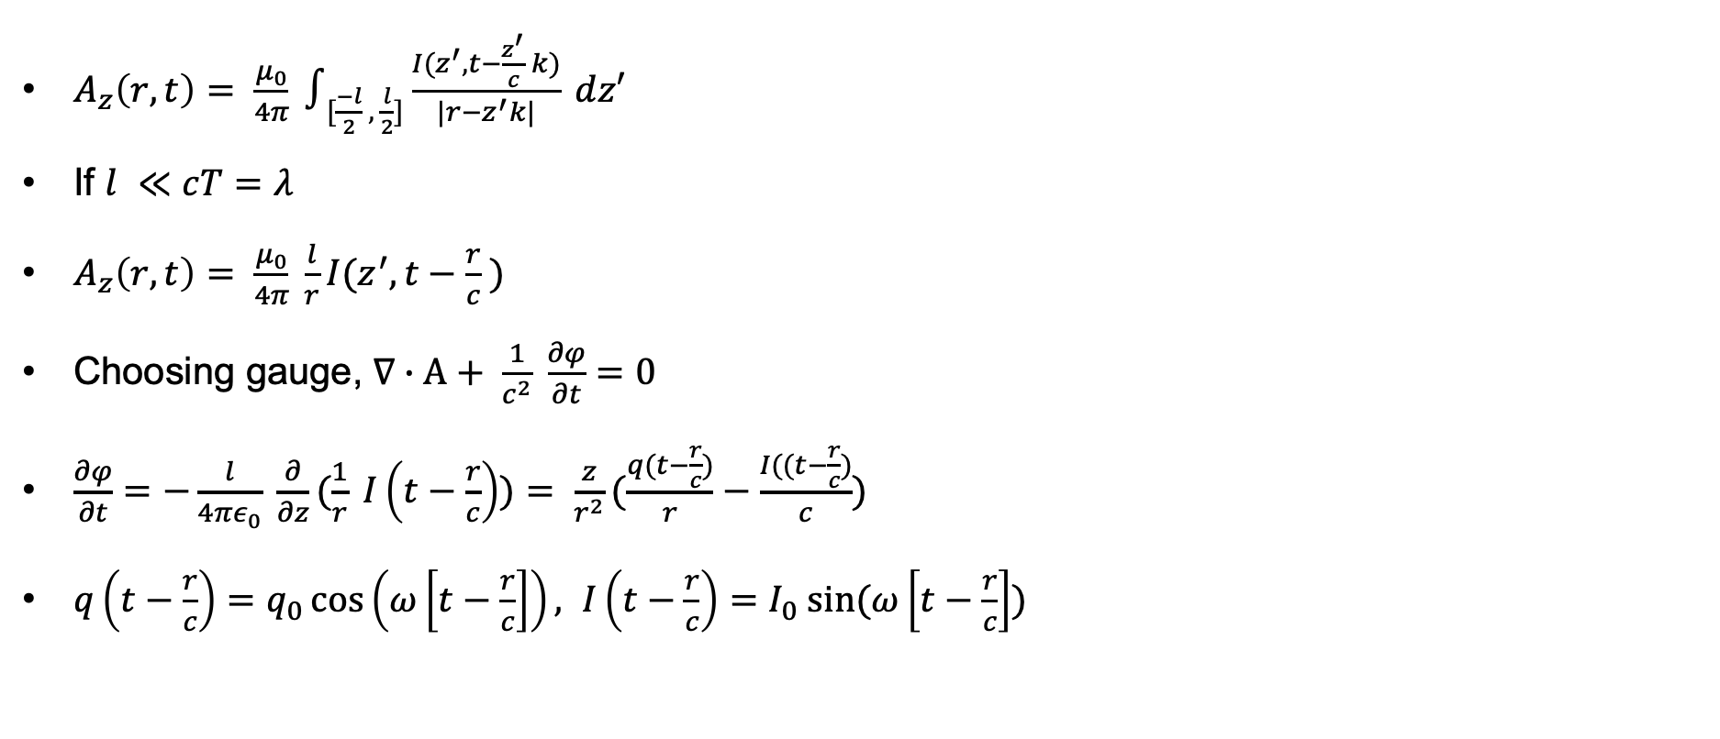
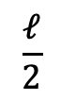
Radiation from a small dipole
q(t)
$A_{z}\left(r,t\right)= \frac{μ_{0}}{4π} ∫_{[\frac{−l}{2} , \frac{l}{2}]}\frac{I(z^{′}, t−\frac{z^{′}}{c} k)}{|r−z^{′}k|} dz′$
If $l ≪cT=λ$
$A_{z}\left(r,t\right)= \frac{μ_{0}}{4π} \frac{l}{r}I(z^{′}, t−\frac{r}{c} )$
Choosing gauge, $∇∙A+ \frac{1}{c^{2}} \frac{∂φ}{∂t}=0$
$\frac{∂φ}{∂t}=−\frac{l}{4πε_{0}} \frac{∂}{∂z}(\frac{1}{r} I\left(t−\frac{r}{c}\right))= \frac{z}{r^{2}}(\frac{q(t−\frac{r}{c})}{r}−\frac{I((t−\frac{r}{c})}{c})$
$q\left(t−\frac{r}{c}\right)=q_{0}\cos\left(ω\left[t−\frac{r}{c}\right]\right), I\left(t−\frac{r}{c}\right)=I_{0} sin⁡(ω\left[t−\frac{r}{c}\right])$
$$\frac{ℓ}{2}$$
$$\frac{ℓ}{2}$$
y
z
-q(t)

Slide 51
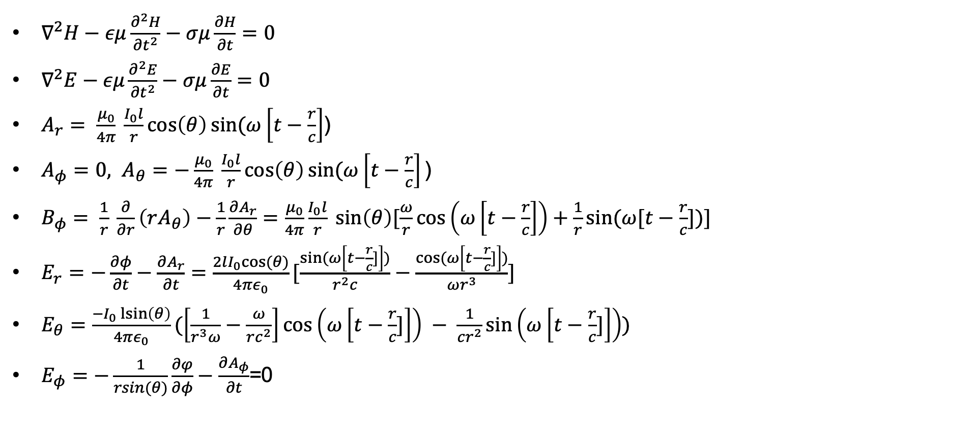
Radiation from a small dipole
q(t)
$$\frac{ℓ}{2}$$
$∇^{2}H−εμ\frac{∂^{2}H}{{∂t}^{2}}−σμ\frac{∂H}{∂t}=0$
$∇^{2}E−εμ\frac{∂^{2}E}{{∂t}^{2}}−σμ\frac{∂E}{∂t}=0$
$A_{r}= \frac{μ_{0}}{4π} \frac{I_{0}l}{r}\cos\left(θ\right)sin⁡(ω\left[t−\frac{r}{c}\right]$)
$A_{φ}=0, A_{θ}=−\frac{μ_{0}}{4π} \frac{I_{0}l}{r}\cos\left(θ\right)sin⁡(ω\left[t−\frac{r}{c}\right]\text{)}$
$B_{φ}= \frac{1}{r} \frac{∂}{∂r}\left(rA_{θ}\right)−\frac{1}{r}\frac{∂A_{r}}{∂θ}=\frac{μ_{0}}{4π}\frac{I_{0}l}{r} sin\left(θ\right)[\frac{ω}{r}\cos\left(ω\left[t−\frac{r}{c}\right]\right)+\frac{1}{r}sin⁡(ω[t−\frac{r}{c}])]$
$E_{r}=−\frac{∂φ}{∂t}−\frac{∂A_{r}}{∂t}=\frac{2lI_{0}cos⁡(θ)}{4πε_{0}}[\frac{sin⁡(ω\left[t−\frac{r}{c}]\right])}{r^{2}c}−\frac{cos⁡(ω\left[t−\frac{r}{c}]\right])}{ωr^{3}}]$
$E_{θ}=\frac{−I_{0}\operatorname{lsin}\left(θ\right)}{4πε_{0}}(\left[\frac{1}{r^{3}ω}−\frac{ω}{rc^{2}}\right]\cos\left(ω\left[t−\frac{r}{c}]\right]\right) − \frac{1}{cr^{2}}\sin\left(ω\left[t−\frac{r}{c}]\right]\right))$
$E_{φ}=−\frac{1}{rsin(θ)}\frac{∂φ}{∂φ}−\frac{∂A_{φ}}{∂t}$=0
$$\frac{ℓ}{2}$$
y
z
-q(t)

Slide 52
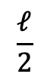
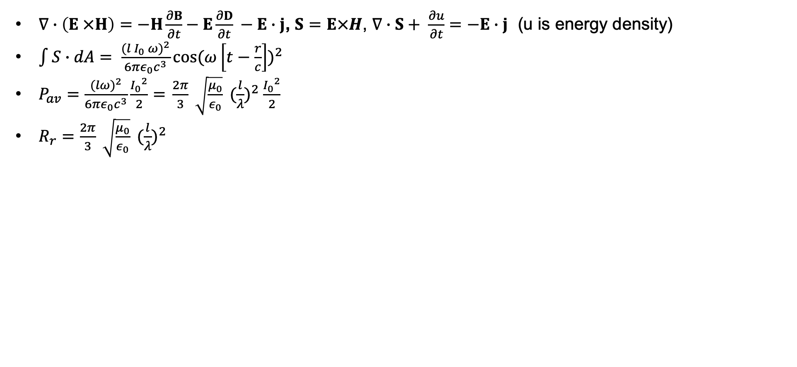
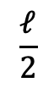
Radiation from a small dipole
$∇∙\left(E ×H\right)=−H\frac{∂B}{∂t}−E\frac{∂D}{∂t} −E∙j$, $S=E×H$, $∇∙S+ \frac{∂u}{∂t}=−E∙j$ (u is energy density)
$\int{S∙dA= \frac{{(l I_{0} ω)}^{2}}{6πε_{0}c^{3}}{{cos⁡(ω\left[t−\frac{r}{c}\right])}^{2}}}$
$P_{av}=\frac{{(lω)}^{2}}{6πε_{0}c^{3}}\frac{{I_{0}}^{2}}{2}{=} \frac{2π}{3} \sqrt{\frac{μ_{0}}{ε_{0}}} {(\frac{l}{λ})}^{2} \frac{{I_{0}}^{2}}{2}$
$R_{r}=\frac{2π}{3} \sqrt{\frac{μ_{0}}{ε_{0}}} {(\frac{l}{λ})}^{2}$
q(t)
$$\frac{ℓ}{2}$$
$$\frac{ℓ}{2}$$
y
z
-q(t)

Slide 53
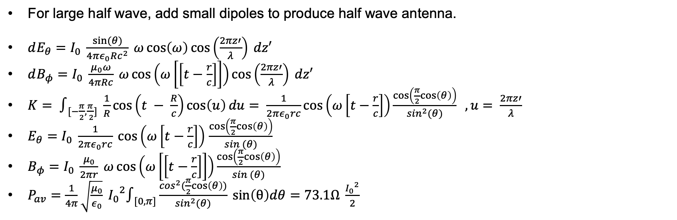
Large half wave dipole
For large half wave, add small dipoles to produce half wave antenna.
$dE_{θ}=I_{0} \frac{sin⁡(θ)}{4πε_{0}Rc^{2}} ω\cos\left(ω\right)\cos\left(\frac{2πz′}{λ}\right) dz′$
$dB_{φ}=I_{0} \frac{μ_{0}ω}{4πRc} ω\cos\left(ω\left[\left[t−\frac{r}{c}\right]\right]\right)\cos\left(\frac{2πz′}{λ}\right) dz′$
$K= ∫_{[−\frac{π}{2},\frac{π}{ 2}]} \frac{1}{R}\cos\left(t − \frac{R}{c}\right)\cos\left(u\right)du= \frac{1}{2πε_{0}rc}\cos\left(ω\left[t−\frac{r}{c}\right]\right)\frac{\cos\left(\frac{π}{2}cos\left(θ\right)\right)}{\sin^{2}(θ)} , u= \frac{2πz′}{λ}$
$E_{θ}=I_{0} \frac{1}{2πε_{0}rc} \cos\left(ω\left[t−\frac{r}{c}\right]\right)$ $\frac{\cos\left(\frac{π}{2}cos\left(θ\right)\right)}{sin (θ)}$
$B_{φ}=I_{0} \frac{μ_{0}}{2πr} ω\cos\left(ω\left[\left[t−\frac{r}{c}\right]\right]\right)\frac{\cos\left(\frac{π}{2}cos\left(θ\right)\right)}{sin (θ)}$
$P_{av}=\frac{1}{4π}\sqrt{\frac{μ_{0}}{ε_{0}}} {I_{0}}^{2}∫_{[0, π]}\frac{\cos^{2}(\frac{π}{2}cos\left(θ\right))}{\sin^{2}(θ)} sin\left(θ\right)dθ=73.1Ω \frac{{I_{0}}^{2}}{2}$

Slide 54
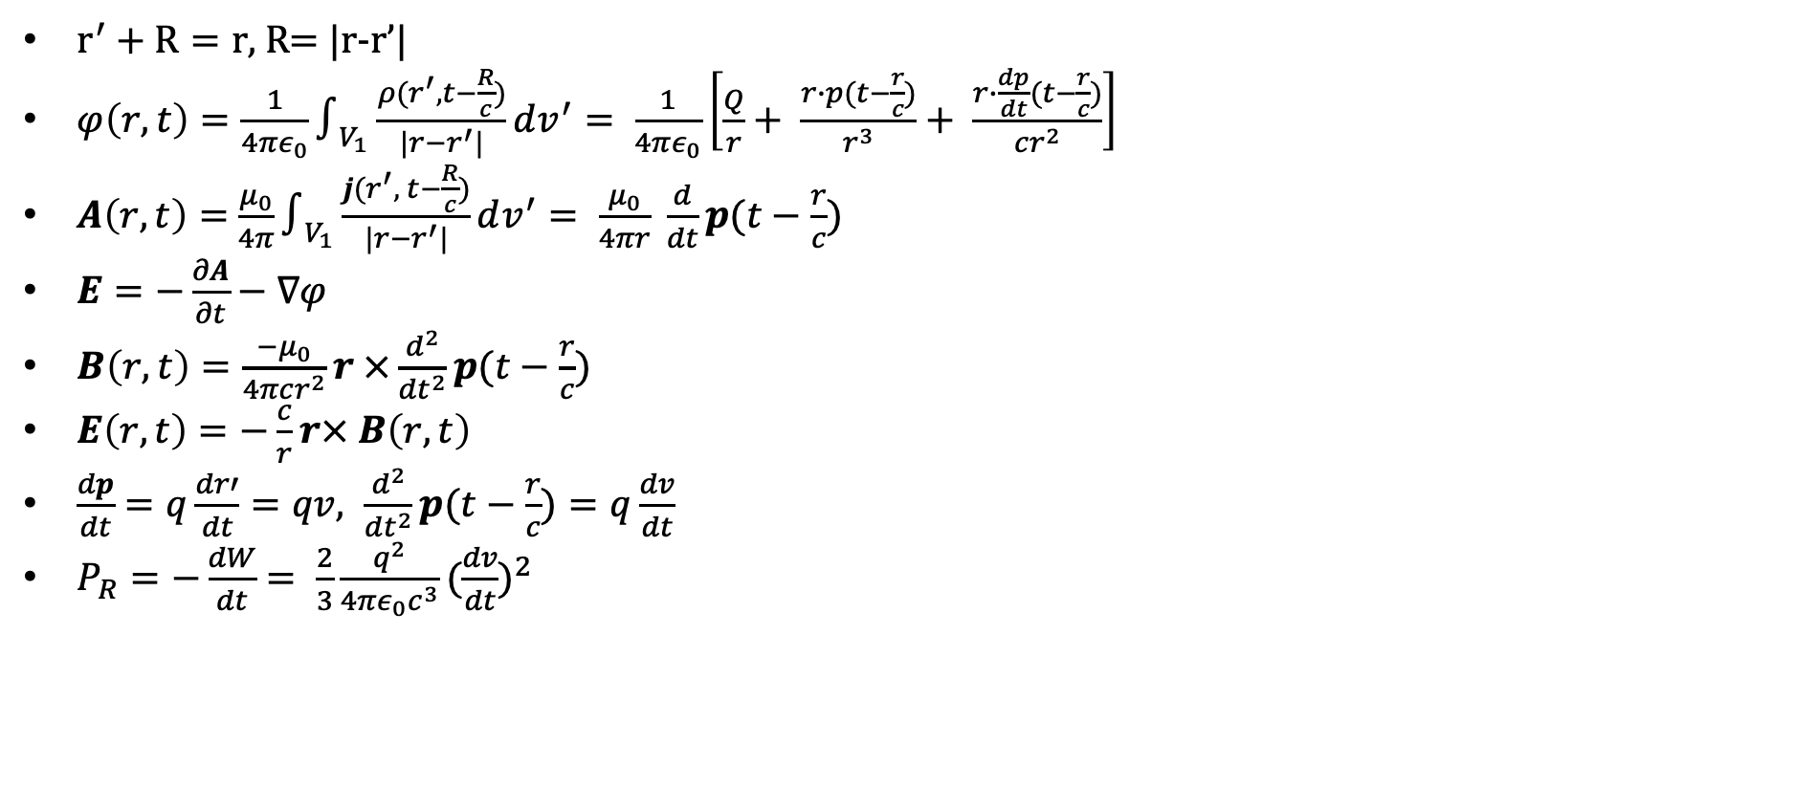
Radiation from an accelerating charge
$r^{′}+R=r$, R= |r-r’|
$φ\left(r,t\right)=\frac{1}{4πε_{0}}∫_{V_{1}}\frac{ρ(r^{′}, t−\frac{R}{c})}{|r−r^{′}|}dv^{′}= \frac{1}{4πε_{0}}\left[\frac{Q}{r}+ \frac{r∙p(t−\frac{r}{c})}{r^{3}}+ \frac{r∙\frac{dp}{dt}(t−\frac{r}{c})}{cr^{2}}\right]$
$A\left(r,t\right)=$ $\frac{μ_{0}}{4π}∫_{V_{1}}\frac{j(r^{′}, t−\frac{R}{c})}{|r−r^{′}|}dv^{′}= \frac{μ_{0}}{4πr} \frac{d}{dt}p(t−\frac{r}{c})$
$E=−\frac{∂A}{∂t}−∇φ$
$B\left(r,t\right)=\frac{−μ_{0}}{4πcr^{2}}r ×\frac{d^{2}}{{dt}^{2}}p(t−\frac{r}{c})$
$E\left(r,t\right)=−\frac{c}{r}r× B\left(r,t\right)$
$\frac{dp}{dt}=q\frac{dr′}{dt}=qv, \frac{d^{2}}{{dt}^{2}}p(t−\frac{r}{c})=q\frac{dv}{dt}$
$P_{R}=−\frac{dW}{dt}= \frac{2}{3}\frac{q^{2}}{4πε_{0}c^{3}}{(\frac{dv}{dt})}^{2}$

Slide 55
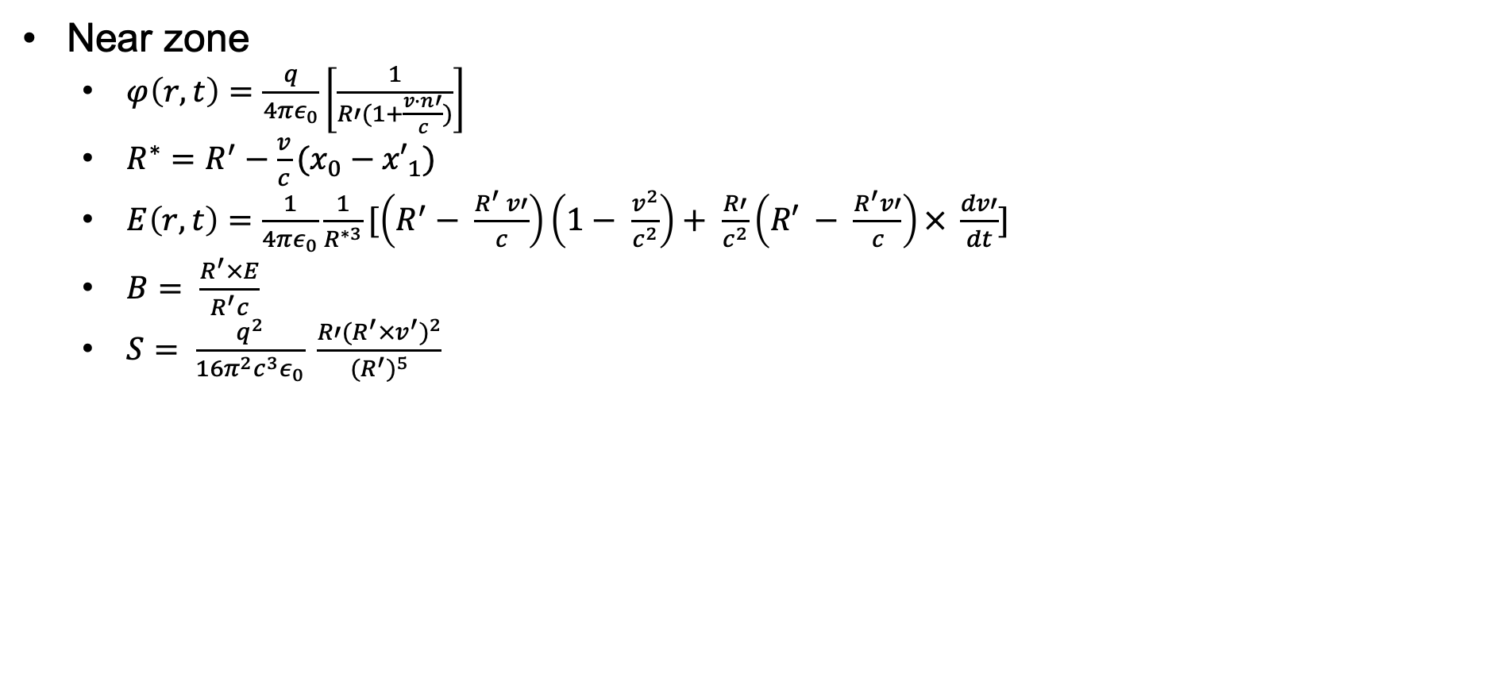
Radiation from a single accelerating charge
Near zone
$φ\left(r,t\right)=\frac{q}{4πε_{0}}\left[\frac{1}{R′(1+\frac{v∙n′}{c})}\right]$
$R^{∗}=R^{′}−\frac{v}{c}(x_{0}−{x′}_{1})$
$E\left(r,t\right)=\frac{1}{4πε_{0}}\frac{1}{R^{∗3}}[\left(R^{′}− \frac{R^{′} v′}{c}\right)\left(1− \frac{v^{2}}{c^{2}}\right)+ \frac{R′}{c^{2}}\left(R′ − \frac{R^{′}v′}{c}\right)× \frac{dv′}{dt}]$
$B= \frac{R^{′}×E}{R^{′}c}$
$S= \frac{q^{2}}{16π^{2}c^{3}ε_{0}} \frac{R′{(R^{′}×v^{′})}^{2}}{{(R^{′})}^{5}}$

Slide 56
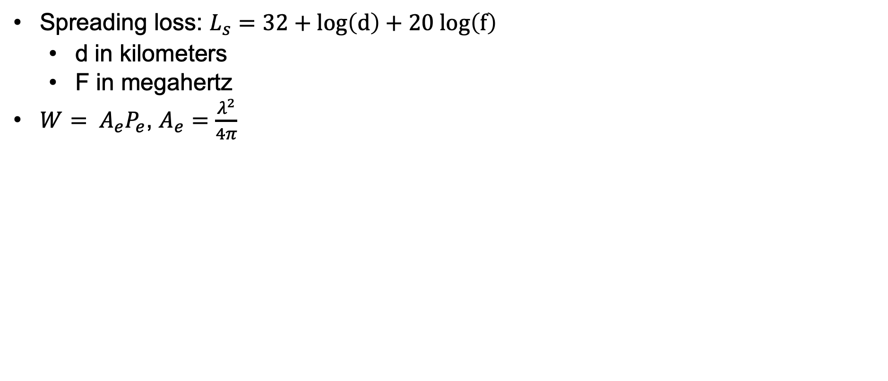
Radiation loss and antenna aperture
Spreading loss: $L_{s}=32+log\left(d\right)+20 log\left(f\right)$
d in kilometers
F in megahertz
$W= A_{e}P_{e}$, $A_{e}=\frac{λ^{2}}{4π}$

Slide 57
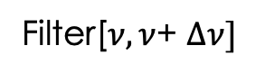
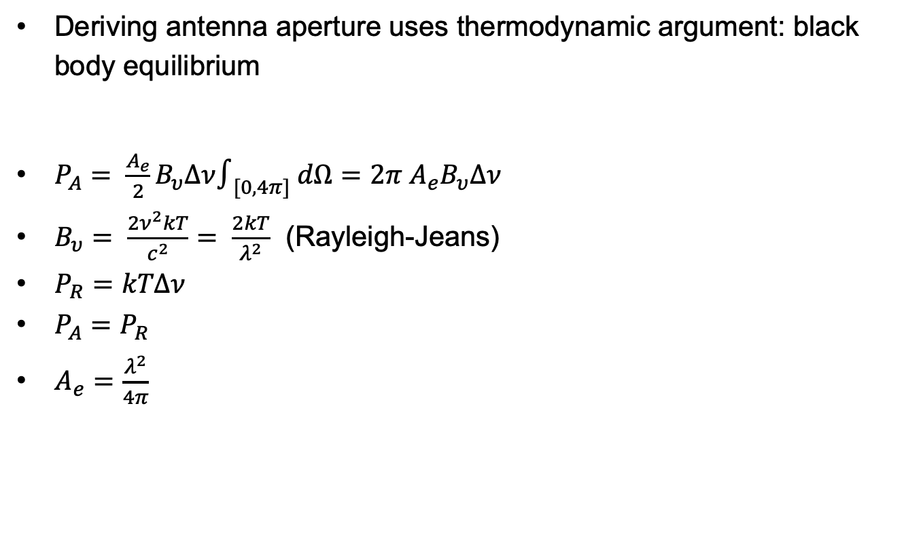
Antenna aperture
Deriving antenna aperture uses thermodynamic argument: black body equilibrium
$P_{A}= \frac{A_{e}}{2}B_{υ}Δν∫_{[0,4π]} dΩ=2π A_{e}B_{υ}Δν$
$B_{υ}= \frac{2ν^{2}kT}{c^{2}}= \frac{2kT}{λ^{2}}$ (Rayleigh-Jeans)
$P_{R}=kTΔν$
$P_{A}=P_{R}$
$A_{e}=\frac{λ^{2}}{4π}$
P_{A}
P_{R}
A
R
T
T
Filter[$ν,ν$+ $Δν]$

Slide 58
Exercises
10K pull-up resistor and 5 v power. What is the power drain when we connect it to ground?
Build some of the circuits in this lecture, analyze them with Kirchhoff’s laws and measure (with an oscilloscope) input and outputs.
Estimate the power at reception of a GPS signal.
Use a multimeter
Use an oscilloscope

Slide 59
Electronics part 4: Computers and computer architecture
Programmable electronics
Digital electronics can be used to build computers which execute binary instructions in digital memory on data in digital memory to compute results or control equipment.
Computers are connected to peripherals (sensors, keyboards, displays, speakers) to collect or transmit data to people or other devices.
You should understand basic computer architecture and how the elements below achieve programmability.
CPU’s
Memory
Busses
I/O – Serial communication
You should understand some important elements of IoT architecture like
SoC’s
IoT busses: SPI, I²C

Slide 60
Computer processor architecture
CPU’s
Memory (registers, SRAM, DRAM)
MMU’s
Busses
Rings and privilege separation
Virtual memory
Devices, interrupts, memory mapped I/O
Programs
Inter-computer communication
GPU’s and FPGA’s

Slide 61
Computer processor architecture
Computers are often described in terms of their architecture.
Architectures focus on the high level interaction of components rather than low level schematics.
Architecture represents the “systems programmer’s” view of the computer.
It was popularized by the deservedly admired “Principles of Operation” describing the IBM /360.
Computers execute digitally encoded instructions which can be loaded at will into a computer. They are “von Neuman” machines.
x
The diagram above is a generic computer architecture. The one on the right is an Intel based computer.
The major blocks are the CPU, clock, memory subsystem (MMU, cache, DRAM), inter-block bus interfaces and I/O subsystem (busses, interrupt processing).

Slide 62
Computer processor architecture
A computer is a “clocked” electronic system. Each computer operation is simple and occurs in a clock “cycle.” The clock cycle of modern computers vary from “millions of cycles per second” to “billions of cycles per second.” The faster, the better.
CPU, clock
The CPU fetches instructions from memory and executes them.
In a simple processor, a single instruction is executed each cycle; in a complex processor, a single instruction might take several cycles and many instructions may be executing, in different execution units, simultaneously.
A typical instruction might be “add memory location a to memory location b.”
Normally, instructions are executed sequentially but there are three ways to change control flow.
First, unconditional jumps or conditional jumps can synchronously change control flow. For example, an unconditional jump might be “jump to the instruction at memory location m” while a conditional jump might be “jump to the instruction at memory location m if the value at memory location a is bigger or equal to the value at memory location b.” This allows program “loops.”
Second, interrupts (from clocks or devices) can instruct the processor to start executing instruction streams at different locations.
Third, error conditions that occur in user mode processing can cause “exceptions” that trap into the OS. An example may be dividing by 0 or attempting to execute a privileged instruction.

Slide 63
Computer processor architecture
Instructions and data are stored in binary form, i.e. as a series of 1’s and 0’s.
Binary values are organized into bytes (8 bit values) and “words” varying from 2 bytes to 8 bytes.
Words represent numerical values (12, 2324241) and addresses.
Addresses are unsigned integers and are represented in the usual binary form.
1 is 0000000000000001
18 is 0000000000010010
Signed integers are usually represented in “two’s complement notation:”
Positive integers have high order bit of 0, the remainder of the word is the ordinary unsigned binary form.
0 is all 0 bits.
Negative numbers have a high order bit of 1 and are arranged so that using the “standard” unsigned addition circuits x + (-x) = 0.
A simple algorithm for turning a positive binary number into its corresponding negative is to flip each bit in the original representation and use unsigned arithmetic to “add 1.”
Try it.

Slide 64
Computer processor architecture
Memory subsystem
Memory systems store binary values organized as 8 bit bytes. Bytes are organized into words and instructions can refer to either “byte sized” data values or “word sized” data values.
Most systems are addressable on byte boundaries and at the very lowest level, memory is accessed by “physical addresses” starting at 0 and ending at the size of the memory - 1.
Programs can be loaded into memory at different locations at different times. As a convenience, most systems have MMU’s which allow a supervisor program to map memory from physical addresses to virtual addresses. Virtual addresses give the program the illusion that memory for their program always starts at 0. The MMU translates virtual addresses into physical addresses.
Actually, memory is usually arranged into a “hierarchy.”
CPU’s have internal memory called registers which can be accessed in a single cycle.
“Main memory” consists of DRAM which (depending on the clock rate of the CPU) can take hundreds of cycles to access.
In between the CPU and main memory is “cache memory” built from SRAM which contains copies of main memory locations. Cache memory can be accessed in a few cycles maybe even one.

Slide 65
Computer processor architecture
Memory subsystem
When a main memory location is accessed and it is not in cache, the value at the location and several sequential locations are loaded into cache. Subsequent accesses are fast.
Cache and main memory contents must be coherent, that is at well understood times the values must be consistent.
After a while, under OS control, cache values are evicted and reside only in main memory.
Inter-block bus interfaces
These are fixed width control lines connecting the CPU and its subsystems. Busses have protocols which dictate the manner in which a device “addresses” another device, puts binary values onto the bus for reading or writing and arbitrates access.
I/O subsystem (busses, interrupt processing).
I/O busses are similar to inter-block buses but are usually slower. When devices use the bus and want the attention of the CPU, the bus protocol causes a processor interrupt.
Some devices can read and write main memory without interrupting the CPU. This is called DMA and it is mediated by the MMU.

Slide 66
Computer processor architecture
There are a few hardware features that greatly simplify programming when many programs are being run. They also provide protection and isolation between programs. Usually there is a single “supervisor” program which manages a computer: this is the operating system “kernel.” Here are some hardware enabled “sharing” features:
Rings of privilege: Most processors have two or more processor modes (ring 0, 1, 2, 3) or supervisor mode and user mode.
The operating system kernel runs in supervisor mode. In supervisor mode, a program can execute any instruction, access any memory location, program any peripheral or dependent system (like the MMU). Kernels set up user address spaces for user programs (operating in user mode) by setting up virtual memory maps (page tables) which cannot be accessed by user programs. Supervisor mode instructions and memory are not visible to user mode programs. Usually, the instructions and memory of one user mode program is not accessible to another user mode program (two different programs can share some memory under kernel control). This prevents one program from interfering with another program. Interrupts are set up to “trap” into supervisor mode and are serviced by the kernel. This allows different user programs to safely share devices like displays, USB devices and disks.
When a user mode program needs a kernel “service,” like writing a file or starting another program, it formats the request and makes a “supervisor call” which traps into the kernel. Base on the arguments and the user mode program privileges, the supervisor performs the service and returns to the user program in user mode.

Slide 67
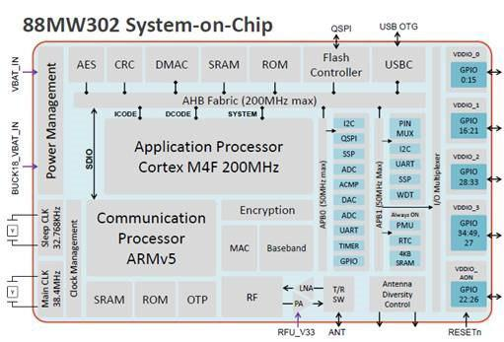
SoC’s
With miniaturization, most or all the computer subsystems can be placed on a single integrated circuit or “die” called a “system on a chip” or “SoC.”
The die pictured on the right is an example with an ARM CPU, MMU, cache, read only memory (ROM), several specialized processors like an AES accelerator which can encrypt data at high speed.
DRAM is usually on a separate chip as are I/O devices.
This processor also has “GPIO” pins which can be connected to external circuits and can be controlled by instructions from the CPU.
Most IoT devices consist of one or more “SoC’s.”
Integration of many devices (billions of transistors) is at the heart of the digital revolution. It’s amazing.

Slide 68
Electronics part 5, Hands on IoT
In this section you will learn to use a simple (and cheap) microcontroller. We will learn:
How to program them.
How to interface a wide variety of sensors, devices and transducers using GPIO pins.
How to communicate with it via the I/O busses (and monitor them).
We’ll do the same for the “Raspberry Pi,” a cheap, but full featured computer which shares the Arduino’s ability to use GPIO but runs a full OS and networking stack.
Arduino and Raspberry Pi represent typical IoT processors.
You will learn the nuts and bolt of connecting Arduino’s and Raspberry Pi with components using perf-boards and how to obtain all these components and design experiments with them.

Slide 69
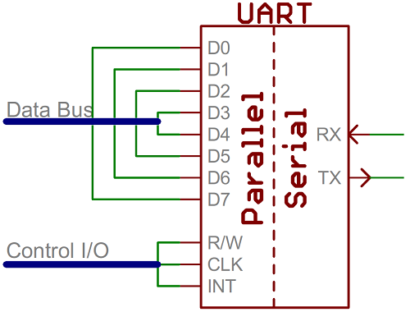
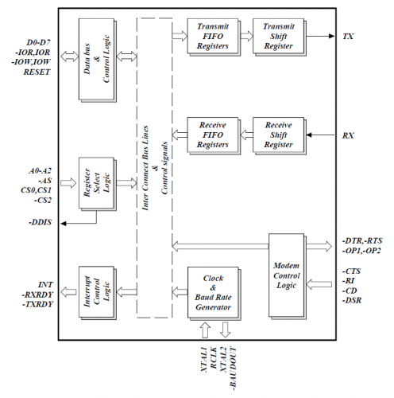
Serial Communication
We need a way to communicate between digital devices and perhaps the easiest method is via an asynchronous serial port.
Universal Asynchronous Receiver/Transmitters (UARTs) are integrated electronics packages (diagram lower right) that implement the serial protocol (next page).
The signals can be carried on a simple pair of wires.
You can interface a UART to a computer using a “badge”. I use an Attify Badge which can interface with UART, JTAG and SPI protocols. Another option is an FT232RL FTDI USB to TTL Serial Adapter Module for Arduino Mini Port. Well demonstrate this later.

Slide 70
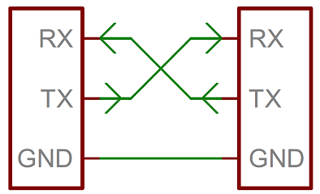
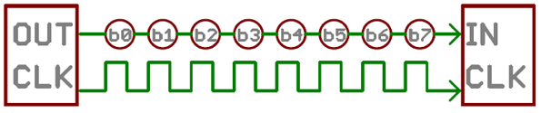
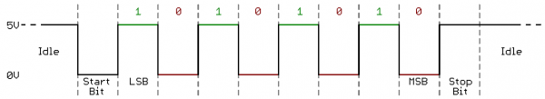
Serial Communication
The UART serial protocol allows two communicating endpoints wired together to send and receive sequentially transmitted digital data bits at speeds (baud rate) known in advance. Each end has a receive pin (RX) and a transmit pin (TX). Data is transmitted in frames consisting of:
Start bit (0), data, transmitted least significant bit (LSB) first, a parity bit and a stop bit (1).
The start bit is LOW telling the receiver that data is coming, then data bits are sent, after 9 bits TX goes HIGH marking the end. So 8 bits of data requires 10 bits transmit/received.
The most common version of this protocol is 9600N1: 9600 baud, no parity, 1 stop bit.

Slide 71
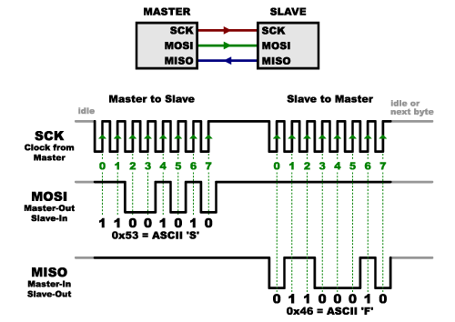
SPI
Serial protocols are faster and more reliable if accompanied with synchronizing clock signals.
A collection of signals shared by two or more endpoints is called a bus.
The first example of a bus is the SPI interface. An SPI bus has a single master device and several slave devices. It is full duplex (meaning the master both transmits and receives data).
The SPI bus signals are:
Master clock (SCLK)
Master output to slave input (MOSI)
Master input to slave output (MISO)
Slave select (SS). This pin on slave is pulled low to select a device)
See https://en.wikipedia.org/wiki/Serial_Peripheral_Interface

Slide 72
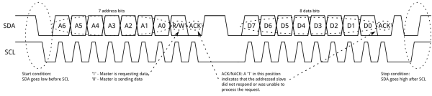
I²C
The I²C bus, like SPI, uses clock information but also allows multiple addressable devices on the same wire bus. The I2C bus consists of the following signals:
SCL
SDA
GND
The protocol is:
In the normal state SDA, SCL are high
To begin, the bus master pulls SCL high and SDA low (transition is start condition).
The master then sends the address of device (MSB first) being addressed and the R(1)/W(0) bit
The slave pulls SDA low to acknowledge (ACK).
The master or slave sends data (MSB, first)
The master generated stop condition by pushing SDA high with SCL high (transition from low to high is stop condition)

Slide 73
IoT Sensors and Arduino
Cameras and CCD’s
IMUs
Temp, humidity, infrared detectors
GPS
Radar, lidar
RF receivers, transmitters
Sound, vibration detection
Barometer (altimeter)

Slide 74

Arduino
The Arduino is a microcontroller development board. It costs about $15.
When the Arduino “wakes up,” it checks the serial connection for a program to be downloaded. If one is present, the Arduino downloads it. If there is no new program or the download is complete, it runs the last loaded program.
Arduino has about 30 “GPIO” pins you can connect to. Some are connected to analog to digital converters (ADC) and digital converters (DAC) so you can read and write analog signals. Some are digital pins you can connect to other digital devices.
Your program can read to write data to the I/O pins.
The heart of the Arduino is a simple microcontroller (e.g. - ATMega-328).
You can supply external power (5V) or it can be powered through the serial interface (3.3V).
There is a complete program development environment available here, as well as tons of sample code for use with sensors (see references).

Slide 75
Arduino
You can connect a lot of devices via the GPIO pins to the Arduino including programs that implement the asynchronous serial interface, SPI, and I2C, as well as digital sensors, memory, actuators like robot arms and radios.
We’ll demonstrate
Reading and writing analog signal
Reading and writing a read only memory (ROM) chip
Reading and writing an SD card
Reading sensor data from thermometers, gyros, accelerometers and infrared detectors
Connecting other devices is very similar.

Slide 76

ESP32
Another microcontroller is the ESP32, released in 2016.
This uses the Xtensa architecture
It has built in wifi and blue-tooth (the Arduino doesn’t).
The documentation is here.
You can use the Arduino IDE to program the ESP32 and the same sample code should work.

Slide 77
Information and Stuff
Here are some datasheets for the hardware and some software we’ll use:
ADXL345 Accelerometer Datasheet
L3G4200D Gyroscope Datasheet
MC5883L Magnetometer Datasheet
DHT Datasheet
Ping sensor Datasheet
MPU-6050 Datasheet
Barometer (BMP-280) Datasheet
I2C EEPROM Datasheet
GPS module Datasheet
24AA515 EEPROM Datasheet
Microchip 93c66b EEProm Datasheet
You will need to get the DHT library and the Arduino development environment.
You can buy all the hardware (including Arduino) at Sparkfun or on Amazon.
You can buy kits with Arduinos, wires and discrete components and lots of sensors from Egloo, Sparkfun and lots of other places. A basic kit is about $50.

Slide 78
Raspberry Pi
Raspberry Pi computers come with a full CPU, an ARM microprocessor, (not just a microcontroller) and have memory and I/O ports (USB, Ethernet).
It runs a standard operating system like Linux.
Chromebooks are built using these sort of ARM chips.
ARM processors can be 16, 32 or 64 bit and can run fairly powerful software.
The Pi’s also have the GPIO pins just like an Arduino does.
It costs about $35.
Its an amazing amount of technology for so little money.
You can do all the projects we do with the Arduino on a Raspberry Pi and send data over a local network or “log on” via a console interface directly.
You can buy them at the same places you buy Arduinos.

Slide 79

Raspberry Pi

Slide 80

Raspberry Pi GPIO pins
PWM (pulse-width modulation)
Software PWM available on all pins
Hardware PWM available on GPIO12, GPIO13, GPIO18, GPIO19
SPI
SPI0: MOSI (GPIO10); MISO (GPIO9); SCLK (GPIO11); CE0 (GPIO8), CE1 (GPIO7)
SPI1: MOSI (GPIO20); MISO (GPIO19); SCLK (GPIO21); CE0 (GPIO18); CE1 (GPIO17); CE2 (GPIO16)
I2C
Data: (GPIO2); Clock (GPIO3)
EEPROM Data: (GPIO0); EEPROM Clock (GPIO1)
Serial
TX (GPIO14); RX (GPIO15)
Pin 2
Pin 4
Pin 1
Pin 3

Slide 81

Raspberry Pi 3 pins
There are three different numbering schemes for:
The pin ordering on the J8 header
The pin number used by wiringPi (which we use)
The BCM (GPIO HW interface) from Broadcom
Note: even numbered header pins are near edge of Raspberry Pi.

Slide 82
Raspberry Pi
Unlike the Arduino, we need to install an OS (Linux) on the Raspberry Pi to use it. Once you do, you can develop, compile and run the IoT programs on the device.
You’ll load the OS and other files on a FAT-32 formatted SD card with at least 4 GB of capacity (I use 32 GB). Download the installer zip file at http://raspberrypi.org/downloads. Unzip it onto the SD card. You should notice the file bootloader.bin on the SD card. Plug the SD card into the pi and boot.
Many of the Raspberry pi sensor examples are in python. For C++ examples, see here, here, here, here (accelerometers, gyros, compasses) and here. We use WiringPi almost exclusively to program GPIO pins. WiringPi supports SPI and I²C interfaces; it is here and is pre-installed on newer Raspberry Pi OS images. Read the reference!
Unlike the Arduino, Raspberry Pi GPIO pins do not natively support analog signals. I use the Adafruit MCP4725 Breakout Board - 12-Bit DAC w/I2C Interface [ADA935] and the Microchip MCP3008-I/P 10-Bit ADC with SPI to interface analog connections.

Slide 83
Labs
Most of the rest of this section is lab exercises to get you used to IoT wiring and programing. We do some circuits and connect and program a number of sensors to Arduino’s, Raspberry Pi’s and in one case, directly to the USB port of a Linux machine. There’s a partial list below. You should do as many of these as you can. Here, “A” means Arduino, “R” means Raspberry Pi and “L” means linux desktop.
Goal | Parts | Device
Simple GPIO IF | LED, resistors | A, R
Analog interface | Variable resistor PCF8591 for R | A, R
Ultrasonic measurement | HC-SR04 | A, R
Digital temperature | DHT-11 | A, R
Digital acceleration/gyro | MPU-6050 | A, R
Read/write EEprom | 24FC515 | A, R
UART | FDTI1232 for linux | A, R
Digital GPS | ATGM336H-5N | A, R, L
Segment display, encoder | SN595 SR | A
Keypad interface |  | A
Goal | Parts | Device
SPI interfacing |  | R
TFT(screen) | ILI9341 240X320 | A
Digital pressure | BMP-180/280 | A, R
Magnetic field | Hall sensor | A, R
Vibration, tilt |  | A, R
LCD (direct and I2C) | LCD-1602 | A, R
RFID | RC522 rfid card | A
Stepper |  | A
Infrared |  | A
Radio | HC-12 | A, RP

Slide 84
Lab: turn on an LED
Wire the ground of the Arduino to.
The code is in the appendix.
680𝞨
5V
1K𝞨
A0
Gnd
Arduino

Slide 85
Arduino code for LED
// turn LED on and off
// Manferdelli
const int switchPin= 4;
const int oscDelay= 500;
const int analogOn= 255;
const int analogOff= 0;
void setup() {
pinMode(switchPin, OUTPUT);
}
void loop() {
for(;;) {
analogWrite(switchPin, analogOff);
delay(oscDelay);
analogWrite(switchPin, analogOn);
delay(oscDelay);
}
}

Slide 86
Raspberry Pi code for LED
#include <stdio.h>
#include <stdint.h>
#include <wiringPi.h>
#include <wiringPiI2C.h>
// turn LED on and off
// Manferdelli
const int switchPin = 0;
const int measurementDelay = 500;
const int loopCount = 250;
int main(int an, char** av) {
wiringPiSetup ();
pinMode (switchPin, OUTPUT);
for (int i = 0; i < loopCount; i++) {
digitalWrite(switchPin, HIGH);
delay(measurementDelay);
digitalWrite(switchPin, LOW);
delay(measurementDelay);
}
return 0;
}
5V, header pin 2
680𝞨
1K𝞨
GPIO0, HDR pin 11
Gnd, HDR pin 6
Raspberry Pi

Slide 87
Lab: Measure voltage output
Suppose you have a voltage output from a device that is proportional to some physical quantity (like the speed of a motor) between 0 and 5V, sampling the value on the pins of the Arduino lets you display or use that value in a control system.
Let’s simulate such source using the circuit on the right, varying the resistance will change data values. Wire the ground of the Arduino to the circuit as indicated.
The code is in the appendix.
Output (varying potentiometer)
ADC value:955, Voltage:4.67
ADC value:1021, Voltage:4.99
ADC value:988, Voltage:4.83
ADC value:876, Voltage:4.28
ADC value:726, Voltage:3.55
ADC value:638, Voltage:3.12
ADC value:596, Voltage:2.91
ADC value:457, Voltage:2.23
ADC value:357, Voltage:1.74
5V
A0
10K𝛺
Gnd
Arduino

Slide 88
Arduino code for voltage measurement
// Measure analog level
// Manferdelli
const int inputPin= A0;
const int pinDelay= 500;
const double maxVoltage= 5.0;
const double maxRange= (double)1024;
void setup() {
pinMode(inputPin, INPUT);
Serial.begin(9600);
Serial.print("Maximum voltage: ");
Serial.print(maxVoltage);
Serial.print(", Maximum range: ");
Serial.print(maxRange);
Serial.println("");
}
void loop() {
int x;
double y;
for(;;) {
delay(pinDelay);
x= analogRead(inputPin);
y= maxVoltage * ((double)x)/maxRange;
Serial.print("Voltage: ");
Serial.print(y);
Serial.println("");
}
}

Slide 89
Voltage measurement on Raspberry Pi
The Raspberry Pi does not have analog pins. You must use an ADC/DAC to get analog values.
We will use a popular ADC/DAC called the PCF8591 which has an I2C interface.
We use the wiringPiI2C library to interface to I2C.
The code is the same for all analog interfacing.
Note: You must enable the Raspberry Pi I2C kernel module or it won’t work. To do this, run raspi-config and use the interfacing option.
The connection to the PCF8591 are:
PCF RP
1(ain0) analog-signal
5, 6, 7, 8 gnd (pin 6)
16 3.3 (pin 1)
14 3.3v
13 gnd
12 gnd
10(scl) rp pin 5 (scl)
9(sda) rp pin 3 (sda)

Slide 90
PCF8591 pinout and connections
The PCF8591 which employs a I2C interface to the Raspberry Pi.
Pin 1 – Ain₀
Pin 2 – Ain₁
Pin 3 – Ain₂
Pin 4 - Ain₃
Pin 5 – A₀
Pin 6 – A₁
Pin 7 – A₂
Pin 8 - V_{SS}
Pin 16 - V_{DD}
Pin 15 - A_{out}
Pin 14 - V_{REF}
Pin 13 - A_{GND}
Pin 12 - EXT
Pin 11 - OSC
Pin 10 - SCL
Pin 9 – SDA
Raspberry Pi connections
SDA (PCF8591) → SDA
SCL → SCL
3.3V → V_{CC}
GND → GND
Ain0 → measured quantity
Ground A₀, A₁, A₂, V_{SS}
Aout → through diode and 1K resistor
AGND, EXT → GND
Use SCL to SDA through pull-up (10K)

Slide 91
Voltage measurement on Raspberry Pi
// Manferdelli
// Raspberry Pi analog read
#include <stdio.h>
#include <wiringPi.h>
#include <pcf8591.h>
const int base = 120;
const int i2c_address = 0x48;
int main(int an, char** av) {
int v = 0;
if (wiringPiSetup() < 0) {
printf("Can't initialize wiringPi\n");
return 1;
}
pcf8591Setup(base, i2c_address);
for(;;) {
v = analogRead(base);
delay(10);
printf("Voltage: %d\n", v);
}
return 0;
}
3.3 V, HDR pin 1
Vcc
Ain0
10K𝛺
SCL, HDR pin 5
SCL
SDA, HDR pin 3
SDA
Gnd, HDR pin 6
Gnd
Raspberry Pi
PCF8591

Slide 92

Lab: Measure Distance
Wire the the Arduino to the “ping” sensor (HC-SR04) as indicated.
The Ping sensor only works up to about 1 meter.
The code is in the appendix. The output below was obtained moving an object at varying distances from the sensor. Distance is in cm.
7
6
10
15
21
26
30
31
24
33
10
9
5
14
22
25
30
33
36
38
24
13
5
3
4
3
108
107
5V
5V
Vcc
D8
Trig
D7
Echo
Gnd
Gnd
Arduino
Ping

Slide 93
Arduino code for measure distance
// Measure distance with ping sensor
// Manferdelli
const int triggerPin= 8;
const int echoPin= 7;
const int measurementDelay= 500;
const int pingDelay= 5;
const double temp = 20; // C
const double soundSpeed = 331.5 + .6 * temp; // m/s
void setup() {
Serial.begin(9600);
Serial.println("Ping sensor test");
pinMode(triggerPin, OUTPUT);
pinMode(echoPin, INPUT);
}
// pulseIn reads a pulse (either HIGH or LOW) on a pin. If value is HIGH,
// pulseIn() waits for the pin to go from LOW to HIGH to starts timing,
// it then waits for the pin to go LOW and stops timing.
// Returns the length of the pulse in microseconds.

Slide 94
Arduino code for measure distance
void measure_distance() {
digitalWrite(triggerPin, LOW);
delayMicroseconds(3);
digitalWrite(triggerPin, HIGH);
delayMicroseconds(5);
digitalWrite(triggerPin, LOW);
double return_time_microsecs = pulseIn(echoPin, HIGH);
double one_way_return_time = return_time_microsecs / 2e6;
double d = soundSpeed * one_way_return_time * 100.0; // cm
Serial.print("Measured distance (cm): ");
Serial.println(d);
}
void loop() {
for(;;) {
delay(measurementDelay);
measure_distance();
}
}

Slide 95
Ping sensor and raspberry pi
Use gpio 7 (pin 7) and gpio 27 (pin 36).
Wiring below. Sensor pins are vcc, trigger, echo gnd (left to right from front)
5.0 V, HDR pin 2
Vcc
GPIO7, HDR pin 7
Trig
Vcc
GPIO27, HDR pin 36
Echo
trigger
Gnd, HDR pin 6
echo
Gnd
Raspberry Pi
Ping Sensor
gnd

Slide 96
RP code for measure distance
// Manferdelli
// Raspberry Pi, ping sensor
#include <stdio.h>
#include <stdlib.h>
#include <stdint.h>
#include <wiringPi.h>
#ifndef byte
typedef unsigned char byte;
#endif
// Connections
// Ping RP
// trigger gpio 7 (pin 7)
// echo gpio 27 (pin 36)
// vcc 5v
// gnd gnd
// I had to use a scope to check,
// RP pin numbering is mysterious.
// Look at the ifdef'd code below
// to see it.
const int trigger_pin = 7;
const int echo_pin = 27;
const int max_distance = 500; // cm
long unsigned time_out_period;
const double sound_speed = 340.0; // speed sound(m/s)
long pulseIn(int pin, int value, int time_out) {
pinMode(echo_pin, INPUT);
long unsigned start = micros();
while(digitalRead(pin) != value) {
if ((micros() - start) > time_out_period)
return 0;
}
long unsigned set = micros();
while(digitalRead(pin) == value) {
if ((micros() - set) > time_out_period)
return 0;
}
long unsigned end = micros();
printf("pulseIn, end: %d, start: %d\n",
end, start);
return end - set;
}

Slide 97
RP code for measure distance
double getDistance() {
#if 1
pinMode(trigger_pin, OUTPUT);
pinMode(echo_pin, OUTPUT);
digitalWrite(trigger_pin, LOW);
delayMicroseconds(5);
digitalWrite(trigger_pin, HIGH);
delayMicroseconds(10);
digitalWrite(trigger_pin, LOW);
#else
// Find pins
pinMode(trigger_pin, OUTPUT);
pinMode(echo_pin, OUTPUT);
for(;;) {
digitalWrite(trigger_pin, LOW);
delayMicroseconds(1000);
digitalWrite(trigger_pin, HIGH);
delayMicroseconds(1000);
digitalWrite(echo_pin, LOW);
delayMicroseconds(1000);
digitalWrite(echo_pin, HIGH);
delayMicroseconds(1000);
}
#endif
long unsigned ping_time = pulseIn(echo_pin, HIGH,
time_out_period);
double d = (((double)ping_time) * sound_speed) / 20000.0;
return d;
}
int main(int an, char** av) {
if (wiringPiSetup() < 0) {
printf("Can't initialize Wiring Pi\n");
return 1;
}
time_out_period = ((max_distance*20000)/sound_speed)+1;
double d;
for(;;) {
d = getDistance();
printf("Target distance is %8.2lf cm\n", d);
delay(1000);
}
return 0;
}

Slide 98

Lab: Measure Temperature
Wire the Arduino as shown to the DHT-11 sensor.
The code is in the appendix. Output taken in my apartment. I guess I need to turn up the heat.
Output
Humidity: 20%
Temperature: 17C
Temperature: 62.60F
Humidity: 20%
Temperature: 17C
Temperature: 62.60F
Freenove
5V
Vcc
1K
D7
Signal
not used
Gnd
Gnd
Arduino
DHT-11
Vcc
Sig
Gnd

Slide 99
Arduino code for measure temperature
// Measure temperature and humidity with DHT-11
// Manferdelli
const int dataPin= 8;
const int measurementDelay= 500;
typedef uint8_t byte;
void setup() {
Serial.begin(9600);
}
void clear_buf(byte* p, int size) {
for (int i = 0; i < size; i++)
p[i] = 0;
}
const int initReadDelay = 18;
void start_measurement() {
pinMode(dataPin, OUTPUT);
digitalWrite(dataPin, LOW);
delay(initReadDelay);
digitalWrite(dataPin, HIGH);
}

Slide 100
Arduino code for measure temperature
const int packetSize = 40; // bits
const int pulseOneLength = 40; // pulse length to be 1
const int pulseDelay= 18;
int measure_th(int* t, int* h) {
byte buf[8];
clear_buf(buf, 8);
byte byte_index = 0;
byte bit_cnt = 7;
pinMode(dataPin, INPUT);
delayMicroseconds(pulseDelay);
pulseIn(dataPin, HIGH);
// Collect each data bit
int time_out = 10000;
for (int i = 0; i < packetSize; i++) {
while (digitalRead(dataPin) == LOW) {
if (time_out-- <= 0)
return -1;
}
time_out = 10000;
unsigned long t = micros();

Slide 101
Arduino code for measure temperature
while (digitalRead(dataPin) == HIGH) {
if (time_out-- <= 0)
return -1;
}
if ((micros() - t) > pulseOneLength) {
buf[byte_index] |= 1 << bit_cnt;
}
if (bit_cnt == 0) {
byte_index++; // next byte
bit_cnt = 7; // MSB
} else {
bit_cnt--;
}
}
*t = buf[2];
*h = buf[0];
if ((buf[0] + buf[2]) != buf[4])
return -1;
return 0;
}

Slide 102
Arduino code for measure temperature
void read_dht11(int* t, int* h) {
start_measurement();
if (measure_th(t, h) < 0) {
*t = 0.0;
*h= 0.0;
return;
}
}
void loop() {
int temperature, humidity;
for(;;) {
delay(measurementDelay);
read_dht11(&temperature, &humidity);
Serial.print("Temp (C): ");
Serial.print(temperature);
Serial.print(", Temp (F): ");
double temp_F = ((double) temperature) * 9.0 / 5.0 + 32.0;
Serial.print(temp_F);
Serial.print(", Humidity (%): ");
Serial.print(humidity);
Serial.println("");
}
}

Slide 103
Raspberry Pi code for measure temperature
// Manferdelli
// Raspberry Pi interface to dht11
#include <stdio.h>
#include <stdlib.h>
#include <stdint.h>
#include <wiringPi.h>
#ifndef byte
typedef unsigned char byte;
#endif
void clearBuf(byte* buf, int n) {
for (int i = 0; i < n; i++) {
buf[i] = 0;
}
}
void printBuf(byte* in, int n) {
for (int i = 0; i < n; i++) {
printf(" %02x", in[i]);
if ((i % 16) == 15) {
printf("\n");
}
}
printf("\n");
}
5.0 V, HDR pin 2
Vcc
1K
Vcc
GPIO7, HDR pin 7
DHT, sig
trigger
Gnd, HDR pin 6
echo
Gnd
Raspberry Pi
DHT-11
gnd

Slide 104
Raspberry Pi code for measure temperature
const int dht_pin = 7;
const int timingDelay = 18;
const int messageDelay = 2000;
const int max_timings = 90;
const int bits_to_read = 40;
#define DATA_BUF_SIZE 10
class temp_sensor {
public:
double h_;
double c_;
double f_;
};
bool get_dht_data(byte* data, int size, temp_sensor* r) {
if (size < 5)
return false;
byte last_state = HIGH;
int counter = 0;
int i = 0;
int j = 0;
pinMode(dht_pin, OUTPUT);
digitalWrite(dht_pin, LOW);
delay(timingDelay);
pinMode(dht_pin, INPUT);

Slide 105
Raspberry Pi code for measure temperature
// Detect change
for (i = 0; i < max_timings; i++) {
counter = 0;
while(digitalRead(dht_pin) == last_state) {
counter++;
delayMicroseconds(1);
if (counter == 255)
break;
}
last_state = digitalRead(dht_pin);
// ignore first 3 transitions
if (i>=4 && (i%2)==0) {
data[j/8] <<= 1;
if (counter > 16)
data[j/8] |= 1;
j++;
}
}
// Make sure we read 40 bits and verify checksum
if (j < bits_to_read)
return false;
byte check_sum = data[0] + data[1] + data[2] + data[3];
if (check_sum != data[4])
return false;

Slide 106
Raspberry Pi code for measure temperature
// Make sure we read 40 bits and verify checksum
if (j < bits_to_read)
return false;
byte check_sum = data[0] + data[1] + data[2] + data[3];
if (check_sum != data[4])
return false;
// calculate readings
int t;
// humidity
t = data[0];
t <<= 8;
t += data[1];
r->h_ = ((double)t)/10.0;
if (r->h_ > 100.0)
r->h_ = ((double)data[0]);

Slide 107
Raspberry Pi code for measure temperature
// temperature
t = data[2] & 0x7f;
t <<= 8;
t += data[3];
r->c_ = ((double)t) / 10.0;
if (r->c_ > 125)
r->c_ = ((double) data[2]);
if (data[2] & 0x80)
r->c_ = -r->c_;
r->f_ = 1.8 * r->c_ + 32.0;
return true;
}
// Program needs to be run as su
int main(int an, char** av) {
if (wiringPiSetup() < 0) {
printf("Can't initialize wiringPi\n");
return 1;
}
temp_sensor r;
byte data[DATA_BUF_SIZE];
for(;;) {
clearBuf(data, DATA_BUF_SIZE);
if (get_dht_data(data, DATA_BUF_SIZE,&r))
printf("Humidity: %7.3lf, Temperature: %7.3lf (C), %7.3lf (F)\n",
r.h, r.c, r.f);
delay(messageDelay);
}
return 0;
}

Slide 108
Lab: Measure Acceleration and angular velocity MPU-6050
The MPU-6050 is gyro, accelerometer and temperature sensor. Wire the Arduino as shown.
Here is sample output:
A.009g, 0.060g)
Temperature (C): 21.54
Gyro: x,y,z (12.49 deg/s, -0.53 deg/s, -4.Accelerometer: x,y,z (1.027g, 0.238g, -0.080g)
Temperature (C): 21.68
Gyro: x,y,z (-213.01 deg/s, 3.59 deg/s, -4.07 deg/s)
Accelerometer: x,y,z (-0.387g, 0.137g, -0.962g)
Temperature (C): 21.68
Gyro: x,y,z (50.60 deg/s, 147.03 deg/s, 2.34 deg/s)
Accelerometer: x,y,z (0.718g, -0.308g, -0.134g)
Temperature (C): 21.78
SparkFun
5V
Vcc
A4
SDA
A5
SCL
D2
Int
Gnd
Gnd
Arduino
MPU-6050

Slide 109
Output continued
Gyro: x,y,z (25.02 deg/s, 33.97 deg/s, -250.14 deg/s)
Accelerometer: x,y,z (0.193g, 0.934g, -0.269g)
Temperature (C): 21.78
Gyro: x,y,z (4.58 deg/s, -10.77 deg/s, -6.54 deg/s)
Accelerometer: x,y,z (0.997g, 0.022g, -0.366g)
Temperature (C): 21.87
Gyro: x,y,z (21.85 deg/s, 86.79 deg/s, 64.41 deg/s)
Accelerometer: x,y,z (0.533g, -0.249g, -0.236g)
Temperature (C): 21.78
Gyro: x,y,z (11.31 deg/s, -109.04 deg/s, 63.29 deg/s)
Accelerometer: x,y,z (0.423g, -0.120g, -0.271g)
Temperature (C): 21.87
Gyro: x,y,z (14.21 deg/s, 41.51 deg/s, -42.22 deg/s)
Accelerometer: x,y,z (1.027g, 0.016g, 0.061g)
Temperature (C): 21.78
Gyro: x,y,z (12.65 deg/s, -0.35 deg/s, -4.89 deg/s)
Accelerometer: x,y,z (1.022g, 0.016g, 0.066g)
Temperature (C): 21.82
Gyro: x,y,z (12.54 deg/s, -0.21 deg/s, -4.98 deg/s)
Accelerometer: x,y,z (1.028g, 0.011g, 0.065g)
Temperature (C): 21.78
Gyro: x,y,z (12.67 deg/s, -0.40 deg/s, -4.97 deg/s)
Accelerometer: x,y,z (1.023g, 0.015g, 0.061g)
Temperature (C): 21.92

Slide 110
Arduino code for measure acceleration
// Read accelerometer (MPU-6050)
// Manferdelli
#include <Wire.h>
typedef uint8_t byte;
const byte i2c_address= 0x68;
const byte sleep_mgmt= 0x6b;
const byte acc_x_out= 0x3b;
const int zero_pt= -512 - (340 * 35);
const double acc_normalizer= 16384.0;
const double gyro_normalizer= 131.0;
const double temp_normalizer= 340.0;
const int measurementDelay= 750;
//
// SDL --> A5
// SDA --> A4
// int --> D2

Slide 111
Arduino code for measure acceleration
typedef uint8_t byte;
struct pdu {
int16_t x_acc;
int16_t y_acc;
int16_t z_acc;
int16_t temp;
int16_t x_gyro;
int16_t y_gyro;
int16_t z_gyro;
};
void setup() {
Serial.begin(9600);
Wire.begin();
write_i2c(sleep_mgmt, 0x00);
}
int16_t swap_bytes(int16_t in) {
return ((in << 8) & 0xff00) | ((in >> 8) & 0x00ff);
}

Slide 112
Arduino code for measure acceleration
int read_i2c(byte r, byte* buf, int size) {
Wire.beginTransmission(i2c_address);
Wire.write(r);
Wire.endTransmission(false);
Wire.requestFrom(i2c_address, size, true);
int i= 0;
while (Wire.available() && i < size) {
buf[i++]= Wire.read();
}
return i;
}
void write_i2c(byte r, byte d) {
Wire.beginTransmission(i2c_address);
Wire.write(r);
Wire.write(d);
Wire.endTransmission(true);
}

Slide 113
Arduino code for measure acceleration
void loop() {
pdu p_out;
read_i2c(acc_x_out, (byte*)&p_out, sizeof(pdu));
p_out.x_acc= swap_bytes(p_out.x_acc);
p_out.y_acc= swap_bytes(p_out.y_acc);
p_out.z_acc= swap_bytes(p_out.z_acc);
p_out.temp= swap_bytes(p_out.temp);
p_out.x_gyro= swap_bytes(p_out.x_gyro);
p_out.y_gyro= swap_bytes(p_out.x_gyro);
p_out.z_gyro= swap_bytes(p_out.x_gyro);
double acc_x= ((double)p_out.x_acc) / acc_normalizer;
double acc_y= ((double)p_out.y_acc) / acc_normalizer;
double acc_z= ((double)p_out.z_acc) / acc_normalizer;
double t= (p_out.temp - zero_pt) / temp_normalizer;
double gyro_x= ((double)p_out.x_gyro) / gyro_normalizer;
double gyro_y= ((double)p_out.y_gyro) / gyro_normalizer;
double gyro_z= ((double)p_out.z_gyro) / gyro_normalizer;

Slide 114
Arduino code for measure acceleration
Serial.println("");
Serial.println("-----------------------------");
Serial.print("Acceleration (g): (");
Serial.print(acc_x);
Serial.print(", ");
Serial.print(acc_y);
Serial.print(", ");
Serial.print(acc_z);
Serial.println(")");
Serial.print("Temperature (C): ");
Serial.print(t);
Serial.println("");
Serial.print("Gyro (deg/sec): (");
Serial.print(gyro_x);
Serial.print(", ");
Serial.print(gyro_y);
Serial.print(", ");
Serial.print(gyro_z);
Serial.println(")");
Serial.println("-----------------------------");
Serial.println("");
delay(measurementDelay);
}

Slide 115
Raspberry Pi code for measure acceleration
// Manferdelli
// Raspberry Pi, mpu-6050
#include <stdio.h>
#include <stdlib.h>
#include <stdint.h>
#include <math.h>
#include <wiringPi.h>
#include <wiringPiI2C.h>
#ifndef byte
typedef unsigned char byte;
#endif
const byte i2c_address = 0x68;
const byte x_address= 0x3b;
const byte y_address = 0x3d;
const byte z_address = 0x3f;
const double pi = 3.1415926535;
5.0 V, HDR pin 2
Vcc
Vcc
SDA, HDR pin 3
SDA
trigger
SCL, HDR pin 5
SCL
Gnd, HDR 6
echo
Gnd
Raspberry Pi
MPU-6050
gnd

Slide 116
Raspberry Pi code for measure acceleration
// Connection scheme
// RP 6050
// Gnd(HDR 6) Gnd
// scl(HDR 5) scl
// 5v (HDR 1) Vcc
// sda(HDR 3) sda
Int read_int(int fd, byte address) {
int r = 0;
int v = 0;
v = wiringPiI2CReadReg8(fd, address);
v <<= 8;
v |= wiringPiI2CReadReg8(fd, address + 1);
if (v &0x8000)
v = -(65536 – v);
return v;
}
Double dist(double a, double b) {
return sqrt(a * a + b * b);
}

Slide 117
Raspberry Pi code for measure acceleration
double get_x_rotation(double x, double y, double z) {
double s = dist(x, z);
if (s == 0.0) {
if (y < 0.0)
return -90.0;
return 90.0;
}
double r = atan(y / s);
return -(r * 180.0 / pi);
}
double get_y_rotation(double x, double y, double z) {
double s = dist(y, z);
if (s == 0.0) {
if (x < 0.0)
return -90.0;
return 90.0;
}
double r = atan(x / s);
return -(r * 180.0 / pi);
}

Slide 118
Raspberry Pi code for measure acceleration
int main(int an, char** av) {
int fd = wiringPiI2CSetup(i2c_address);
if (fd < 0) {
printf("Can't initialize Wiring Pi\n");
return 1;
}
wiringPiI2CWriteReg8(fd, 0x6b, 0); // disable sleep
int a_x, a_y, a_z;
double scaled_x, scaled_y, scaled_z;
double rot_x, rot_y;
for(;;) {
a_x = read_int(fd, x_address);
a_y = read_int(fd, y_address);
a_z = read_int(fd, z_address);
scaled_x = ((double)a_x) / 16384.0;
scaled_y = ((double)a_y) / 16384.0;
scaled_z = ((double)a_z) / 16384.0;
rot_x = get_x_rotation(scaled_x, scaled_y, scaled_z);
rot_y = get_y_rotation(scaled_x, scaled_y, scaled_z);
printf("Scaled acceleration: (%07.2f, %07.2f, %07.2f), x-y rotation: (%07.2f, %07.2f)\n",
scaled_x, scaled_y, scaled_z, rot_x, rot_y);
delay(1000);
}
return 0;
}

Slide 119
Lab: Read/write an EEPROM
The 24FC515 EEProm communicates over I²C .
Wire the Arduino to the eeprom as indicated.
The code follows.
5V
Vcc (8)
A4
SDA (5)
A5
SCL (6)
A2 (3)
A0 (1)
A1 (2)
WP (7)
Gnd
Gnd (4)
24FC515 EEPROM
Arduino

Slide 120
Arduino code for EEprom
// eeprom read/write
// Manferdelli
#include <Wire.h>
typedef uint8_t byte;
const int measurementDelay= 500;
const int initial_clock_setting= 400000;
const uint32_t maxMillis= 2000;
#define MAX_BYTES 64
// Theoretically, the 24LC256 has a 64-byte page write buffer but
// we'll write 16 at a time.
#define MAX_I2C_WRITE 16
// This address is determined by the way your address pins are wired.
// In the diagram from earlier, we connected A0 and A1 to Ground and
// A2 to 5V. To get the address, we start with the control code from
// the datasheet (1010) and add the logic state for each address pin
// in the order A2, A1, A0 (100) which gives us 0b1010100, or in
// Hexadecimal, 0x54.
const byte eeprom_address= 0x54;

Slide 121
Arduino code for EEprom
// Read
byte readEEProm(uint32_t address) {
Wire.beginTransmission(eeprom_address);
Wire.write((int) (address >> 8)); // MSB
Wire.write((int) (address & 0xff)); // LSB
Wire.endTransmission();
Wire.requestFrom(eeprom_address, 1);
byte r = 0xff;
if (Wire.available())
r= Wire.read();
return r;
}
// Write
void writeEEProm(uint32_t address, byte* data, int size) {
Wire.beginTransmission(eeprom_address);
Wire.write((int) (address >> 8)); // MSB
Wire.write((int) (address & 0xff)); // LSB
for (byte b = 0; b < size; b++)
Wire.write(data[b]);
Wire.endTransmission();
}

Slide 122
Arduino code for EEprom
void printHexByte(byte b) {
if (b < 16)
Serial.print("0");
Serial.print(b, HEX);
}
int readStream(byte* buf, int max) {
int num_bytes = 0;
for(;;) {
while(Serial.available()) {
if (num_bytes >= max)
return num_bytes;
}
buf[num_bytes++] = Serial.read();
}
return num_bytes;
}
int initBuf(byte* buf, int max) {
int i = 0;
for (i = 0; i < 64; i++)
buf[i] = (byte) (i + 16);
return i;
}

Slide 123
Arduino code for EEprom
void printBytes(byte* buf, int n) {
for (int i = 0; i < n; i++) {
printHexByte(buf[i]);
Serial.print(" ");
if ((i%16) ==15)
Serial.println("");
}
}
uint32_t end_address= 0x40; //0x7d00;
void setup() {
Serial.begin(9600);
Wire.begin();
Wire.setClock(initial_clock_setting);
byte to_write[MAX_BYTES];
int current = 0;
int num_bytes= initBuf(to_write, MAX_BYTES);
int num_left= num_bytes;
int n;
Serial.println("Bytes accepted:");
printBytes(to_write, num_bytes);
Serial.println("");

Slide 124
Arduino code for EEprom
while(num_left > 0) {
if (num_left >= MAX_I2C_WRITE)
n = MAX_I2C_WRITE;
else
n = num_left;
writeEEProm(current, &to_write[current], n);
num_left -= n;
current += n;
}
Serial.println("Bytes written");
Serial.println("");
// Read bytes to end_address
Serial.println("Bytes read:");
byte v;
for (uint32_t a = 0; a < end_address; a++) {
v= readEEProm(a);
printHexByte(v);
if ((a%16) ==15)
Serial.println("");
}
}
void loop() {
}

Slide 125
EEprom Raspberry pi
We could simulate the I2C interface as we did with the Arduino but the Raspberry Pi has some utilities you can use instead.
I2cdetect – detects I2C devices connected to the RP
I2cdump – reads I2C registers
I2cget – reads specific I2C registers
I2cset – sets specific I2C registers
If you wire the 24FC515 just as in the Arduino case but with Vcc to RP 3.3 (pin 1), gnd to RP gnd (pin 6), sda to RP sda (pin 3) and scl to RP scl (pin 5), for example, the following command will read out the ROM. Try it on a ROM you’ve initialized with the Arduino.
i2cdump "bcm2835 I2C adapter" 0x54

Slide 126

Lab: GPS
The ATGM336H-5N GNSS module receives GPS signals and communicates through a UART interface.
GPS code follows. The GPS module communicates over a simple serial line implemented by SoftwareSerial in the Arduino libraries.
The module uses the “NEMA message format” that reports UTC time, latitude, and longitude.
A NEMA message report for Boston is (42.361732,N,071.090595,W)is:
$GNRMC,005536.000,A,4236.1732,N,07109.0595,W,0.00,0.00,230218,,,A*68
3.3V
Vcc
A3
RX
A5
TX
Gnd
Gnd (4)
Arduino
ATGM336H
126

Slide 127
Arduino code for GPS
// GPS
// Manferdelli
#include <SoftwareSerial.h>
#include <Adafruit_GPS.h>
#ifndef byte
typedef uint8_t byte;
#endif
const int gpsReceivePin= 3;
const int gpsTransmitPin= 5;
const int messageDelay= 500;
// Note: GPS transmit pin is SoftwareSerial receive pin and vice-versa
SoftwareSerial serialGPS = SoftwareSerial(gpsTransmitPin, gpsReceivePin);
Adafruit_GPS GPS(&serialGPS);
void setup() {
Serial.begin(9600);
GPS.begin(9600);
GPS.sendCommand(PMTK_SET_NMEA_OUTPUT_RMCGGA);
GPS.sendCommand(PMTK_SET_NMEA_UPDATE_1HZ);
GPS.sendCommand(PGCMD_ANTENNA);
}

Slide 128
Arduino code for GPS
void printTwoDigitInt(int x) {
if (x < 10)
Serial.print("0");
Serial.print(x);
}
void printTwoDigitDouble(double x) {
if (x < 10.0)
Serial.print("0");
Serial.print(x);
}
struct gpm_msg_values {
int hour_;
int min_;
double seconds_;
double degrees_lat_;
double degrees_long_;
int num_sats_;
};
// s: string to match, t: message string
char* strmatch(const char* s, char* t) {
for (;;) {
if (*s == 0 || *t == 0)
return NULL;
if (*s != *t)
return NULL;
s++; t++;
if (*s == 0)
return t;
}
}
char* find_string_in_msg(const char* str, char* msg) {
int l = strlen(msg);
char* s = NULL;
for (int i = 0; i < l; i++) {
s = strmatch(str, &msg[i]);
if (s != NULL)
return s;
}
return NULL;
}

Slide 129
Arduino code for GPS
// NMEA message format
// $GNGGA,HHMMSS.SSS,DDMM.MMMM,N/S,DDDMM.MMMM,E/W,n,NS...A*20
bool parseNMEAMessage(char* msg, struct gpm_msg_values* v) {
char* time_string = find_string_in_msg("$GNGGA,", msg);
if (time_string == NULL)
return false;
sscanf(time_string, "%02d%02d", &v->hour_, &v->min_);
sscanf(time_string+4, "%f", &v->seconds_);
char* latitude_string = find_string_in_msg(",", time_string);
if (latitude_string == NULL)
return false;
int deglat;
int mlat;
int minlat;
sscanf(latitude_string, "%02d%02d.%04d", &deglat, &mlat, &minlat);
v->degrees_lat_ = ((double)deglat) + (((double)mlat) + ((double)minlat) / 10000.0) / 60.0;
char* ns_string = find_string_in_msg(",", latitude_string);
if (ns_string == NULL || (*ns_string != 'N' && *ns_string != 'S'))
return false;
if (*ns_string == 'S')
v->degrees_lat_ *= -1.0;

Slide 130
Arduino code for GPS
char* longitude_string = ns_string + 2;
int deglong;
int mlong;
int minlong;
sscanf(longitude_string, "%03d%02d.04d", &deglong, &mlong, &minlong);
v->degrees_long_ = ((double)deglong) + (((double)mlong) + ((double)minlong)/ 10000.0) / 60.0;
char* ew_string = find_string_in_msg(",", longitude_string);
if (ew_string == NULL || (*ew_string != 'E' && *ew_string != 'W'))
return false;
if (*ew_string == 'W')
v->degrees_long_ *= -1.0;
return true;
}
void loop() {
gpm_msg_values out;
bool got_fix = false;

Slide 131
Arduino code for GPS
while (!got_fix) {
for(;;) {
char c = GPS.read(); // causes the message to be read
if (GPS.newNMEAreceived())
break;
}
got_fix = parseNMEAMessage(GPS.lastNMEA(), &out);
if (got_fix) {
Serial.print("Time: ");
printTwoDigitInt(out.hour_);
Serial.print(":");
printTwoDigitInt(out.min_);
Serial.print(":");
printTwoDigitDouble(out.seconds_);
Serial.print(" GMT, ");
Serial.print("Position: ");
Serial.print(out.degrees_lat_);
Serial.print(" degrees latitude, ");
Serial.print(out.degrees_long_);
Serial.print(" degrees longitude");
Serial.println();
}
}
delay(messageDelay);
}

Slide 132
Lab: Connect a Linux machine to a GPS sensor
We’ll first connect a Linux machine, from the USB port on the Linux machine, to an FDTI1232 and connect the FDTI-1232 to the GPS sensor.
GPS module FDTI1232
gnd gnd
vcc vcc
RX TX
TX RX
You can also connect using the USB ports in the same way Raspberry Pi, well do that next.

Slide 133
Linux code for GPS
#include <stdio.h>
#include <unistd.h>
#include <fcntl.h>
#include <termios.h>
#include <string.h>
#ifndef byte
typedef unsigned char byte;
#endif
#define uartDevice "/dev/ttyUSB0"
#define BUF_SIZE 512
void clearBuf(byte* buf, int n) {
for (int i = 0; i < n; i++) {
buf[i] = 0;
}
}
const char* eol = "\r\n";
void sendCommand(int fd, const char* command) {
write(fd, command, strlen(command));
write(fd, eol, 2);
}

Slide 134
Linux code for GPS
#define PMTK_SET_NMEA_OUTPUT_RMCGGA "$PMTK314,0,1,0,1,0,0,0,0,0,0,0,0,0,0,0,0,0,0,0*28"
#define PMTK_SET_NMEA_UPDATE_1HZ "$PMTK220,1000*1F"
#define PGCMD_ANTENNA "$PGCMD,33,1*6C"
void setup_gps(int fd) {
sendCommand(fd, PMTK_SET_NMEA_OUTPUT_RMCGGA);
sleep(1);
sendCommand(fd, PMTK_SET_NMEA_UPDATE_1HZ);
sleep(1);
sendCommand(fd, PGCMD_ANTENNA);
sleep(1);
}
// s: string to match, t: message string
char* strmatch(const char* s, char* t) {
for (;;) {
if (*s == 0 || *t == 0)
return NULL;
if (*s != *t)
return NULL;
s++; t++;
if (*s == 0)
return t;
}
}

Slide 135
Linux code for GPS
char* find_string_in_msg(const char* str, char* msg) {
int l = strlen(msg);
char* s = NULL;
for (int i = 0; i < l; i++) {
s = strmatch(str, &msg[i]);
if (s != NULL)
return s;
}
return NULL;
}
// GPS value structure
struct gpm_msg_values {
int hour_;
int min_;
double seconds_;
double degrees_lat_;
double degrees_long_;
int num_sats_;
};
return 0;
}

Slide 136
Linux code for GPS
// NMEA message format
// $GNGGA,HHMMSS.SSS,DDMM.MMMM,N/S,DDDMM.MMMM,E/W,n,NS...A*20
bool parseNMEAMessage(char* msg, struct gpm_msg_values* v) {
char* time_string = find_string_in_msg("$GNGGA,", msg);
if (time_string == NULL)
return false;
sscanf(time_string, "%02d%02d", &v->hour_, &v->min_);
sscanf(time_string+4, "%lf", &v->seconds_);
char* latitude_string = find_string_in_msg(",", time_string);
if (latitude_string == NULL)
return false;
int deglat;
int mlat;
int minlat;
sscanf(latitude_string, "%02d%02d.%04d", &deglat, &mlat, &minlat);
v->degrees_lat_ = ((double)deglat) + (((double)mlat) + ((double)minlat) / 10000.0) / 60.0;
char* ns_string = find_string_in_msg(",", latitude_string);
if (ns_string == NULL || (*ns_string != 'N' && *ns_string != 'S'))
return false;
if (*ns_string == 'S')
v->degrees_lat_ *= -1.0;
char* longitude_string = ns_string + 2;

Slide 137
Linux code for GPS
int deglong;
int mlong;
int minlong;
sscanf(longitude_string, "%03d%02d.%04d", &deglong, &mlong, &minlong);
v->degrees_long_ = ((double)deglong) + (((double)mlong) + ((double)minlong)
/ 10000.0) / 60.0;
char* ew_string = find_string_in_msg(",", longitude_string);
if (ew_string == NULL || (*ew_string != 'E' && *ew_string != 'W'))
return false;
if (*ew_string == 'W')
v->degrees_long_ *= -1.0;
return true;
}
bool get_location(int fd) {
gpm_msg_values out;
bool got_fix = false;
byte buf[BUF_SIZE];
int n;
int msg_count = 1;

Slide 138
Linux code for GPS
while (!got_fix) {
sleep(2);
clearBuf(buf, BUF_SIZE);
n = read(fd, buf, BUF_SIZE - 1);
if (n <= 0) {
printf("read returns %d\n", n);
continue;
}
buf[n++] = 0;
if (n > 2)
printf("Message %d: %s", msg_count++, (char*) buf);
got_fix = parseNMEAMessage((char*)buf, &out);
if (got_fix) {
printf("Time: %02d:%02d:%07.4f GMT, ", out.hour_, out.min_, out.seconds_);
printf("Position: %8.5f (lat), %8.5f (long)\n", out.degrees_lat_, out.degrees_long_);
return true;
}
}
return false;
}

Slide 139
Linux code for GPS
int main(int an, char** av) {
int baudRate = 9600;
int fd = open(uartDevice, O_RDWR | O_NOCTTY | O_NDELAY);
if (fd < 0) {
printf("Can't open %s\n", uartDevice);
return 1;
}
// setup gps sensor and get location
setup_gps(fd);
for (int i = 0; i < 10; i++) {
get_location(fd);
printf("\n");
}
close(fd);
return 0;
}

Slide 140
Lab: RP GPS
We can also use the code above on the Raspberry Pi to connect to a GPS sensor from a USB port on the RP. If you want to use the mini-USB port, you need to use “/dev/serial0.”

Slide 141
Lab: UART from Raspberry Pi interface
Finally, we can connect from the Raspberry Pi Tx (pin 8) and Rx (pin 10) pins directly to the GPS sensor.
First, you’ll have to enable the RP pins RX/TX pins by adding (or editing) a line in /boot/config.txt.
We need to open the native RP UART device, /dev/ttyS0.
UARTs are important. We’ll use this for GPS and HC-12.

Slide 142
Raspberry Pi code for UART (GPS)
// GPS Interfacing with Raspberry Pi using C (WiringPi Library)
// Raspberry Pi GPS
// 3.3V (GPIO Pin 1) VCC
// GND (GPIO Pin 6) GND
// TXD (GPIO Pin 8) RXD
// RXD (GPIO Pin 10) TXD
#define uartDevice "/dev/ttyS0”
#define BUF_SIZE 512
const int messageDelay = 50;
void clearBuf(byte* buf, int n) {
for (int i = 0; i < n; i++) {
buf[i] = 0;
}
}
3.3 V, HDR pin 1
Vcc
GPIO15 (TX)
HDR pin 8
RX
Vcc
trigger
GPIO16 (RX)
HDR pin 10
TX
echo
Gnd, HDR pin 6
Gnd
Raspberry Pi
ATGM336H
gnd

Slide 143
Raspberry Pi code for GPS
const char* eol = "\r\n";
void sendCommand(int fd, const char* command) {
for (int i = 0; i < strlen(command); i++)
serialPutchar(fd, command[i]);
serialPutchar(fd, eol[0]);
serialPutchar(fd, eol[1]);
}
#define PMTK_SET_NMEA_OUTPUT_RMCGGA "$PMTK314,0,1,0,1,0,0,0,0,0,0,0,0,0,0,0,0,0,0,0*28"
#define PMTK_SET_NMEA_UPDATE_1HZ "$PMTK220,1000*1F"
#define PGCMD_ANTENNA "$PGCMD,33,1*6C"
void setup_gps(int fd) {
sendCommand(fd, PMTK_SET_NMEA_OUTPUT_RMCGGA);
sendCommand(fd, PMTK_SET_NMEA_UPDATE_1HZ);
sendCommand(fd, PGCMD_ANTENNA);
}

Slide 144
Raspberry Pi code for GPS
// s: string to match
// t: message string
char* strmatch(const char* s, char* t) {
for (;;) {
if (*s == 0 || *t == 0)
return NULL;
if (*s != *t)
return NULL;
s++; t++;
if (*s == 0)
return t;
}
}
char* find_string_in_msg(const char* str, char* msg) {
int l = strlen(msg);
char* s = NULL;
for (int i = 0; i < l; i++) {
s = strmatch(str, &msg[i]);
if (s != NULL)
return s;
}
return NULL;
}
// GPS value structure
struct gpm_msg_values {
int hour_;
int min_;
double seconds_;
double degrees_lat_;
double degrees_long_;
int num_sats_;
};

Slide 145
Raspberry Pi code for GPS
// NMEA message format
// $GNGGA,HHMMSS.SSS,DDMM.MMMM,N/S,DDDMM.MMMM,E/W,n,NS...A*20
bool parseNMEAMessage(char* msg, struct gpm_msg_values* v) {
char* time_string = find_string_in_msg("$GNGGA,", msg);
if (time_string == NULL)
return false;
sscanf(time_string, "%02d%02d", &v->hour_, &v->min_);
sscanf(time_string+4, "%f", &v->seconds_);
char* latitude_string = find_string_in_msg(",", time_string);
if (latitude_string == NULL)
return false;
int deglat;
int mlat;
int minlat;
sscanf(latitude_string, "%02d%02d.%04d", &deglat, &mlat, &minlat);
v->degrees_lat_ = ((double)deglat) + (((double)mlat) + ((double)minlat) / 10000.0) / 60.0;
char* ns_string = find_string_in_msg(",", latitude_string);
if (ns_string == NULL || (*ns_string != 'N' && *ns_string != 'S'))
return false;
if (*ns_string == 'S')
v->degrees_lat_ *= -1.0;
char* longitude_string = ns_string + 2;

Slide 146
Raspberry Pi code for GPS
int deglong, mlong, minlong;
sscanf(longitude_string, "%03d%02d.04d", &deglong, &mlong, &minlong);
v->degrees_long_ = ((double)deglong) + (((double)mlong) + ((double)minlong)/ 10000.0) / 60.0;
char* ew_string = find_string_in_msg(",", longitude_string);
if (ew_string == NULL || (*ew_string != 'E' && *ew_string != 'W'))
return false;
if (*ew_string == 'W')
v->degrees_long_ *= -1.0;
return true;
}
int read_serial_line(int fd, byte* buf, int size) {
int r;
int n = 0;
while (n < (size - 1)) {
r = serialGetchar(fd);
buf[n++] = r;
if (r == '\n') {
buf[n++] = 0;
return n;
}
}
return -1;
}

Slide 147
Raspberry Pi code for GPS
bool get_location(int fd) {
gpm_msg_values out;
bool got_fix = false;
byte buf[BUF_SIZE];
int n;
while (!got_fix) {
clearBuf(buf, BUF_SIZE);
n = read_serial_line(fd, buf, BUF_SIZE);
if (n < 0) {
continue;
}
got_fix = parseNMEAMessage((char*)buf, &out);
if (got_fix) {
printf("Time: %02d:%02d:%07.4f GMT, ", out.hour_, out.min_, out.seconds_);
printf("Position: %8.5f (lat), %8.5f (long)\n", out.degrees_lat_, out.degrees_long_);
return true;
}
delay(messageDelay);
}
return false;
}

Slide 148
Raspberry Pi code for GPS
int main(int an, char** av) {
int baudRate = 9600;
// Initialize wiringPi
if (wiringPiSetup() < 0) {
printf("wiringPiSetup failed\n");
return 0;
}
// Open the serial device
int fd = serialOpen(uartDevice, baudRate);
if (fd < 0) {
printf("Can't open serialDevice\n");
return 1;
}
// setup gps sensor and get location
setup_gps(fd);
get_location(fd);
close(fd);
return 0;
}

Slide 149
Raspberry Pi code to SPI bus
To connect to SPI, use the following connections
3.3 V, HDR pin 1
Vcc
GPIO 12
HDR pin 19
MOSI
GPIO 13
HDR pin 21
MISO
Vcc
GPIO 11 (CE1)
HDR pin 26
SS (select)
trigger
GPIO14
HDR pin 23
SCLK
echo
Gnd, HDR pin 6
Gnd
Raspberry Pi
SPI bus
gnd

Slide 150
Raspberry Pi code for SPI
// Manferdelli
// Raspberry Pi SPI
#include <stdio.h>
#include <stdlib.h>
#include <stdint.h>
#include <wiringPiSPI.h>
#ifndef byte
typedef unsigned char byte;
#endif
const int chip_select = 1;
const int bus_speed = 50000;
#define BUF_SIZE 128
// RP SPI connections
// RP SPI
// Gnd Gnd
// 3.3V Vcc
// CE1 SS (shift select)
// SCK SCK
// MOSI SDI
// MISO SDO

Slide 151
Raspberry Pi code for SPI
int main(int an, char** av) {
int fd = wiringPiSPISetup(chip_select, bus_speed);
if (fd < 0) {
printf("Can't initialize SPI interface\n");
return 1;
}
int result;
byte buf[BUF_SIZE];
// clear display
buf[0] = 0x76;
result = wiringPiSPIDataRW(chip_select, buf, 1);
if (result < 0) {
printf("Initial clear failed\n");
}
sleep(5);
// Are we addressing all segments
for (int i = 1; i <= 0x7f; i++) {

Slide 152
Raspberry Pi code for SPI
buf[0] = 0x77;
buf[1] = i;
result = wiringPiSPIDataRW(chip_select, buf, 2);
if (result < 0) {
printf("First R/W failed\n");
}
buf[0] = 0x7b;
buf[1] = i;
result = wiringPiSPIDataRW(chip_select, buf, 2);
if (result < 0) {
printf("Second R/W failed\n");
}
buf[0] = 0x7c;
buf[1] = i;
result = wiringPiSPIDataRW(chip_select, buf, 2);
if (result < 0) {
printf("Third R/W failed\n");
}
buf[0] = 0x7d;
buf[1] = i;
result = wiringPiSPIDataRW(chip_select, buf, 2);
if (result < 0) {
printf("Fourth R/W failed\n");
}

Slide 153
Raspberry Pi code for SPI
buf[0] = 0x7e;
buf[1] = i;
result = wiringPiSPIDataRW(chip_select, buf, 2);
if (result < 0) {
printf("Fifth R/W failed\n");
}
sleep(5);
}
// clear display
buf[0] = 0x76;
result = wiringPiSPIDataRW(chip_select, buf, 1);
if (result < 0) {
printf("Final clear failed\n");
}
return 0;
}

Slide 154
Lab: TFT Screen
Here we describe the HiLetgo 2.4 Inch TFT LCD Display Shield Touch Panel ILI9341 240X320
The TFT module uses the SPI interface. Its data sheet is here, and a supporting library is here.
Include Adafruit_GFX.h and Adafruit_TFTLCD.h libraries. Connections (use 5v for power).
A0 →RD
A1 →WR
A2 →RS
A3→CS
A4→RST
D8→D0
D9→D1
D2→ D2
D3→D3
…
D7→D7
Amazon
154

Slide 155
Arduino code for TFT
#include <Adafruit_GFX.h>
#include <Adafruit_TFTLCD.h>
#include <TouchScreen.h>
#define LCD_CS A3 // Chip Select goes to Analog 3
#define LCD_CD A2 // Command/Data goes to Analog 2
#define LCD_WR A1 // LCD Write goes to Analog 1
#define LCD_RD A0 // LCD Read goes to Analog 0
#define LCD_RESET A4
#define BLUE 0x001F
#define WHITE 0xFFFF
Adafruit_TFTLCD tft(LCD_CS, LCD_CD, LCD_WR, LCD_RD, LCD_RESET);
void setup() {
Serial.begin(9600);
Serial.println("Starting...");
tft.begin(0x9341); // SDFP5408
}
void loop() {
int k = 0;
tft.fillScreen(WHITE);
tft.setCursor(0, 2);
tft.setTextColor(BLUE);
tft.setTextSize(2);
tft.println("hello world %d", k++);
delay(2000);
}
155

Slide 156
Lab: Measure pressure
We will use the GY-65 (or GY-68) to measure pressure, you can find the datasheet with pictures here. I’ve found a newer version is more accurate. See here.
The Bosch barometer is very accurate and gives both temperature and pressure.
You can use the pressure to calculate the altitude of the sensor. The details are explained in the datasheet. This could come in useful if you’re in a plane.
The sensor uses an I2C interface and each sensor comes with its own calibration data.
Wire the Arduino as shown.
3.3 V
Vcc
A5
SDA
A4
SDL
Gnd
Gnd
Arduino
GY-65

Slide 157
Arduino code for measure pressure
// gy-65 altitude, pressure, temp
// Manferdelli, Reference: https://www.sparkfun.com/tutorials/253
#include <Wire.h>
typedef uint8_t byte;
const int dataPin= 8;
const int measurementDelay= 500;
const int i2c_address= 0x77;
const int tempDelay= 5;
struct calibration_data {
int16_t ac1_;
int16_t ac2_;
int16_t ac3_;
uint16_t ac4_;
uint16_t ac5_;
uint16_t ac6_;
int16_t b1_;
int16_t b2_;
int16_t mb_;
int16_t mc_;
int16_t md_;
// temps
long b5_;
};

Slide 158
Arduino code for measure pressure
int16_t swap_bytes(int16_t in) {
return ((in << 8) & 0xff00) | ((in >> 8) & 0x00ff);
}
int read_i2c(byte r, byte* buf, int size) {
Wire.beginTransmission(i2c_address);
Wire.write(r);
Wire.endTransmission(false);
Wire.requestFrom(i2c_address, size, true);
int i= 0;
while (Wire.available() && i < size) {
buf[i++]= Wire.read();
}
return i;
}
byte read_i2c_byte(byte r) {
Wire.beginTransmission(i2c_address);
Wire.write(r);
Wire.endTransmission(false);
Wire.requestFrom(i2c_address, 1, true);
if (Wire.available()) {
return Wire.read();
}
}

Slide 159
Arduino code for measure pressure
void write_i2c(byte r, byte d) {
Wire.beginTransmission(i2c_address);
Wire.write(r);
Wire.write(d);
delay(tempDelay);
Wire.endTransmission(true);
}
int read_i2c_int(byte address) {
int16_t d;
read_i2c(address, (byte*)&d, sizeof(int16_t));
d = swap_bytes(d);
return d;
}
const double pressure_at_sea_level= 101325.0; // Pa
void calibrate(calibration_data* d) {
read_i2c(0xaa, (byte*)d, sizeof(calibration_data));
int16_t* ip = (int16_t*)d;
for (int i = 0; i < 16; i++) {
ip[i]= swap_bytes(ip[i]);
}
}

Slide 160
Arduino code for measure pressure
double calculate_altitude(long pressure) {
double normalizedP= ((double)pressure)/ pressure_at_sea_level;
double a = (1.0 - pow(normalizedP, 1 / 5.255)) * 44330.0;
return a;
}
const long OSS = 1;
long calculate_real_temperature(calibration_data& cd, long raw) {
long x1 = ((raw - ((long)cd.ac6_)) * ((long)cd.ac5_)) >> 15;
long x2 = (((long)cd.mc_) << 11) / (x1 + ((long)cd.md_));
cd.b5_ = x1 + x2;
long t = (cd.b5_ + 8) >> 4;
Serial.println("");
Serial.println("Real temperature");
Serial.print("x1: ");
Serial.println(x1);
Serial.print("x2: ");
Serial.println(x2);
Serial.print("b5: ");
Serial.println(cd.b5_);
return t / 10;
}

Slide 161
Arduino code for measure pressure
long calculate_real_pressure(calibration_data& cd, long raw) {
long p;
long b6 = cd.b5_ - 4000;
long x1 = (((long)cd.b2_) * ((b6 * b6) >> 12)) >> 11;
long x2 = (((long)cd.ac2_) * b6) >> 11;
long x3 = x1 + x2;
long b3 = (((((long)cd.ac1_) * 4 + x3) << OSS) + 2) / 4;
x1= (((long)cd.ac3_) * b6) >> 13;
x2 = (((long)cd.b1_) * ((b6 * b6) >> 12)) >> 16;
x3 = (x1 + x2 + 2) / 4;
long b4 = (((long)cd.ac4_) * (x3 + 32768)) >> 15;
long b7 = (raw - b3) * (50000 >> OSS);
if (b7 < 0x80000000UL)
p = (b7 * 2) / b4;
else
p = (b7 / b4) * 2;
x1 = (p >> 8) * (p >> 8);
x1 = (x1 * 3038) >> 16;
x2 = (-7357 * p) >> 16;
p += (x1 + x2 + 3791) >> 4;
return p;
}

Slide 162
Arduino code for measure pressure
long raw_temperature() {
write_i2c(0xf4, 0x2e);
delay(tempDelay);
long t = read_i2c_int(0xf6);
return t;
}
long raw_pressure() {
write_i2c(0xf4, 0x2e);
delay(tempDelay);
byte msb= read_i2c_byte(0xf6);
byte lsb1= read_i2c_byte(0xf7);
byte lsb2= read_i2c_byte(0xf8);
long rp = ((((long)msb) << 16) + (((long)lsb1) << 8) + ((long)lsb2)) >> (8 - OSS);
return rp;
}
long get_temperature(calibration_data& cd) {
long rt= raw_temperature();
Serial.print("Raw temperature: ");
Serial.print(rt);
Serial.println("");
return calculate_real_temperature(cd, rt);
}

Slide 163
Arduino code for measure pressure
long raw_temperature() {
write_i2c(0xf4, 0x2e);
delay(tempDelay);
long t = read_i2c_int(0xf6);
return t;
}
long raw_pressure() {
write_i2c(0xf4, 0x2e);
delay(tempDelay);
byte msb= read_i2c_byte(0xf6);
byte lsb1= read_i2c_byte(0xf7);
byte lsb2= read_i2c_byte(0xf8);
long rp = ((((long)msb) << 16) + (((long)lsb1) << 8) + ((long)lsb2)) >> (8 - OSS);
return rp;
}
long get_temperature(calibration_data& cd) {
long rt= raw_temperature();
Serial.print("Raw temperature: ");
Serial.print(rt);
Serial.println("");
return calculate_real_temperature(cd, rt);
}

Slide 164
Arduino code for measure pressure
long get_pressure(calibration_data& cd) {
long rp = raw_pressure();
long p = calculate_real_pressure(cd, rp);
return p;
}
void setup() {
Serial.begin(9600);
Wire.begin();
}

Slide 165
Arduino code for measure pressure
void loop() {
calibration_data cd;
calibrate(&cd);
printCalibration(cd);
double temperature= (double)get_temperature(cd);
double pressure= (double)get_pressure(cd);
double altitude= calculate_altitude(pressure);
Serial.print("Temperature (C): ");
Serial.print(temperature);
Serial.print(", pressure (Pa): ");
Serial.print(pressure);
Serial.print(", altitude (m): ");
Serial.print(altitude);
Serial.println("");
delay(measurementDelay);
}

Slide 166
Raspberry Pi code for measure pressure (bmp280)
You can download a support library for the Bosch BMP-280 but I had trouble getting it to work. For one thing, when I ordered one, I got a different chip, the “BME-280,” which is electrically identical but has a humidity sensor. It has a chip id the library doesn’t recognize. Some BMP-280’s are labeled BME-280’s.
I ended up writing my own interface library which is included in the Lab directories.
The connections from the Raspberry Pi are the usual SDA, SCL pins (HDR 3, 5). Vcc should be 3.3 volts, not 5v.

Slide 167
Bmp-280 output
chip id: 60
Calibration data:
t1: 6f11, t2: 68c9, t3: 32
p1: 9322, p2: ffffd694, p3: bd0
p4: 15f9, p5: 32, p6: fffffff9, p7: 0x02 fine: 00 get CNTRL: 00, MEAS: 00 Config data before init: standby: 00, mode: 00filter: 00, odr: 08 samp_temp: 00, samp_press: 00 Config data after init standby: 04, mode: 03 filter: 03, odr: 05 samp_temp: 04, samp_press: 04 set CNTRL: 93, MEAS: 8c get CNTRL: 93, MEAS: 8c Configuration data after set: standby: 04, mode: 03 filter: 04, odr: 05 samp_temp: 04, samp_press: 04
Sea level pressure: 1018.0000 (Pa)
uncompensated temperature reading: 523358, 0x7fc5e uncompensated pressure reading: 344664, 0x54258 Temperature: 21.89 (C), pressure: 1015.3782 (Pa), alt: 21.7491 (m)
uncompensated temperature reading: 523374, 0x7fc6e uncompensated pressure reading: 344662, 0x54256 Temperature: 21.89 (C), pressure: 1015.3846 (Pa), alt: 21.6958 (m)
uncompensated temperature reading: 523387, 0x7fc7b uncompensated pressure reading: 344663, 0x54257 Temperature: 21.90 (C), pressure: 1015.3782 (Pa), alt: 21.7491 (m)

Slide 168
Lab: Hall Sensor
A Hall sensor measures magnetic fields. In the configuration below, when a magnetic field of the right polarity is present, the out terminal will go to ground.
You can find a tutorial and pictures here.
Wire the Arduino as shown. Code follows.
5 V
Vcc
10K
A0
out
Gnd
Gnd
Arduino
Hall sensor
Maker

Slide 169
Arduino code for Hall sensor
// Hall sensor
// Manferdelli
typedef uint8_t byte;
const int dataPin= A0;
const int measurementDelay= 500;
void setup() {
Serial.begin(9600);
pinMode(dataPin, INPUT);
}
const int zero_field= 527;
void loop() {
int field_strength= analogRead(dataPin);
Serial.print("Field: ");
Serial.print(field_strength);
int calibrated_field = field_strength - zero_field;
Serial.print(", calibrated field: ");
Serial.print(calibrated_field);
Serial.println("");
delay(measurementDelay);
}

Slide 170
Raspberry Pi code for Hall sensor
Use PCF8591 ADC and I2C interface described earlier.
// Manferdelli
// Raspberry Pi read hall sensor
#include <stdio.h>
#include <wiringPi.h>
#include <pcf8591.h>
const int base = 120;
const int i2c_address = 0x48;
// const int zero_field = 527;
const int zero_field = 7; //this is better for 3.3v
const int measurement_delay = 500;
// PCF Connections
// PCF RP
// 1(ain0) analog-signal
// 5, 6, 7, 8 gnd (pin 6)
// 16 3.3 (pin 1)
// 14 3.3v
// 13 gnd
// 12 gnd
// 10(scl) 5 (scl)
// 9(sda) 3 (sda)
int main(int an, char** av) {
int strength = 0;
if (wiringPiSetup() < 0) {
printf("Can't initialize wiringPi\n");
return 1;
}
pcf8591Setup(base, i2c_address);
for(;;) {
strength = analogRead(base);
int calibrated_strength = strength - zero_field;
printf("Strength: %d, calibrated measurement: %d\n",
strength, calibrated_strength);
delay(measurement_delay);
}
return 0;
}

Slide 171

Lab: Vibration sensor
You can find pictures of the vibration sensor and a tutorial here. The vibration sensor is a switch that is normally off, vibration causes it to conduct.
Wire the vibration sensor and the Arduino as shown.
5 V
Vcc
D8
out
Gnd
Gnd
Freenove
Vibration sensor
Arduino

Slide 172
Arduino code for vibration
// Vibration
// Manferdelli
typedef uint8_t byte;
const int dataPin= 2;
const int measurementDelay= 20;
volatile int state = -1;
void trigger() {
state= 1;
}
void setup() {
Serial.begin(9600);
attachInterrupt(dataPin, trigger, RISING);
}
void loop() {
if (state == 1) {
Serial.println("Vibration detected");
delay(1);
state= 0;
}
delay(measurementDelay);
}

Slide 173
Lab: Tilt sensor
You can find pictures of the tilt sensor and a tutorial here. The resistance of the tilt sensor increases with the angle of inclination from level. You can test this with a meter.
Wire the tilt sensor and the Arduino as shown.
5 V
Vcc
D2
out
Gnd
Gnd
Arduino
Tilt sensor

Slide 174
Arduino code for Tilt sensor
// Tilt
// Manferdelli
typedef uint8_t byte;
const int dataPin= 8;
const int measurementDelay= 500;
void setup() {
Serial.begin(9600);
pinMode(dataPin, INPUT);
digitalWrite(dataPin, HIGH); // Why?
}
void loop() {
int tilted= digitalRead(dataPin);
Serial.println("");
if (tilted == 0) {
Serial.println("Tilted");
} else {
Serial.println("Not tilted");
}
delay(measurementDelay);
}

Slide 175
Lab: LCD-1602 display
You can find pictures of the display and a tutorial in the Freenove manual here. We wire it directly but you can also buy LCD-1602 modules with I²C interfaces which saves lots of pins.
The LCD 1602 display wiring is complicated, so we don’t do it graphically.
LCD RS pin to digital pin 12
LCD Enable pin to digital pin 11
LCD D4 pin to digital pin 5
LCD D5 pin to digital pin 4
LCD D6 pin to digital pin 3
LCD D7 pin to digital pin 2
LCD R/W pin to ground
LCD VSS pin to ground
LCD VCC pin to 5V
10K resistor: ends to +5V and ground
wiper to LCD VO pin (pin 3)

Slide 176
Arduino code for LCD display
// LCD display
// Manferdelli
#include <LiquidCrystal.h>
typedef uint8_t byte;
// 16x2 LCD display. The LiquidCrystal library works with all LCD displays
// that are compatible with the Hitachi HD44780 driver.
// LCD RS pin to digital pin 12
// LCD Enable pin to digital pin 11
// LCD D4 pin to digital pin 5
// LCD D5 pin to digital pin 4
// LCD D6 pin to digital pin 3
// LCD D7 pin to digital pin 2
// LCD R/W pin to ground
// LCD VSS pin to ground
// LCD VCC pin to 5V
// 10K resistor: ends to +5V and ground
// wiper to LCD VO pin (pin 3)
// See: http://www.arduino.cc/en/Tutorial/LiquidCrystalHelloWorld
const int rs = 12, en = 11, d4 = 5, d5 = 4, d6 = 3, d7 = 2;
LiquidCrystal lcd(rs, en, d4, d5, d6, d7);

Slide 177
Arduino code for LCD display
void setup() {
Serial.begin(9600);
lcd.begin(16, 2);
lcd.clear();
lcd.leftToRight();
lcd.setCursor(0, 1);
lcd.write("Hello, John");
lcd.setCursor(0, 0);
lcd.write("0123456789abcdef");
}
void loop() {
// set the cursor to column 0, line 1 line 1 is the second row
lcd.setCursor(0, 1);
lcd.print(millis() / 1000);
}

Slide 178
Lab: RP LCD-1602 display
We connect the Raspberry Pi to the 1602 via a I2C connection (so your 1602 needs an i2c interface)
The connection from the RP use the same SDA, SCL connections (HDR 3, 5).
The 1602 requires a 5-volt voltage source.

Slide 179
Raspberry Pi code for LCD display (using I2C)
// Manferdelli
// Raspberry Pi, i2c-lcd
#include <stdio.h>
#include <stdlib.h>
#include <stdint.h>
#include <string.h>
#include <wiringPi.h>
#include <wiringPiI2C.h>
#ifndef byte
typedef unsigned char byte;
#endif
const byte lcd_i2c_address = 0x27;
// Connection
// RP I2c IF
// gnd(HDR 6) Gnd
// scl(HDR 5) scl
// 5v (HDR 1) Vcc
// sda(HDR 3) sda

Slide 180
Raspberry Pi code for LCD display (using I2C)
void write_int(int fd, int data) {
data |= 0x08;
wiringPiI2CWrite(fd, data);
return;
}
int read_int(int fd) {
return wiringPiI2CRead(fd);
}
void send_command(int fd, int c) {
int t;
// RS=0, RW=0, EN=1
t = (c & 0xf0) | 0x04;
write_int(fd, t);
delay(2);
// EN = 0
t &= 0xfb;
write_int(fd, t);
// RS=0, RW=0, EN=1
t = ((c & 0x0f) << 4) | 0x04;
write_int(fd, t);
delay(2);
// EN = 0
t &= 0xfb;
write_int(fd, t);
}
void send_data(int fd, int d) {
int t;
// RS=1, RW=0, EN=1
t = (d & 0xf0) | 0x05;
write_int(fd, t);
delay(2);
// EN = 0
t &= 0xfb;
write_int(fd, t);

Slide 181
Raspberry Pi code for LCD display (using I2C)
// RS=1, RW=0, EN=1
t = ((d & 0x0f) << 4) | 0x05;
write_int(fd, t);
delay(2);
// EN = 0
t &= 0xfb;
write_int(fd, t);
}
bool lcd_init(int fd) {
// 8 line
send_command(fd, 0x33);
delay(5);
// 4 line
send_command(fd, 0x32);
delay(5);
// 2 line
send_command(fd, 0x28);
// display enable
delay(5);
send_command(fd, 0x0c);
send_command(fd, 0x01); //clear
delay(5);
wiringPiI2CWrite(fd, 0x08);
return true;
}
void write_line(int fd, int line , int position, const char* data) {
if (line < 0 || line > 1)
return;
if (position < 0 || line > 15)
return;
int len = strlen(data);
if (len > 15)
return;
int addr = 0x40 * line + 0x80 + position;
printf("write_line %d %d, %s\n", line, position, data);
send_command(fd, addr);
for (int i = 0; i < len; i++) {
send_data(fd, data[i]);
}
}
void clearBuf(byte* buf, int n) {
for (int i = 0; i < n; i++) {
buf[i] = 0;
}
}

Slide 182
Raspberry Pi code for LCD display (using I2C)
int main(int an, char** av) {
int fd = wiringPiI2CSetup(lcd_i2c_address);
if (fd < 0) {
printf("Can't initialize Wiring Pi\n");
return 1;
}
if (!lcd_init(fd)) {
printf("Can't initialize LCD\n");
return 1;
}
char buf[16];
for(int j = 0; j < 20; j++) {
send_command(fd, 0x01);
delay(5);
write_line(fd, 0, 0, "Line 0");
clearBuf((byte*)buf, 16);
sprintf(buf, "Run %d", j);
write_line(fd, 1, 1, buf);
delay(5000);
}
return 0;
}

Slide 183

Lab: RFID
You can find pictures of the RFID sensor and a tutorial in the Freenove manual here. The RC522 rfid card uses an SPI interface. You’ll also need a Mifare1 S50 card or FOB.
You’ll need to download the “RFID Library” for Arduino.
Wire the Arduino as shown.
Newegg
Freenove

Slide 184
Arduino code for RFID
// rfid
// Manferdelli
#include <SPI.h>
#include <MFRC522.h>
typedef uint8_t byte;
const int rstPin = 9;
const int ssPin = 10;
const int measurementDelay= 500;
// Class args: slave select, reset
MFRC522 rfid(ssPin, rstPin);
void setup() {
Serial.begin(9600);
SPI.begin();
rfid.PCD_Init();
}
bool access_valid(int size, byte* id) {
// our card has id: FA-7C-63-2E
if (size != 4)
return false;
if ( id[0] != 0xfa || id[1] != 0x7c || id[2] != 0x63 || id[3] != 0x2e)
return false;
return true;
}

Slide 185
Arduino code for RFID
void loop() {
if (rfid.PICC_IsNewCardPresent()) {
if(rfid.PICC_ReadCardSerial()) {
Serial.print("Card type: ");
for (int i = 0; i < rfid.uid.size; i++) {
if (i != 0)
Serial.print("-");
if (rfid.uid.uidByte[i] <= 0x9) {
Serial.print("0");
}
Serial.print(rfid.uid.uidByte[i], HEX);
}
Serial.println("");
if (access_valid(rfid.uid.size, rfid.uid.uidByte)) {
Serial.println("Access granted");
} else {
Serial.println("Access denied");
}
} else {
Serial.println("Can't read card serial number");
}
} else {
Serial.println("Card not present");
}
delay(measurementDelay);
}

Slide 186


Lab: Stepper
Stepper motors advance one step in response to a signal, so turning continuously requires a sequence of pulses in a phased order.
Rather than timing the pulses with the Arduino, we use an IC that maps pulses to stepper inputs and drives more current than the Arduino can.
Wire the Arduino with the stepper controller as shown.
Freenove
Freenove

Slide 187
Arduino code for Stepper
// Stepper
// Manferdelli
typedef uint8_t byte;
const int measurementDelay= 1000;
int out_ports[4] = {
11, 10, 9, 8
};
void setup() {
Serial.begin(9600);
for (int i = 0; i < 4; i++)
pinMode(out_ports[i], OUTPUT);
}
const int FW = 0;
const int BW = 1;

Slide 188
Arduino code for Stepper
void move_one_step(int dir) {
static byte out = 1;
if (dir == FW) {
if (out != 0x08)
out = out << 1;
else
out = 1;
} else {
if (out != 1)
out = out >> 1;
else
out = 0x08;
}
for (int i = 0; i < 4; i++) {
digitalWrite(out_ports[i], (out & (1<<i)) ? HIGH:LOW);
}
}

Slide 189
Arduino code for Stepper
void move_steps(int steps, byte ms_delay) {
if (steps > 0) {
for (int i = 0; i < steps; i++) {
move_one_step(FW);
delay(ms_delay);
}
} else {
for (int i = 0; i < -steps; i++) {
move_one_step(BW);
delay(ms_delay);
}
}
}
void loop() {
move_steps(2048, 4);
delay(measurementDelay);
move_steps(-2048, 4);
delay(measurementDelay);
}

Slide 190

Lab: infrared sensor
You can find a tutorial in the Freenove manual here. The IR sensor detects an input infrared light wave modulated to blink at about 38 kHz (So constant IP sources are ignored). The output (on data pin 1) is a pulse width modulated signal.
Wire the infrared sensor and Arduino as shown.
5 V
Vcc (3)
10K
D12
Data (1)
Gnd
Gnd (2)
Arduino
IR sensor

Slide 191

IR encoding
Uses pulse distance encoding for bits
0: 562.5µs pulse burst followed by a 562.5µs space
1: 562.5µs pulse burst followed by a 1.6875ms space
IR message consists of:
a 9ms leading pulse burst
a 4.5ms space
the 8-bit address of receiving device followed by its 8-bit logical
the 8-bit command followed by its 8-bit logical inverse
a final 562.5µs pulse burst.
Figure from Altium

Slide 192
Arduino code for infrared sensor
// Infrared
// Manferdelli
#include <IRremote.h>
typedef uint8_t byte;
const int dataPin= 12;
const int measurementDelay= 200;
IRrecv receiver(dataPin);
void setup() {
Serial.begin(9600);
receiver.enableIRIn();
}
void loop() {
decode_results results;
if (receiver.decode(&results)) {
Serial.print(results.value, HEX);
Serial.println("");
receiver.resume();
}
delay(measurementDelay);
}

Slide 193
Infrared – Raspberry pi
You can use a library, lirc, to interface the raspberry pi.
The code is unexceptional, and I’ve included an untested version on the following page.

Slide 194
Raspberry Pi code for infrared sensor
Not tested yet
// Manferdelli
// Raspberry Pi, infrared
#include <stdio.h>
#include <stdlib.h>
#include <stdint.h>
#include <wiringPi.h>
#include <softPwm.h>
#include <lirc/lirc_client.h>
#include <time.h>
#ifndef byte
typedef unsigned char byte;
#endif
// Connection scheme
// Same as arduino
// sig goes to gpio 4 (pin 7)
const int sig_pin = 7;
const char* key_map[21] = {
" KEY_CHANNELDOWN ",
" KEY_CHANNEL ",
" KEY_CHANNELUP ",
" KEY_PREVIOUS ",
" KEY_NEXT ",
" KEY_PLAYPAUSE ",
" KEY_VOLUMEDOWN ",
" KEY_VOLUMEUP ",
" KEY_EQUAL ",
" KEY_NUMERIC_0 ",
" BTN_0 ",
" BTN_1 ",
" KEY_NUMERIC_1 ",
" KEY_NUMERIC_2 ",
" KEY_NUMERIC_3 ",
" KEY_NUMERIC_4 ",
" KEY_NUMERIC_5 ",
" KEY_NUMERIC_6 ",
" KEY_NUMERIC_7 ",
" KEY_NUMERIC_8 ",
" KEY_NUMERIC_9 "
};

Slide 195
Raspberry Pi code for infrared sensor
int main(int an, char** av) {
if (wiringPiSetup() < 0) {
printf("Can't initialize Wiring Pi\n");
return 1;
}
linc_config *config;
char* code;
int button_timer = millis();
if (lirc_init("lirc", 1) < 0) {
printf("Can't initialize ir library\n");
return 1;
}
if (lirc_readconfig(NULL, &config, NULL) == 0) {
while (lirc_nextcode(&code) == 0) {
if (code == NULL)
continue;
if ((millis() - button_timer) > 400) {
}
printf("Code: %s\n", code);
free(code);
}
lirc_freeconfig(config);
}
lirc_deinit();
return 0;
}

Slide 196



Lab: seven segment display
You can find a tutorial about the seven-segment display in the Freenove manual here.
There are two types, one has COM connected to anodes, one to diodes.
The SN74hc595 is a serial to parallel shift register which conserves GPIO pins.
Wire the Arduino as shown.
SN54hc595
a
b
c
d
e
f
g
Freenove
Engineer’s garage
h
Freenove

Slide 197
Arduino code for display
// Seven segment display
// Manferdelli
#ifndef byte
typedef uint8_t byte;
#endif
int latchPin = 12;
int clockPin = 13;
int dataPin = 11;
const int measurementDelay= 1500;
// Pin11 to SH_CP 74HC595
// Pin12 connected to ST_CP 74HC595,
// Pin13 connected to DS of 74HC595

Slide 198
Arduino code for display
// encoding of digits
// a b c d e f g h
// 0 1 1 1 1 1 1 0 0 0xfc
// 1 0 1 1 0 0 0 0 0 0x60
// 2 1 1 0 1 1 0 1 0 0xda
// 3 1 1 1 1 0 0 1 0 0xf2
// 4 0 1 1 0 0 1 1 0 0x66
// 5 1 0 1 1 0 1 1 0 0xb6
// 6 1 0 1 1 1 1 1 0 0xbe
// 7 1 1 1 0 0 0 0 0 0xe0
// 8 1 1 1 1 1 1 1 0 0xfe
// 9 1 1 1 0 0 1 1 0 0xe6
// a 1 1 1 1 1 0 1 0 0xfa
// b 0 0 1 1 1 1 1 0 0x3e
// c 0 0 0 1 1 0 1 0 0x1a
// d 0 1 1 1 1 0 1 0 0x7a
// e 1 0 0 1 1 1 1 0 0x9e
// f 1 1 0 0 1 1 1 0 0x8e
byte digit_pattern_seg_on[] = {
0xfc, 0x60, 0xda, 0xf2,
0x66, 0xb6, 0xbe, 0xe0,
0xfe, 0xe6, 0xfa, 0x3e,
0x1a, 0x7a, 0x9e, 0x8e,
};

Slide 199
Arduino code for display
byte digit_pattern_seg_off[] = {
0x03, 0x9f, 0x25, 0x0d,
0x99, 0x49, 0x41, 0x1f,
0x01, 0x19, 0x05, 0xc1,
0xe4, 0x85, 0x61, 0x71,
};
void setup() {
Serial.begin(9600);
pinMode(latchPin, OUTPUT);
pinMode(clockPin, OUTPUT);
pinMode(dataPin, OUTPUT);
}
void writeData(int value) {
digitalWrite(latchPin, LOW);
shiftOut(dataPin, clockPin, LSBFIRST, value);
digitalWrite(latchPin, HIGH);
}
void loop() {
for (int j = 0; j < 16; j++) {
writeData(digit_pattern_seg_off[j]);
delay(measurementDelay);
}
}

Slide 200


Lab: Keypad
You can find a tutorial about the keypad in the Freenove manual here.
Wire the Arduino as shown.

Slide 201
Arduino code for keypad
// Keypad
// Manferdelli
#include <Keypad.h>
const int dataPin= 8;
const int measurementDelay= 500;
typedef uint8_t byte;
byte rowPins[4] = {11, 10, 9, 8};
byte colPins[4] = {7, 6, 5, 4};
Keypad myKeypad = Keypad(makeKeymap(keys), rowPins, colPins, 4, 4);
// define the symbols on the buttons of the keypad
char keys[4][4] = {
{'1', '2', '3', 'A'},
{'4', '5', '6', 'B'},
{'7', '8', '9', 'C'},
{'*', '0', '#', 'D'}
};

Slide 202
Arduino code for keypad
void setup() {
Serial.begin(9600);
}
void loop() {
// Get the character input
char keyPressed = myKeypad.getKey();
// If there is a character input, sent it to the serial port
if (keyPressed) {
Serial.println(keyPressed);
}
}

Slide 203

Lab: HC-12
The HC-12 is a half-duplex 20 dBm (100 mW) transceiver with -117 dBm (2×10⁻¹⁵ W) sensitivity at 5000 bps. It uses an open spectrum 433-473MHz which covers 100 channels and has a range of about a kilometer.
You can find an HC-12 tutorial here.
It uses the STM8S003F3 microcontroller and the Si4463 transceiver.
The interface is a standard UART, serial line.
Wire the Arduino as indicated, the capacitor is a 22 µF to 1 mF reservoir capacitor.
From All about circuits

Slide 204
Lab: HC-12
Module parameters, like channel selection and baud rate, are changed with the “AT” command. The HC-12 only responds to parameter changes when it’s in “command mode.” Command mode is enabled when the “set” pin on the HC-12 is set LOW. The other mode, transparent mode, is the usual mode, it is enabled when the “set” pin on the HC-12 is set HIGH.
If we send “AT” to the hc-12, it returns “OK”. (This is a test message,)
If we send AT+Bxxxxx, where xxxxx is the baud rate, the hc-12 changes baud rate. The allowable baud rates are 1200 bps, 2400 bps, 4800 bps, 9600 bps, 19200 bps, 38400 bps, 57600 bps, and 115200 bps. The default is 9600 bps. For example, if we send “AT+B38400” to the hc-12, it returns “OK+B19200”.
AT+Cxxx change wireless communication channel, where 001 <= xxx <= 100. The default is channel 1. For example, if we send “AT+C006” command to the hc-12, it will return “OK+C006”. Each channel is 400kHz higher than the previous one.

Slide 205
Arduino code for HC-12
// hc12
// Manferdelli
#include <SoftwareSerial.h>
const int deviceReceivePin= 4;
const int deviceTransmitPin= 5;
const int deviceSetPin = 6;
#ifndef byte
typedef uint8_t byte;
#endif
// Note: device transmit pin is SoftwareSerial receive pin
// and vice-versa.
SoftwareSerial hc12(deviceTransmitPin, deviceReceivePin);
void copy(char* from, char* to, int size) {
for(int i = 0; i < size; i++)
to[i] = from[i];
return;
}

Slide 206
Arduino code for HC-12
int read_from_serial(int max, char* b) {
int i = 0;
while (hc12.available() != 0 && (i < max)) {
b[i++] = hc12.read();
}
return i;
}
void setup() {
pinMode(deviceSetPin, OUTPUT);
delay(100);
Serial.begin(9600);
hc12.begin(9600);
}

Slide 207
Arduino code for HC-12
void loop() {
char send_buf[65];
char receive_buf[65];
copy((char*)"AT", send_buf, 3);
for (;;) {
digitalWrite(deviceSetPin, HIGH); // Transparent mode
delay(200);
hc12.listen();
int n = read_from_serial(64, receive_buf);
if (n > 0) {
receive_buf[n] = 0;
Serial.print("Received: ");
Serial.println((const char*)receive_buf);
} else {
Serial.println("nothing received");
}
digitalWrite(deviceSetPin, LOW); // Command mode
delay(500);
hc12.print(send_buf);
Serial.print("Sent ");
Serial.println((const char *)send_buf);
}
}

Slide 208
Raspberry Pi code for HC-12
// Manferdelli, HC-12
#define PIN_ACCESS
#include <stdio.h>
#include <unistd.h>
#include <fcntl.h>
#include <termios.h>
#include <string.h>
#include <stdlib.h>
#include <sys/ioctl.h>
#ifdef PIN_ACCESS
#include <wiringPi.h>
#endif
#ifndef byte
typedef unsigned char byte;
#endif
// HC12 Interfacing with RP through Rx, Tx
// Connections
// FDMI1232 HC12
// vcc vcc
// gnd gnd
// rxd txd
// txd rxd
// RP HC12
// vcc vcc
// gnd gnd
// rxd (pin 10) txd
// txd (pin 8) rxd
#ifdef PIN_ACCESS
#define uartDevice "/dev/serial0"
#else
#define uartDevice "/dev/ttyUSB0"
#endif
#define BUF_SIZE 512
const int set_pin = 7;

Slide 209
Raspberry Pi code for HC-12
void clearBuf(byte* buf, int n) {
for (int i = 0; i < n; i++) {
buf[i] = 0;
}
}
int bytes_available(int fd) {
int num_bytes = 0;
ioctl(fd, FIONREAD, &num_bytes);
return num_bytes;
}
const char* eol = "\r\n";
void send_command(int fd, const char* command) {
byte response[128];
printf("Command: %s\n", command);
// command mode
digitalWrite(set_pin, LOW);
delay(200);
tcflush(fd, TCIFLUSH);
write(fd, command, strlen(command));
int n = 0;
delay(200);
while (bytes_available(fd) > 0) {
clearBuf(response, 128);
n = read(fd, response, 127);
if (n > 1) {
printf("Response: %s", (char*)response);
}
tcflush(fd, TCIFLUSH);
}
digitalWrite(set_pin, HIGH);
delay(200);
}

Slide 210
Raspberry Pi code for HC-12
bool setup(int fd, int new_baud_rate, int new_channel) {
#ifdef PIN_ACCESS
int n = 0;
byte request[128];
pinMode(set_pin, OUTPUT);
// test command, hc12 should return "OK"
clearBuf(request, 128);
send_command(fd, "AT");
// baud rate
clearBuf(request, 128);
sprintf((char*)request, "AT+B%04d", new_baud_rate);
send_command(fd, (char*)request);
// channel command
clearBuf(request, 128);
sprintf((char*)request, "AT+C%03d", new_channel);
send_command(fd, (char*)request);
// back to transparent mode
digitalWrite(set_pin, HIGH);
delay(200);
#endif
return true;
}

Slide 211
Raspberry Pi code for HC-12
int main(int an, char** av) {
byte receive_buf[BUF_SIZE];
byte send_buf[BUF_SIZE];
#ifdef PIN_ACCESS
if (wiringPiSetup() < 0) {
printf("Can't init wiringPi\n");
return 1;
}
#endif
int fd = open(uartDevice,
O_RDWR | O_NOCTTY | O_NDELAY);
if (fd < 0) {
printf("Can't open %s\n", uartDevice);
return 1;
}
speed_t new_baud_rate = 9600;
int new_channel = 6;
for (int i = 0; i < (an - 1); i++) {
if (strcmp(av[i], "-baud") == 0) {
unsigned ls = 0;
ls = atoi(av[++i]);
new_baud_rate = ls;
continue;
}
if (strcmp(av[i], "-channel") == 0) {
unsigned ls = 0;
ls = atoi(av[++i]);
new_channel = ls;
continue;
}
}
if (new_channel < 1 || new_channel>100)
new_channel = 1;
// turn off blocking for reads.
fcntl(fd, F_SETFL, 0);
// set baud rate
struct termios t;
tcgetattr(fd, &t);
cfsetispeed(&t, new_baud_rate);
tcsetattr(fd, TCSANOW, &t);
// setup hc-12
// We need pin access for this
setup(fd, new_baud_rate, new_channel);
int in_size, out_size;

Slide 212
Raspberry Pi code for HC-12
// setup hc-12
setup(fd, new_baud_rate, new_channel);
int in_size, out_size;
tcflush(fd, TCIFLUSH);
for(int i = 0; i < 5; i++) {
while (bytes_available(fd) > 0) {
clearBuf(receive_buf, BUF_SIZE);
in_size = read(fd, receive_buf, BUF_SIZE - 1);
receive_buf[in_size++] = 0;
printf("Received: %s", (const char*)receive_buf);
}
clearBuf(send_buf, BUF_SIZE);
sprintf((char*)send_buf,"Message %d", i);
out_size = strlen((char*)send_buf);
write(fd, send_buf, out_size);
printf("Sent: %s\n", (char*)send_buf);
#ifdef PIN_ACCESS
delay(200);
#endif
}
close(fd);
return 0;
}

Slide 213

Lab: Rotary encoder
If the encoder is rotating clockwise the output A will be ahead of output B.
A digital device (like the Arduino) can track the speed of rotation and turn the sequence of pulses into a measured position.
Wire the Arduino as shown.
5 V
Vcc (3)
10K
D2
Pin 1
D4
Pin 3
Gnd
Middle pin (Pin 2)
Arduino
Rotary encoder
Hobby Electronics

Slide 214
Arduino code for rotary encoder
// Rotary encoder
// Manferdelli
typedef uint8_t byte;
const int clockPin= 2;
const int dataPin= 4;
const int measurementDelay= 100;
int position = -1;
void encoder() {
if (digitalRead(clockPin) == digitalRead(dataPin))
position++;
else
position--;
}

Slide 215
Arduino code for rotary encoder
void setup() {
Serial.begin(9600);
pinMode(clockPin, INPUT);
pinMode(dataPin, INPUT);
digitalWrite(clockPin, HIGH);
digitalWrite(dataPin, HIGH);
attachInterrupt(0, encoder, CHANGE);
}
void loop() {
Serial.println("");
Serial.print("Position: ");
Serial.print(position);
Serial.println("");
delay(measurementDelay);
}

Slide 216
Lab: Use dead reckoning with an IMU and Google maps
Openweather API is here.
Google maps API is here.
https://maps.googleapis.com/maps/api/staticmap?center=Brooklyn+Bridge,New+York,NY&zoom=13&size=600x300&maptype=roadmap &markers=color:blue%7Clabel:S%7C40.702147,-74.015794&markers=color:green%7Clabel:G%7C40.711614,-74.012318 &markers=color:red%7Clabel:C%7C40.718217,-73.998284 &key=YOUR_API_KEY
Google speech API is here.
216

Slide 217
Lab: Raspberry Pi attached cameras
Get a Raspberry Pi camera here. The data sheet is here.
There are two versions of the Camera Module:
The standard version, which is designed to take pictures in normal light
The NoIR version, which doesn’t have an infrared filter, so you can use it with an infrared light source to take pictures in the dark
There are two command line utilities that use the camera
raspistill -o Desktop/image.jpg
raspivid -o Desktop/video.h264
The first takes still pictures and the second captures video.
There are also programmatic interfaces, which we describe next.
You can update and configure the camera using the following:
sudo apt-get-update
sudo apt-get upgrade
sudo raspi-config
217

Slide 218
Using Raspberry Pi with Python
Here’s some sample python code that accesses the camera to capture a still:
from picamera import PiCamera
from time import sleep
camera = PiCamera()
camera.start_preview()
sleep(5)
camera.capture('/home/pi/Desktop/image.jpg')
camera.stop_preview()
You’ll have to install python first this way:
sudo apt update
sudo apt install python3-picamera
218

Slide 219
Using Raspberry Pi with Python
This code changes some camera properties:
camera.resolution = (2592, 1944)
camera.framerate = 15
camera.start_preview()
sleep(5)
camera.capture('/home/pi/Desktop/max.jpg')
camera.stop_preview()
camera.start_preview()
camera.annotate_text = "Hello world!"
sleep(5)
camera.capture('/home/pi/Desktop/text.jpg')
camera.stop_preview()
219

Slide 220
Using Raspberry Pi with C++
There are several C++ camera interface libraries. Here we use raspicam which you can find here. To install raspicam, download it and install cmake:
sudo apt-get update && sudo apt-get upgrade
sudo apt-get install cmake. Then build the library.
To compile the following sample code, do the following:
g++ still.cc -L /opt/vc/lib -I/usr/local/include -lraspicam -lmmal -lmmal_core -lmmal_util
#include <unistd.h>
#include <ctime>
#include <fstream>
#include <iostream>
#include <raspicam/raspicam.h>
using namespace std;
int main (int argc, char **argv) {
raspicam::RaspiCam Camera;
if (!Camera.open()) {cerr<<"Error opening camera"<<endl; return -1;}
… continued on next slide
220

Slide 221
Using Raspberry Pi with C++
// Wait a while until camera stabilizes
sleep(3);
// Capture
Camera.grab();
unsigned char *data=new unsigned char[
Camera.getImageTypeSize(raspicam::RASPICAM_FORMAT_RGB)];
Camera.retrieve (data,raspicam::RASPICAM_FORMAT_RGB );//get camera image
// Save
std::ofstream outFile("raspicam_image.ppm",std::ios::binary);
outFile<<"P6\n"<<Camera.getWidth() <<" "<<Camera.getHeight() <<" 255\n";
outFile.write ((char*) data,
Camera.getImageTypeSize(raspicam::RASPICAM_FORMAT_RGB));
cout<<"Image saved at raspicam_image.ppm"<<endl;
// Free resources
delete data;
return 0;
}
221

Slide 222

Some of the experiments on a perf board

Slide 223
References
Feynman’s Lectures on Physics.
Berkeley physics course volumes 1, 2, 3.
Sears, Zemansky and Young, University Physics.
Schaum’s outline in Physics for Engineering and Science.
Griffiths, Introduction to Electrodynamics.
ARRL Handbook.
Rutledge, Electronics of Radio.
Scherz, Practical Electronics for Inventors.
Bryant and O’Halleron, Computer Systems, a programmer’s perspective.
Patterson and Hennessy, Computer Architecture.

Slide 224
References
IBM, System 360, Principles of Operation (a classic)
Intel, Intel Processor Architecture (5 volumes)
Arm Architecture manual
Tannenbaum, Operating systems
http://www.freenove.com (Sensor kit projects)
Tero Karvinen, Kimmo Karvinen, Ville Valtokari, Make: Sensors
Wallace, Richardson, Getting started with Raspberry Pi
Tero Karvinen, Kimmo Karvinen, Make: Arduino Bots and Gadgets

Slide 225
Exercises
Get the data sheets for the processors, sensors, and memory for some IoT device.
Get the RF sources from an IoT devices (frequency, power, ...) from the FCC filings.
Get the circuit board layouts for an IoT device? What could you use them for?
Calculate the current drain on the Arduino pins for some of our experiments.
Use the Arduino to build a communication line based on infrared.
Use the Arduino to build an RFID reader.
Use the Arduino to connect a Hall (magnetic field) sensor.
Connect a small digital radio (e.g.- NRF24L01, Adafruit RFM69HCW Transceiver).
Display some of our sensor readings on a local small screen like the LCD 1602.
How would you use a gyro and accelerometer to do “dead reckoning.”
Connect a GPS module and investigate the theory of GPS positioning and accuracy.

Slide 226
Tools and equipment
Standard Electronics tools (~$50)
De-soldering station ($99)
5 Perf boards ($10), lots of wired jumpers, clips to connect to chips (e.g.-EEPROMs) ...
2 Volt-ohm meters ($50)
Signal generator ($40)
Oscilloscope ($350)
Various parts (see Practical Electronics)
Attify Badge (to connect to I2C, SPI, UARTs and JTAGs) ($20)
Arduino ($15)
Sensor starter kits, some include Arduinos ($50-$80). These contain accelerometers, light sensors, compass, GPS modules, temp/humidity
Power supplies
More exotic: signal generator, spectrum analyzer.

Slide 227
License
This material is licensed under Apache License, Version 2.0, January 2004.
Use, duplication or distribution of this material is subject to this license and any such use, duplication or distribution constitutes consent to license terms.
You can find the full text of the license at: http://www.apache.org/licenses/.

Slide 228

All classical physics --- behold
$γ\left(v\right)= {[1−{\left(\frac{v}{c}\right)}^{2}]}^{−\frac{1}{2}}$, $c=2.99725 × {10}^{8} \frac{m}{s}$
$p=mv, m= m_{0}γ(v)$
$F=−G \frac{m_{1}m_{2}}{r^{2}} e_{r}$, $G=6.671 × {10}^{−11} \frac{N−m^{2}}{{kg}^{2}}$
$∇∙E= \frac{ρ}{ϵ_{0}}$, 𝜖₀ = 8.854 × 10⁻¹² C²/N-m².
$∇∙B=0$
$∇×E=−\frac{∂B}{∂t}$
$c^{2} ∇×B= \frac{j}{ϵ_{0}}+ \frac{∂E}{∂t}$
$∇∙j=−\frac{∂ρ}{∂t}$
$F=q(E+v×B)$

Slide 229

Physical data and phenomenology
$k_{B}=1.38 × {10}^{−16}\frac{ergs}{deg}$
$h=6.6262 × {10}^{−27} erg−sec$
$pV=nRT, R=8.3143 \frac{J}{mol−deg}$
$q_{e}=1.6022 ×{10}^{−19} C$
$F_{spring}=−kx$
$ρ_{air}=1.293 \frac{mg}{{cm}^{3}}, ρ_{water}=1\frac{g}{{cm}^{3}}$, $ρ_{ice}=.917\frac{g}{{cm}^{3}}$
$v_{sound−air}=330 \frac{m}{s}$
Solution to Maxwell:
$φ\left(1,t\right)= \int{\frac{ρ(2, t−\frac{r_{12}}{c})}{4πε_{0}r_{12}}} dV$, $E=−(∇φ+\frac{∂A}{∂t})$
$A\left(1,t\right)= \int{\frac{j(2, t−\frac{r_{12}}{c})}{4πε_{0}{c^{2}r}_{12}}} dV$, $B= ∇×A$

Slide 230

Physical data and phenomenology
In conductors, $j=σE$. $ρ= \frac{1}{σ}$, the resistivity.
$ρ_{Cu}=1.7 ×{10}^{−8} ohm−m$
$ρ_{rubber}= {10}^{15} ohm−m$
Poynting: $S= \frac{1}{μ_{0}} (E×B)$.
In materials:
$D= ε_{0}E+P$
$H= \frac{1}{μ_{0}}B−M$
$∇∙D= ρ_{f}$
$∇×H= j_{f}+\frac{∂D}{∂t}$
$j_{d}=\frac{∂D}{∂t}$
Often, $P=ε_{0}χ_{m}E$, $D=εE$, $M=χ_{m} H,$ $H=\frac{1}{μ}B$

Slide 231
Raspberry Pi 3 pins

Slide 232

Lab: Servo
You can find this in the Freenove manuals here.
Wire the servo and Arduino as shown.
5 V
Vcc
D3
Signal
Freenove
Gnd
Gnd
Arduino
Servo

Slide 233
Arduino code for Servo
// Stepper
// Manferdelli
typedef uint8_t byte;
const int measurementDelay= 1000;
int out_ports[4] = {
11, 10, 9, 8
};
void setup() {
Serial.begin(9600);
for (int i = 0; i < 4; i++)
pinMode(out_ports[i], OUTPUT);
}
const int FW = 0;
const int BW = 1;

Slide 234
Arduino code for Servo
void move_one_step(int dir) {
static byte out = 1;
if (dir == FW) {
if (out != 0x08)
out = out << 1;
else
out = 1;
} else {
if (out != 1)
out = out >> 1;
else
out = 0x08;
}
for (int i = 0; i < 4; i++) {
digitalWrite(out_ports[i], (out & (1<<i)) ? HIGH:LOW);
}
}

Slide 235
Arduino code for Servo
void move_steps(int steps, byte ms_delay) {
if (steps > 0) {
for (int i = 0; i < steps; i++) {
move_one_step(FW);
delay(ms_delay);
}
} else {
for (int i = 0; i < -steps; i++) {
move_one_step(BW);
delay(ms_delay);
}
}
}
void loop() {
move_steps(2048, 4);
delay(measurementDelay);
move_steps(-2048, 4);
delay(measurementDelay);
}

Slide 236
Introduction to Electronics
Lumped circuits, voltage, current, impedance, circuit diagrams
Kirchhoff, Thevenin, Norton
Timers, circuits, feedback, oscillators, amplifiers, filters, digital gates
Capacitance, resistance, inductance, wave forms, Kirchhoff and part/circuit modelling
Transistors, diodes, IC’s
Oscilloscopes, meters, spectrum analyzers, perf boards, discrete circuits
Radio: Maxwell and all that
Travelling waves, antennas, aperture, SNR
Computer architecture
Clocked circuits, memory
Power and computing
IoT architecture and sensors
Tools and resources

